Slide 1
ACT PREP
Math Section

Slide 2
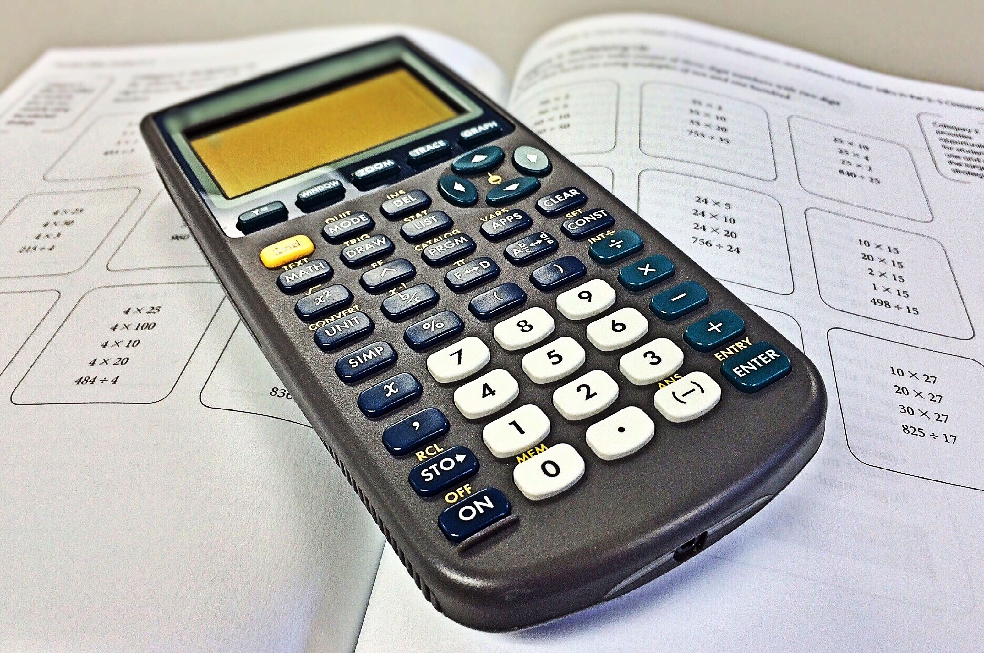
Math Test
THIS IS A TEST OF WHAT YOU KNOW!
The test includes:
Arithmetic (middle school math)
Algebra
Geometry
Advanced Algebra
Trigonometry
This Photo by Unknown Author is licensed under CC BY

Slide 3
Timing
You will have 60 questions to complete in 60 minutes!

Slide 4
Pacing
Read EVERY problem.
Don’t spend your time on those problems that you can’t work.
EASY, then WORK it!
+ HARD, then SKIP it!
— IMPOSSIBLE, then SKIP it
Come back to hard problems
Save impossible problems for last, guess if you need to.
You may use a calculator!
Problems are in order from easy to hard.

Slide 5
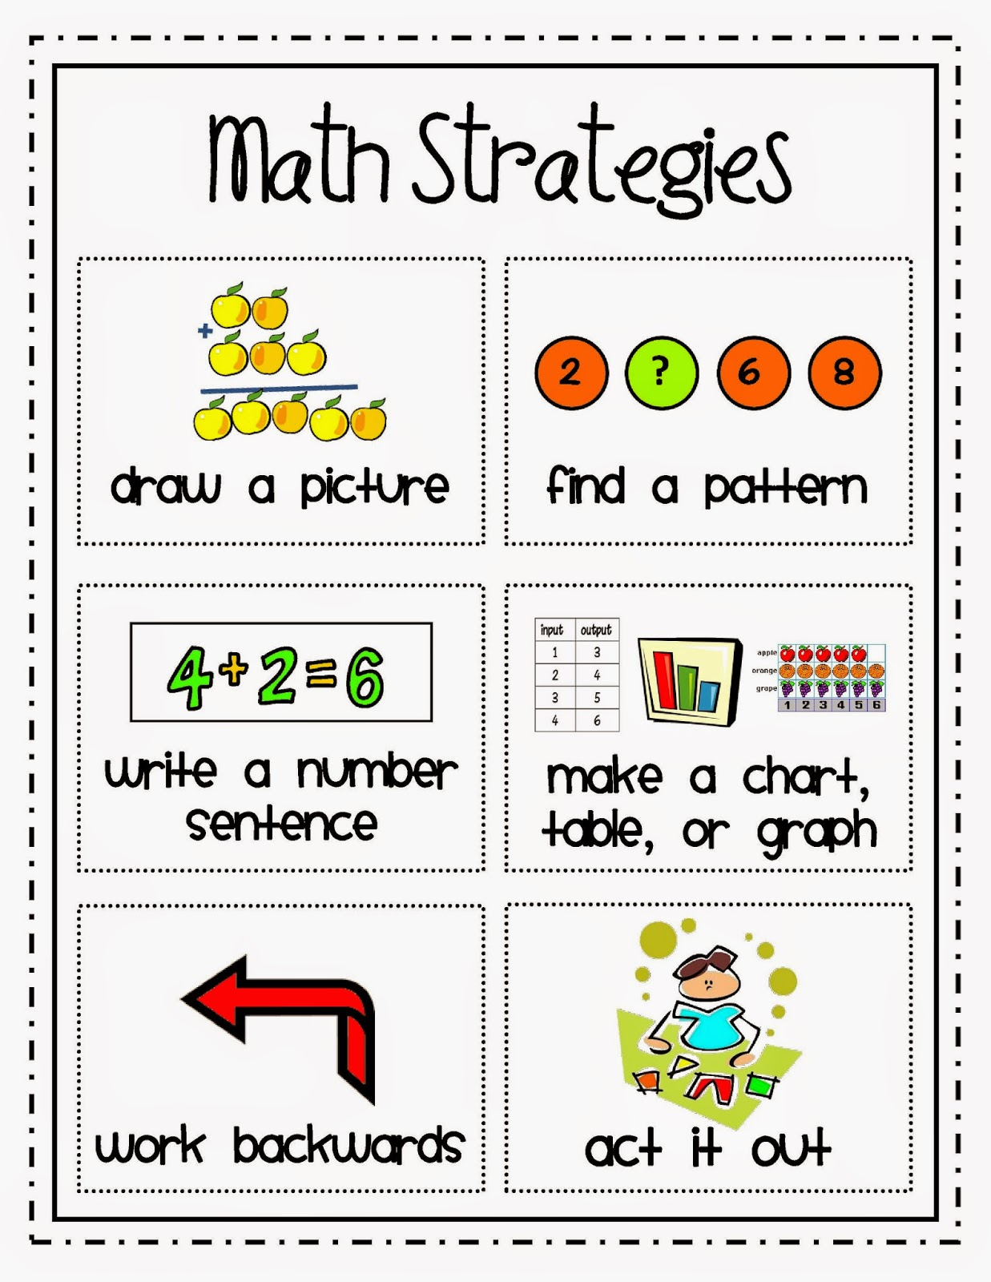
Strategies
Draw and label diagrams, if possible.
Use substitution a lot (plug in answers)
Use proportions often
Trust what you see
Work Backwards
Eliminate answer choices
In the absence of numbers, make them up!

Slide 6
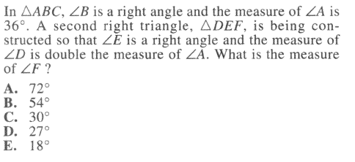
Draw a Diagram

Slide 7
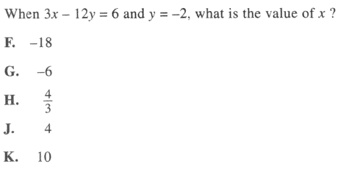
Substitute

Slide 8
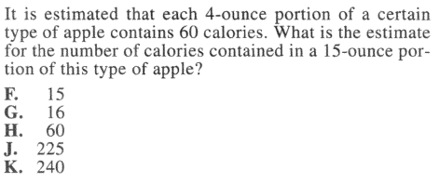
Use proportions

Slide 9
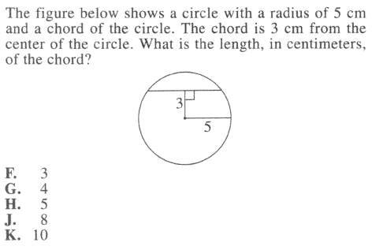
Use your Eyes

Slide 10
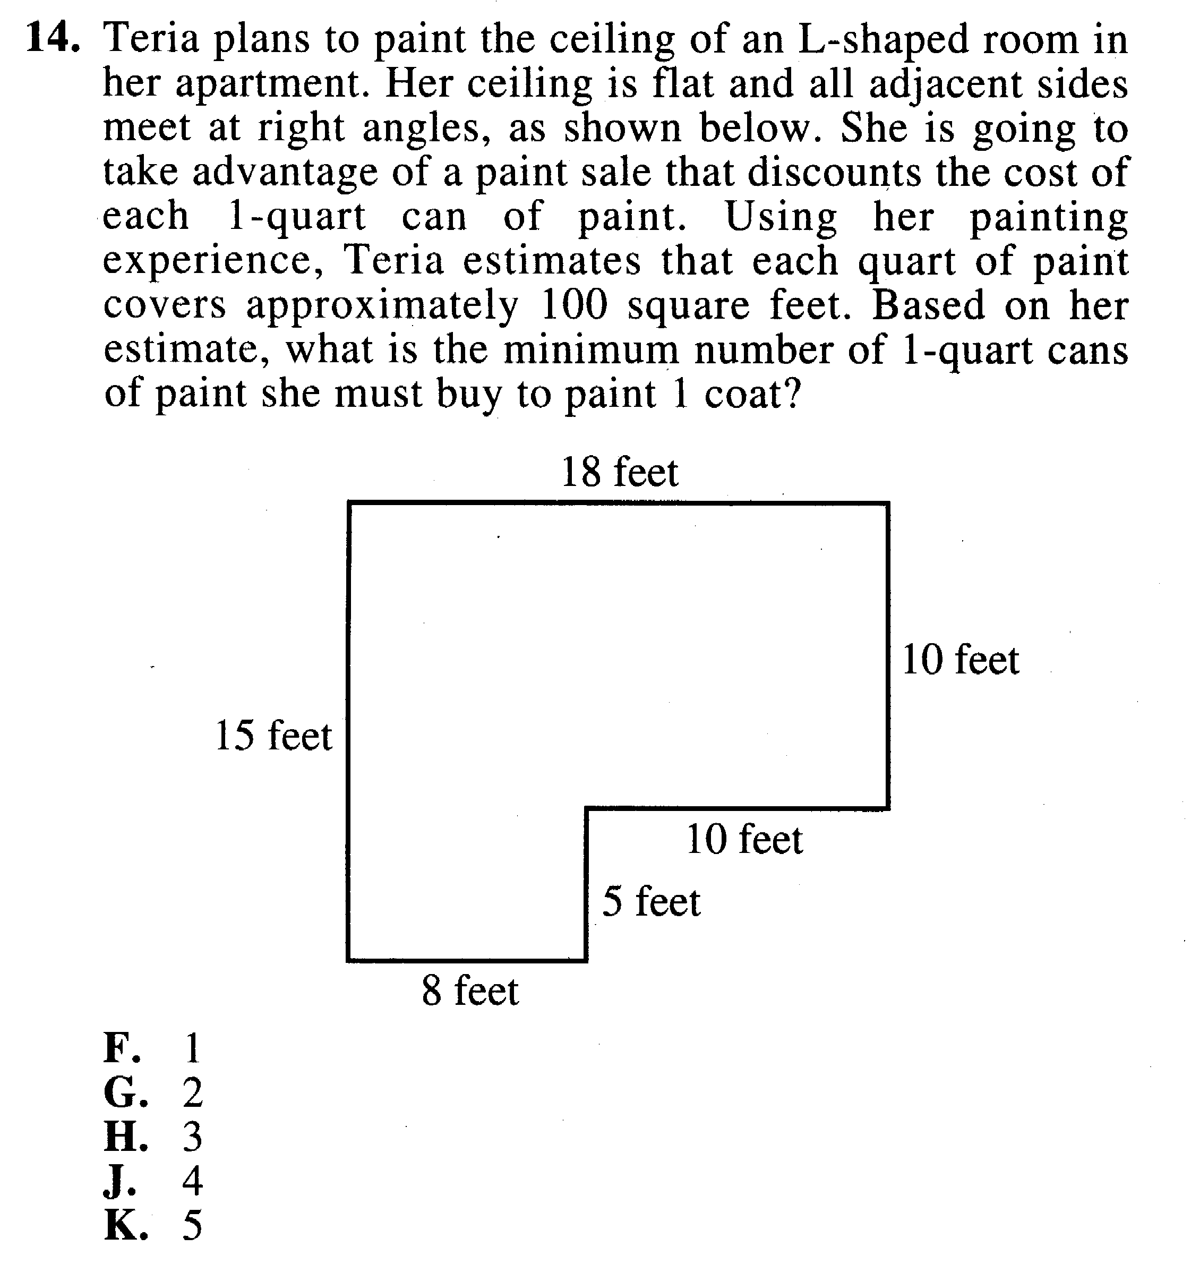
Divide Diagrams

Slide 11
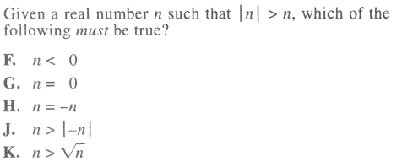
Make Up Numbers

