Slide 1
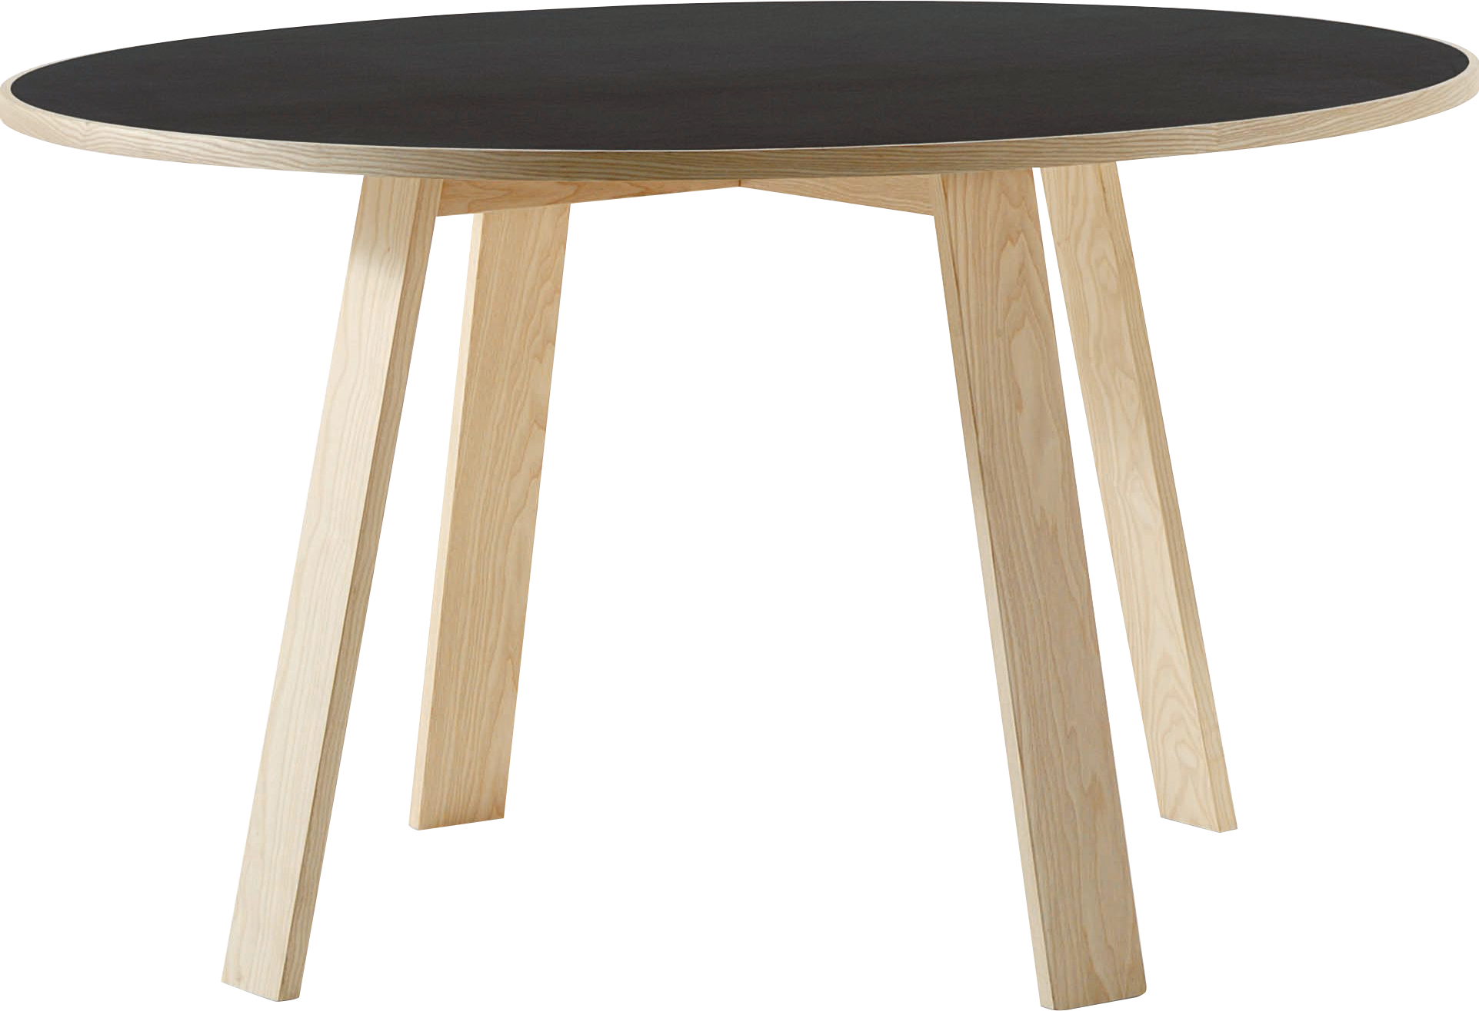
​
Welcome to Algebra 2
Mrs. Carter's Website
Delta Math

Slide 2
Chapter 11 Overview Polynomials
Lessons
11-1 Add & Subtract Polynomials
11-2 Multiply by a Monomial
11-3 Divide and find factors
11-4 Multiply Two Binomials
Activities
Bell Work
Notes
Real World Applications
Assignments
Complete & Submit Bell work
Complete & Submit Delta Math
Work on Challenge Questions
Study: Complete Independent Practice

Slide 3
Chapter 11 Polynomials Standard
B.A.APR.A.1 Understand that polynomials form a system analogous to the
integers, namely, they are closed under the operations of addition, subtraction,
and multiplication; add, subtract, and multiply polynomials.

Slide 4
11-1 Add & Subtract Polynomials Objectives
An expression consisting of two or more terms
SWBAT write polynomials in standard form IOT add & subtract them.
Containing a square root

Slide 5
11-1 Add & Subtract Polynomials
Key Concepts
______________________- a mathematical expression consisting of more than two terms.
______________________- a mathematical expression consisting of one term.
______________________- a mathematical expression consisting of two terms.
________________________- the number part of a term.
______________________- a term consisting of a single number.
______________________- terms consisting of the same variables and exponents but may have different coefficients.
______________________- a way of ordering the terms of a polynomial with the greatest power of one of these variables to the least power.
Polynomial
Monomial
Binomial
Coefficient
Constant Term
Like Terms
Standard Form

Slide 6
11-1 Examples

Slide 7
11-1 Examples

Slide 8
11-1 Examples

Slide 9
11-1 Examples

Slide 10
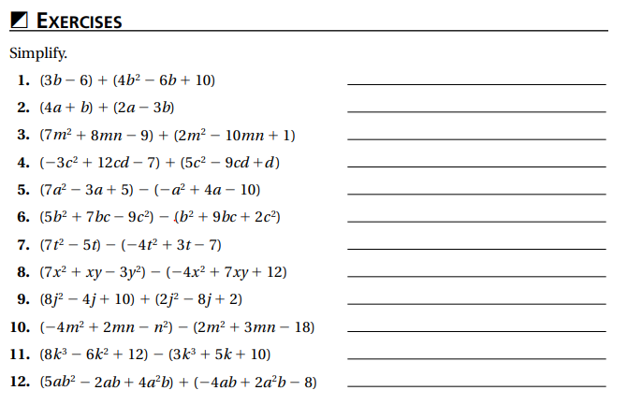
Independent Practice/Lesson Check 11-1

Slide 11
Independent Practice/Lesson Check 11-1

Slide 12
Chapter 11 Polynomials Standard
B.A.APR.A.1 Understand that polynomials form a system analogous to the
integers, namely, they are closed under the operations of addition, subtraction,
and multiplication; add, subtract, and multiply polynomials.

Slide 13
11-2 Multiply by a Monomial Objectives
An expression consisting of two or more terms
SWBAT write polynomials in standard form IOT multiply them.
Writing the terms in order from greatest power to least

Slide 14
11-2 Examples

Slide 15
11-2 Examples

Slide 16
11-2 Examples

Slide 17
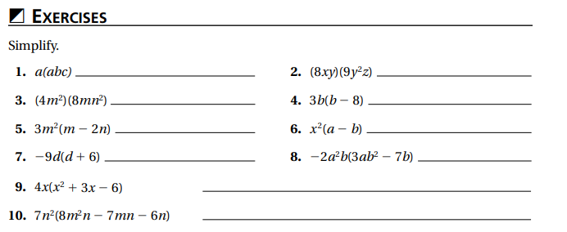
Independent Practice/Lesson Check 11-2

Slide 18
Independent Practice/Lesson Check 11-2

Slide 19
Chapter 11 Polynomials Standard
B.A.APR.A.1 Understand that polynomials form a system analogous to the
integers, namely, they are closed under the operations of addition, subtraction,
and multiplication; add, subtract, and multiply polynomials.
Key Concepts
____________________________- a mathematical expression consisting of all the common factors.
Greatest Common Factor (GCF)

Slide 20
11-3 Divide & Find Factors Objectives
An expression consisting of two or more terms
SWBAT extract factors IOT factor polynomials into a monomial factor and a polynomial factor.
A number or expression that divides another expression without remainder

Slide 21
11-3 Examples

Slide 22
11-3 Examples

Slide 23
11-3 Examples

Slide 24
11-3 Examples

Slide 25
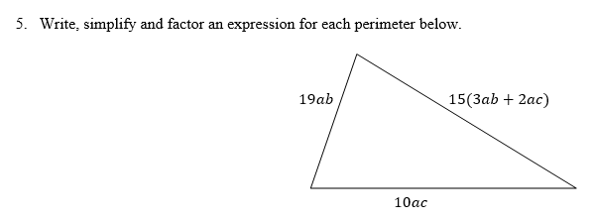
11-3 Examples

Slide 26
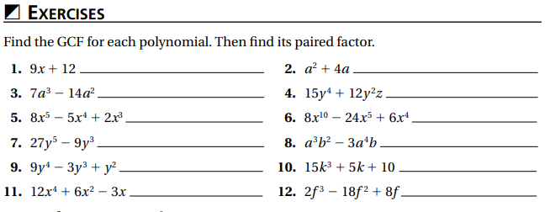
Independent Practice/Lesson Check 11-3

Slide 27
Independent Practice/Lesson Check 11-3

Slide 28
Chapter 11 Polynomials Standard
B.A.APR.A.1 Understand that polynomials form a system analogous to the
integers, namely, they are closed under the operations of addition, subtraction,
and multiplication; add, subtract, and multiply polynomials.

Slide 29
11-4 Multiply Binomials & Polynomials Objectives
An expression consisting of two or more terms
SWBAT multiply binomials IOT expand them.
Key Concepts
Difference of Squares
______________________- the product of two binomials that differ only in their signs.
$$\left(a+b\right)\left(a−b\right)=a^{2}−b^{2}$$

Slide 30
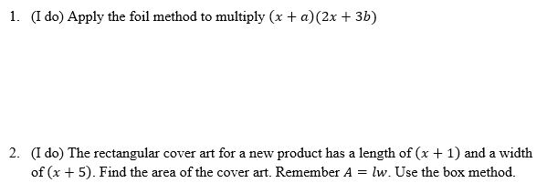
11-4 Examples

Slide 31
11-4 Examples
3. (We do) Multiply the perfect square $\left(10x+3y\right)\left(10x−3y\right).$
4. (We do) Multiply $\left(3x−4\right)(3x^{2}+6x−2)$

Slide 32
11-4 Examples
5. Multiply $\left(2x−1\right)\left(x−4\right)(x+5)$

Slide 33
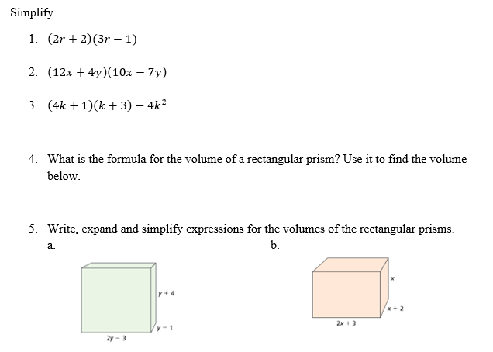
Independent Practice/Lesson Check 11-4

Slide 34
Independent Practice/Lesson Check 11-4

