Slide 1
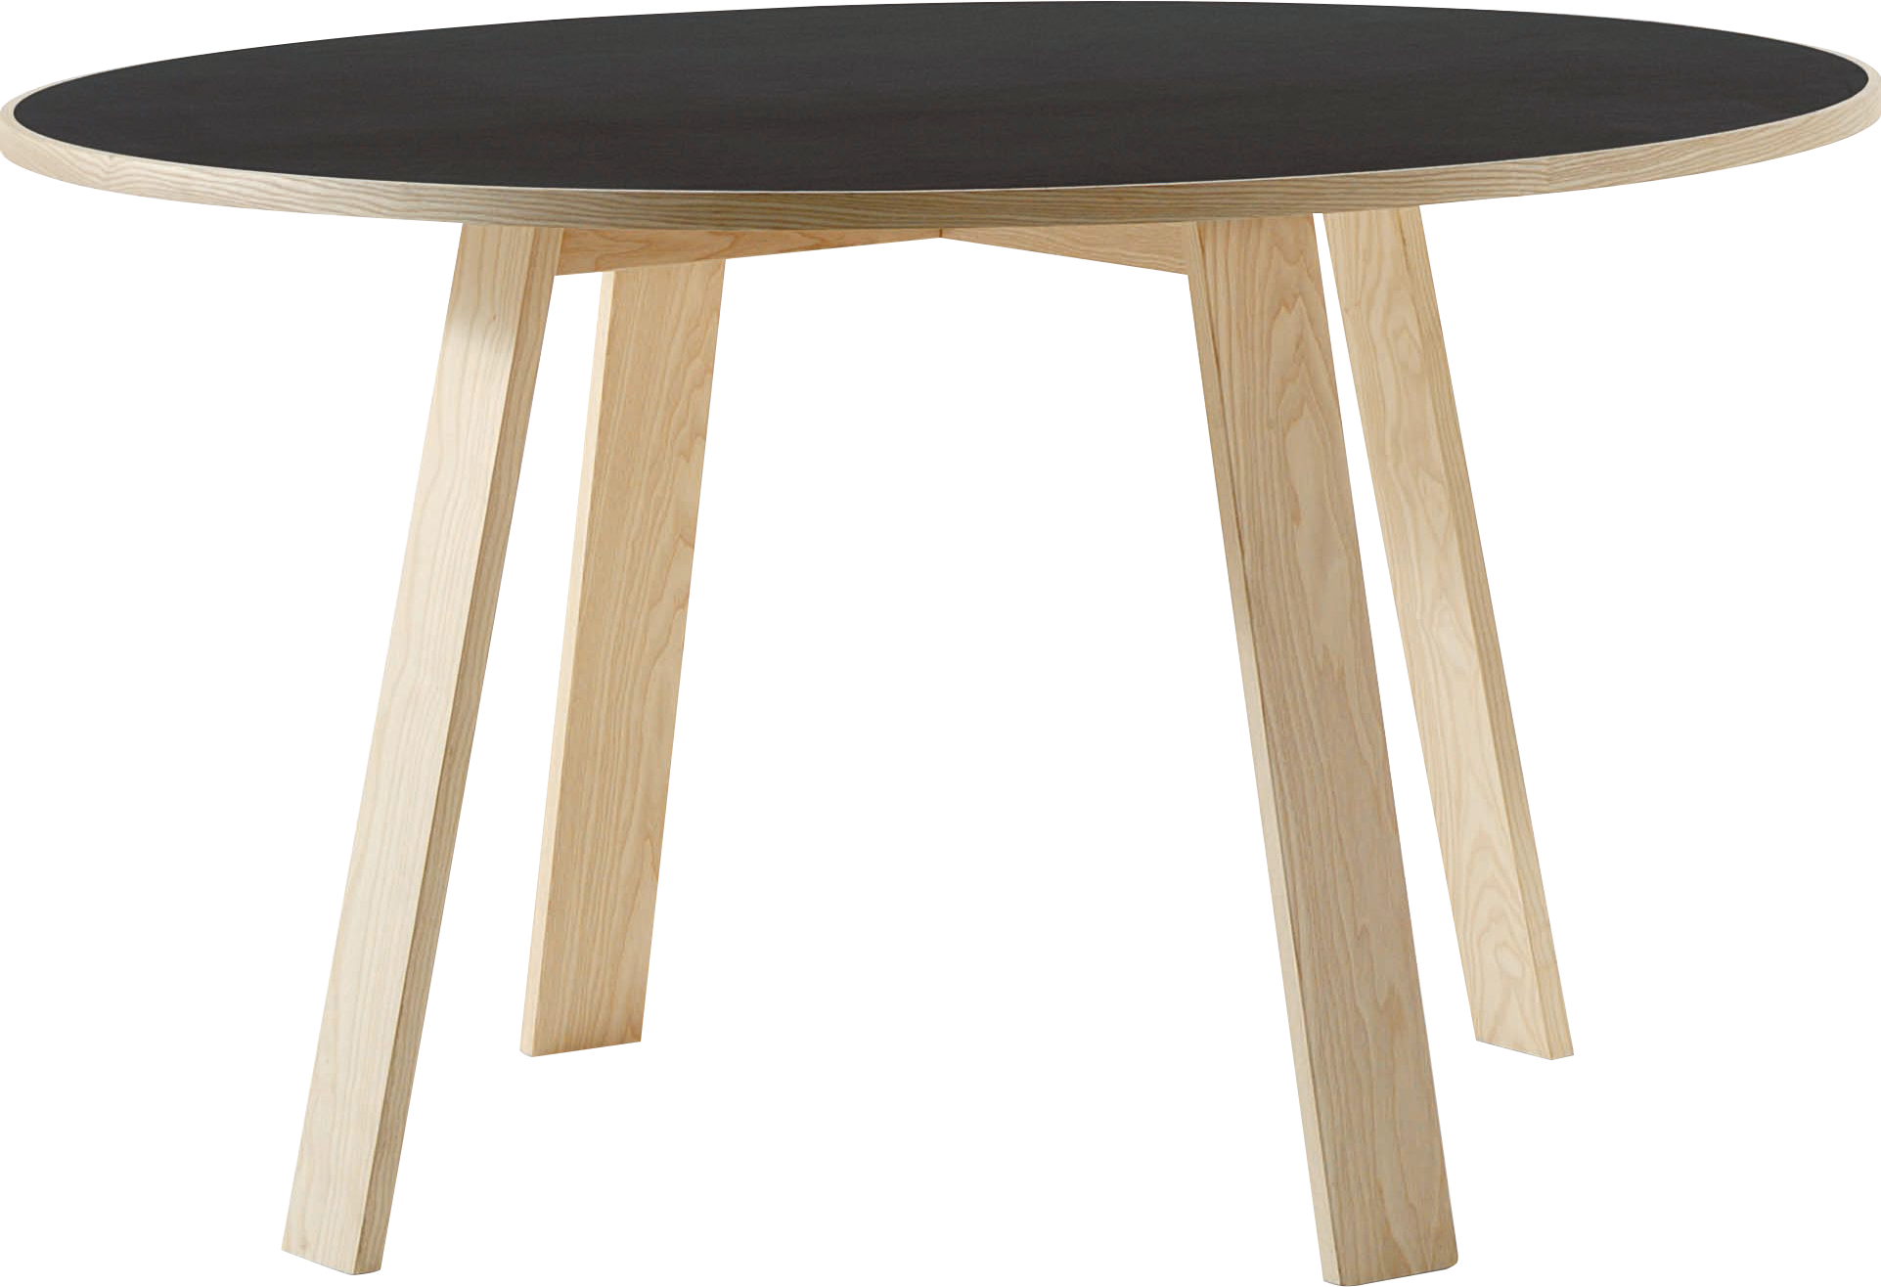
​
Welcome to Algebra 2
Mrs. Carter's Website
Delta Math

Slide 2
Chapter 12 Overview Quadratics
Lessons
12-1 Graph Parabolas
12-2 General Quadratic Functions
12-3 Factor & Graph
12-4 Complex Numbers
12-5 Completing the Square
12-6 Quadratic Formula
Activities
Bell Work
Notes
Real World Applications
Assignments
Complete & Submit Bell work
Complete & Submit Delta Math
Work on Challenge Questions
Study: Complete Independent Practice

Slide 3
Chapter 12 Quadratics Standards
B.F.IF.C.4 Graph linear, quadratic, absolute value, and piecewise functions expressed symbolically and show key features of the graph, by hand in simple cases and using technology for more complicated ones.
B.N.Q.A.1 Use units as a way to understand problems and to guide the solution of multi-step problems; choose and interpret units consistently in formulas; choose and interpret the scale and the origin in graphs and data displays.
B.A.REI.B.2 Solve quadratic equations in one variable. Solve quadratic equations by inspection (e.g., for x2 = 49), taking square roots, completing the square, knowing and applying the quadratic formula, and factoring, as appropriate to the initial form of the equation. Recognize when the quadratic formula gives complex solutions and write them as a ± bi for real numbers a and b.
B.N.CN.A.1 Know there is a complex number i such that i2 = -1, and every complex number has the form a + bi with a and b real.
B.N.CN.A.2 Know and use the relation i2 = -1 and the commutative, associative and distributive properties to add, subtract, and multiply complex numbers.
B.A.APR.B.2 Identify zeros of polynomials when suitable factorizations are available and use the zeros to construct a rough graph of the function defined by the polynomial.
B.F.IF.A.2 Use function notation, evaluate functions for inputs in their domains and interpret statements that use function notation in terms of a context.
B.N.Q.A.3 Solve problems involving squares, square roots of numbers, cubes and cube roots of numbers.

Slide 4
12-1 Graph Parabolas Objectives
x-intercepts
y-intercepts
Vertex
Axis of symmetry
A function that can be written as f(x) = ax² + bx + c
SWBAT graph quadratic functions IOT identify key features of quadratic equations.
Name
Locate
Label
A diagram that represents the relationship between the quantities

Slide 5
12-1 Graph Parabolas
Key Concepts
______________________- a function that can be written in the standard form $f(x)=ax²+bx+c$, where a ≠ 0
______________________- the graph of a quadratic function.
______________________- the line goes through the vertex of a parabola such that the left and right sides are symmetric.
Quadratic Function
Parabola
Axis of Symmetry

Slide 6
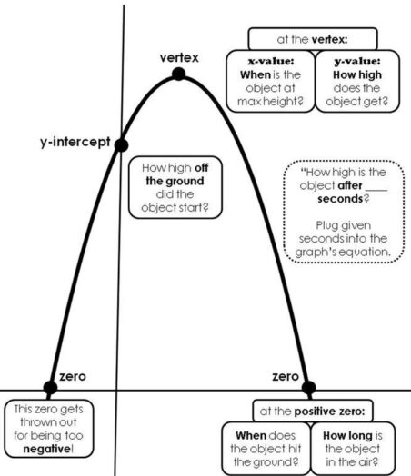
12-1 Graph Parabolas
Key Concepts

Slide 7
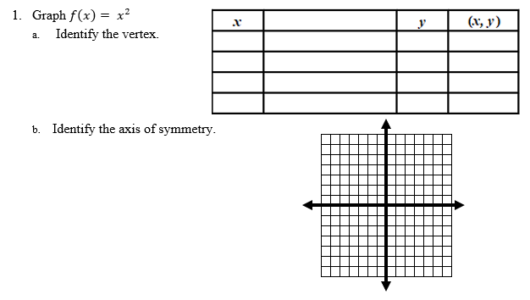
12-1 Examples
I do

Slide 8
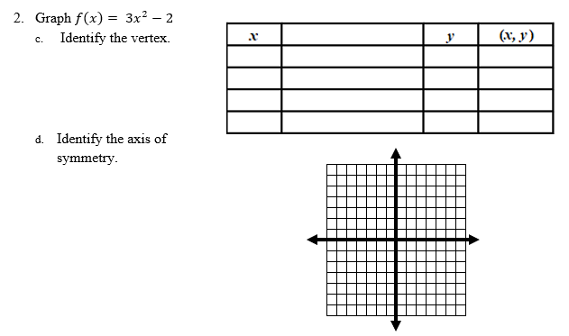
12-1 Examples
I do

Slide 9
12-1 Examples
We do

Slide 10
12-1 Examples
They do

Slide 11
Independent Practice/Lesson Check 12-1

Slide 12
Independent Practice/Lesson Check 12-1

Slide 13
Chapter 12 Quadratics Standards
B.F.IF.C.4 Graph linear, quadratic, absolute value, and piecewise functions expressed symbolically and show key features of the graph, by hand in simple cases and using technology for more complicated ones.
B.N.Q.A.1 Use units as a way to understand problems and to guide the solution of multi-step problems; choose and interpret units consistently in formulas; choose and interpret the scale and the origin in graphs and data displays.
B.A.REI.B.2 Solve quadratic equations in one variable. Solve quadratic equations by inspection (e.g., for x2 = 49), taking square roots, completing the square, knowing and applying the quadratic formula, and factoring, as appropriate to the initial form of the equation. Recognize when the quadratic formula gives complex solutions and write them as a ± bi for real numbers a and b.
B.N.CN.A.1 Know there is a complex number i such that i2 = -1, and every complex number has the form a + bi with a and b real.
B.N.CN.A.2 Know and use the relation i2 = -1 and the commutative, associative and distributive properties to add, subtract, and multiply complex numbers.
B.A.APR.B.2 Identify zeros of polynomials when suitable factorizations are available and use the zeros to construct a rough graph of the function defined by the polynomial.
B.F.IF.A.2 Use function notation, evaluate functions for inputs in their domains and interpret statements that use function notation in terms of a context.
B.N.Q.A.3 Solve problems involving squares, square roots of numbers, cubes and cube roots of numbers.

Slide 14
12-2 General Quadratic Functions Objectives
x-intercepts
y-intercepts
Vertex
Axis of symmetry
A function that can be written as f(x) = ax² + bx + c
SWBAT graph general quadratic functions IOT identify key features of quadratics..
Name
Locate
Label
A diagram that represents the relationship between the quantities

Slide 15
12-2 General Quadratic Functions
Key Concepts
______________________- a function that can be written in the standard form $f(x)=ax²+bx+c$, where a ≠ 0
______________________- the graph of a quadratic function.
______________________- the line goes through the vertex of a parabola such that the left and right sides are symmetric.
Quadratic Function
Parabola
Axis of Symmetry

Slide 16
12-2 General Quadratic Functions
Key Concepts
Graphing Quadratic Equations
Step 1: Identify a, b, & c.
Step 2: Graph the axis of symmetry.
Step 3: Find the vertex.
Step 4: Plot the y-intercept and its reflection.
Step 5: Draw the graph through the points. Label the points.

Slide 17
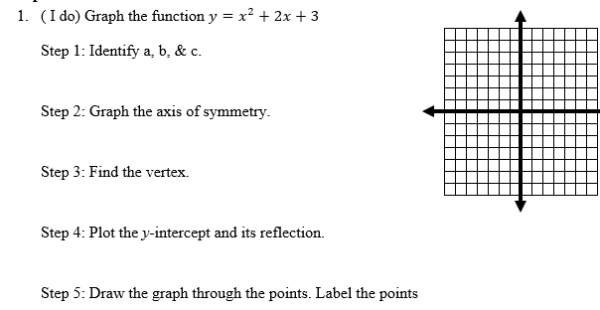
12-2 Examples

Slide 18
12-2 Examples

Slide 19
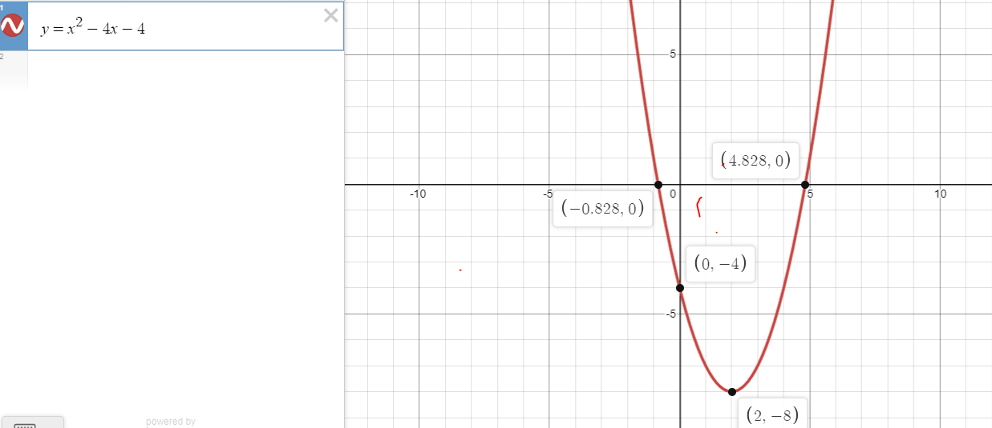
12-2 Examples

Slide 20
12-2 Examples

Slide 21
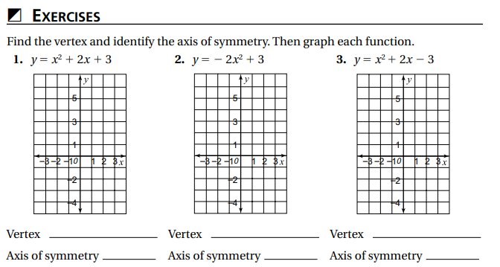
Independent Practice/Lesson Check 12-2

Slide 22
Independent Practice/Lesson Check 12-2

Slide 23
Chapter 12 Quadratics Standards
B.F.IF.C.4 Graph linear, quadratic, absolute value, and piecewise functions expressed symbolically and show key features of the graph, by hand in simple cases and using technology for more complicated ones.
B.N.Q.A.1 Use units as a way to understand problems and to guide the solution of multi-step problems; choose and interpret units consistently in formulas; choose and interpret the scale and the origin in graphs and data displays.
B.A.REI.B.2 Solve quadratic equations in one variable. Solve quadratic equations by inspection (e.g., for x2 = 49), taking square roots, completing the square, knowing and applying the quadratic formula, and factoring, as appropriate to the initial form of the equation. Recognize when the quadratic formula gives complex solutions and write them as a ± bi for real numbers a and b.
B.N.CN.A.1 Know there is a complex number i such that i2 = -1, and every complex number has the form a + bi with a and b real.
B.N.CN.A.2 Know and use the relation i2 = -1 and the commutative, associative and distributive properties to add, subtract, and multiply complex numbers.
B.A.APR.B.2 Identify zeros of polynomials when suitable factorizations are available and use the zeros to construct a rough graph of the function defined by the polynomial.
B.F.IF.A.2 Use function notation, evaluate functions for inputs in their domains and interpret statements that use function notation in terms of a context.
B.N.Q.A.3 Solve problems involving squares, square roots of numbers, cubes and cube roots of numbers.

Slide 24
12-3 Factor & Solve Quadratics Objectives
A function that can be written as f(x) = ax² + bx + c
SWBAT use a variety of methods IOT solve quadratic functions.
Name
Locate
Label
Graphing
Factoring
Completing the Square
Quadratic Formula

Slide 25
12-3 Factor & Solve Quadratics
Key Concepts
Root
__________________________-a solution of a quadratic equation.
__________________________-a solution of a quadratic equation.
__________________________-a solution of a quadratic equation.
* These solutions can be found by _____________________, ______________________,
________________________________ or using the ______________________________.
Zero
x-intercept
Factoring
Graphing
Completing the Square
Quadratic Formula

Slide 26
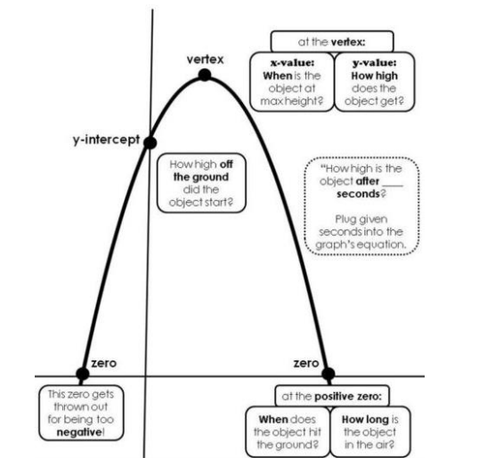
12-2 General Quadratic Functions
Key Concepts

Slide 27
12-3 Examples

Slide 28
12-3 Examples
Example 1 con’t

Slide 29
12-3 Examples

Slide 30
12-3 Examples

Slide 31
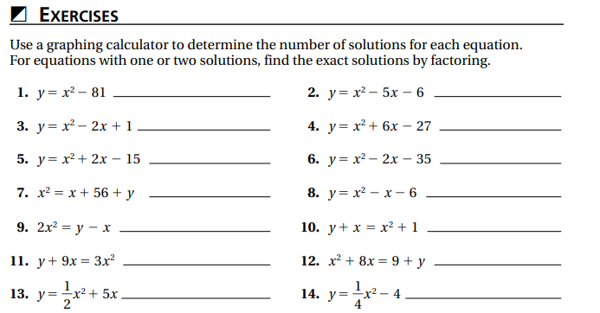
Independent Practice/Lesson Check 12-3

Slide 32
Independent Practice/Lesson Check 12-3

Slide 33
Chapter 12 Quadratics Standards
B.F.IF.C.4 Graph linear, quadratic, absolute value, and piecewise functions expressed symbolically and show key features of the graph, by hand in simple cases and using technology for more complicated ones.
B.N.Q.A.1 Use units as a way to understand problems and to guide the solution of multi-step problems; choose and interpret units consistently in formulas; choose and interpret the scale and the origin in graphs and data displays.
B.A.REI.B.2 Solve quadratic equations in one variable. Solve quadratic equations by inspection (e.g., for x2 = 49), taking square roots, completing the square, knowing and applying the quadratic formula, and factoring, as appropriate to the initial form of the equation. Recognize when the quadratic formula gives complex solutions and write them as a ± bi for real numbers a and b.
B.N.CN.A.1 Know there is a complex number i such that i2 = -1, and every complex number has the form a + bi with a and b real.
B.N.CN.A.2 Know and use the relation i2 = -1 and the commutative, associative and distributive properties to add, subtract, and multiply complex numbers.
B.A.APR.B.2 Identify zeros of polynomials when suitable factorizations are available and use the zeros to construct a rough graph of the function defined by the polynomial.
B.F.IF.A.2 Use function notation, evaluate functions for inputs in their domains and interpret statements that use function notation in terms of a context.
B.N.Q.A.3 Solve problems involving squares, square roots of numbers, cubes and cube roots of numbers.

Slide 34
12-4 Complex Numbers Objectives
Numbers in the form a + bi, where a represents the real number and b is an imaginary
SWBAT perform operations with complex numbers IOT find non-real solutions.
Imaginary solutions
Add, subtract, multiply, divide, simplify

Slide 35
12-4 Complex Numbers
Key Concepts
i
______________________- the imaginary unit defined as the number whose square is -1. $i=\sqrt{−1}$, i²= -1
______________________- a number defined as a + bi, where a is real and bi is imaginary.
______________________- number pairs of the form a + bi and a – bi
Complex Number
Complex Conjugates

Slide 36
12-4 Examples

Slide 37
12-4 Examples

Slide 38
12-4 Examples

Slide 39
12-4 Examples

Slide 40
12-4 Examples

Slide 41
12-4 Examples

Slide 42
12-4 Examples

Slide 43
12-4 Examples

Slide 44
Independent Practice/Lesson Check 12-4

Slide 45
Independent Practice/Lesson Check 12-4

Slide 46
Chapter 12 Quadratics Standards
B.F.IF.C.4 Graph linear, quadratic, absolute value, and piecewise functions expressed symbolically and show key features of the graph, by hand in simple cases and using technology for more complicated ones.
B.N.Q.A.1 Use units as a way to understand problems and to guide the solution of multi-step problems; choose and interpret units consistently in formulas; choose and interpret the scale and the origin in graphs and data displays.
B.A.REI.B.2 Solve quadratic equations in one variable. Solve quadratic equations by inspection (e.g., for x2 = 49), taking square roots, completing the square, knowing and applying the quadratic formula, and factoring, as appropriate to the initial form of the equation. Recognize when the quadratic formula gives complex solutions and write them as a ± bi for real numbers a and b.
B.N.CN.A.1 Know there is a complex number i such that i2 = -1, and every complex number has the form a + bi with a and b real.
B.N.CN.A.2 Know and use the relation i2 = -1 and the commutative, associative and distributive properties to add, subtract, and multiply complex numbers.
B.A.APR.B.2 Identify zeros of polynomials when suitable factorizations are available and use the zeros to construct a rough graph of the function defined by the polynomial.
B.F.IF.A.2 Use function notation, evaluate functions for inputs in their domains and interpret statements that use function notation in terms of a context.
B.N.Q.A.3 Solve problems involving squares, square roots of numbers, cubes and cube roots of numbers.

Slide 47
12-6 The Quadratic Formula Objectives
A function that can be written as f(x) = ax² + bx + c
SWBAT use a variety of methods IOT solve quadratic functions.
Name
Locate
Label
Graphing
Factoring
Completing the Square
Quadratic Formula

Slide 48
12-6 The Quadratic Formula
Key Concepts
Discriminant
______________________- the value of the expression $b^{2}−4ac$
______________________- expressed as $x=\frac{−b±\sqrt{b^{2}−4ac}}{2a}$ can be used to solve quadratic.
Discriminant Rules
If $b^{2}−4ac>0$, there are 2 real solutions.
If $b^{2}−4ac=0$, there is 1 real solution.
If $b^{2}−4ac<0$, there are 0 real solutions.
Quadratic Formula

Slide 49
12-6 Examples

Slide 50
12-6 Examples

Slide 51
12-6 Examples

Slide 52
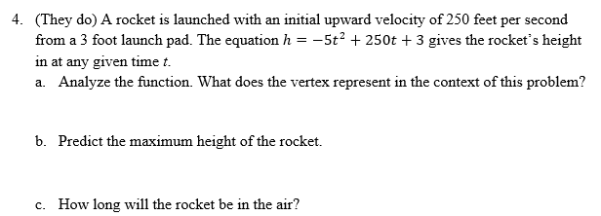
12-6 Examples

Slide 53
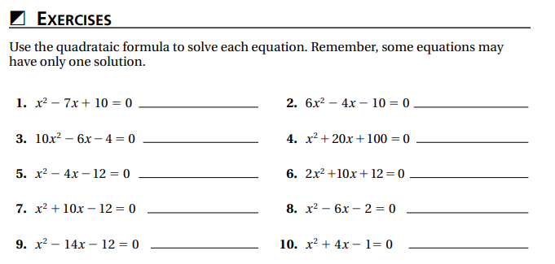
Independent Practice/Lesson Check 12-6

Slide 54
Independent Practice/Lesson Check 12-6

Slide 55
Chapter 12 Quadratics Standards
B.F.IF.C.4 Graph linear, quadratic, absolute value, and piecewise functions expressed symbolically and show key features of the graph, by hand in simple cases and using technology for more complicated ones.
B.N.Q.A.1 Use units as a way to understand problems and to guide the solution of multi-step problems; choose and interpret units consistently in formulas; choose and interpret the scale and the origin in graphs and data displays.
B.A.REI.B.2 Solve quadratic equations in one variable. Solve quadratic equations by inspection (e.g., for x2 = 49), taking square roots, completing the square, knowing and applying the quadratic formula, and factoring, as appropriate to the initial form of the equation. Recognize when the quadratic formula gives complex solutions and write them as a ± bi for real numbers a and b.
B.N.CN.A.1 Know there is a complex number i such that i2 = -1, and every complex number has the form a + bi with a and b real.
B.N.CN.A.2 Know and use the relation i2 = -1 and the commutative, associative and distributive properties to add, subtract, and multiply complex numbers.
B.A.APR.B.2 Identify zeros of polynomials when suitable factorizations are available and use the zeros to construct a rough graph of the function defined by the polynomial.
B.F.IF.A.2 Use function notation, evaluate functions for inputs in their domains and interpret statements that use function notation in terms of a context.
B.N.Q.A.3 Solve problems involving squares, square roots of numbers, cubes and cube roots of numbers.

Slide 56
12-7 Polynomial Roots & Zeros Objectives
A diagram that represents the relationship between the quantities
An expression consisting of two or more terms
Examine in detail to interpret
SWBAT analyze the graphs of polynomials using properties of polynomials IOT determine the number and types of roots for a polynomial equation.
SWBAT use factorizations IOT find the roots for polynomial equations.
Rules accepted as fact
Roots can be real or imaginary
A number or expression that divides another expression without remainder

Slide 57
12-7 Polynomial Roots & Zeros
Key Concepts
Solution
Root
Zero
x-intercept

Slide 58
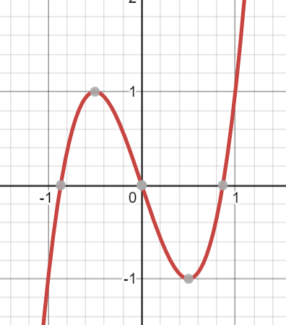
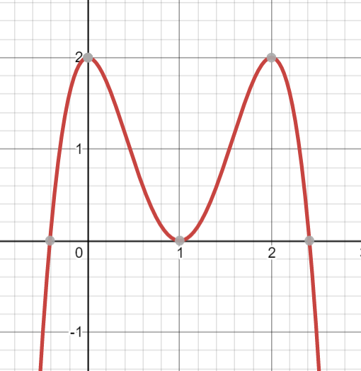
12-7 Examples

Slide 59
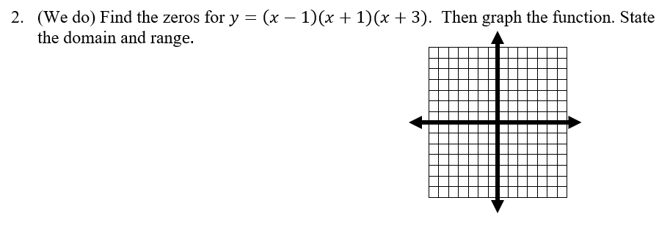
12-7 Examples

Slide 60
12-7 Examples

Slide 61
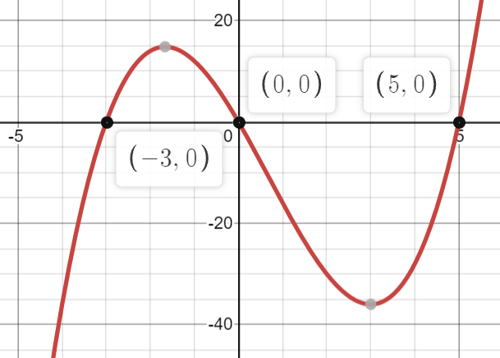
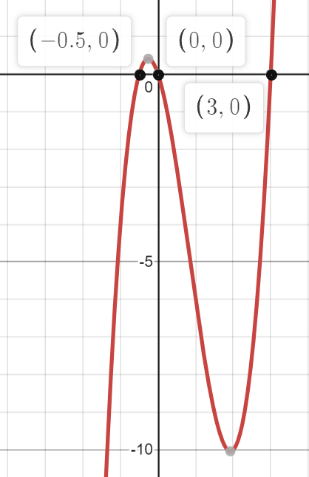
12-7 Examples

Slide 62
12-7 Examples

Slide 63
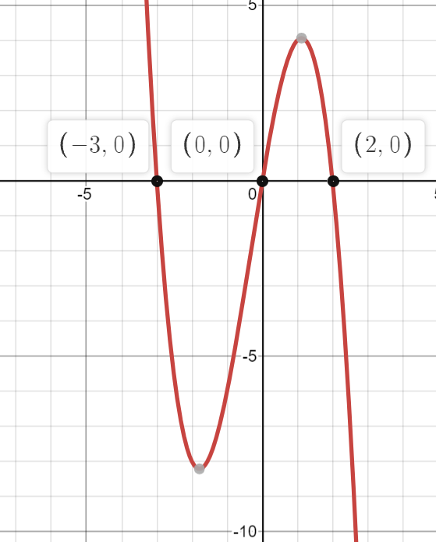
12-7 Examples

Slide 64
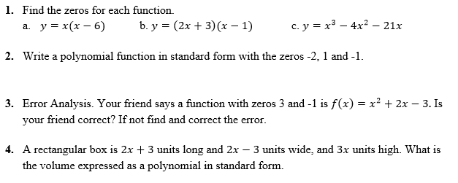
Independent Practice/Lesson Check 12-7

Slide 65
Independent Practice/Lesson Check 12-7

