Slide 1
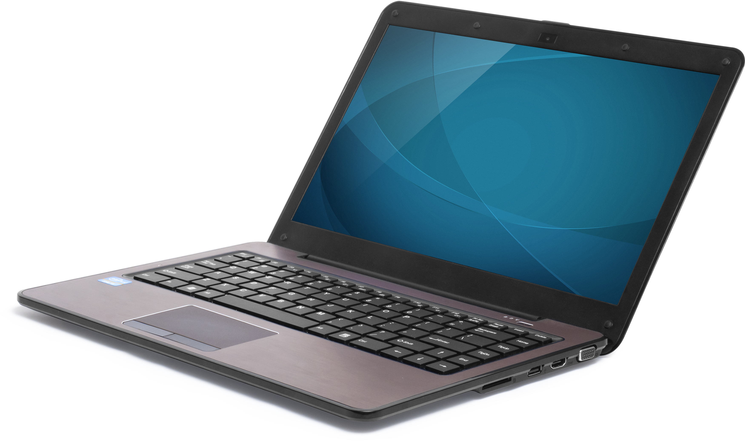
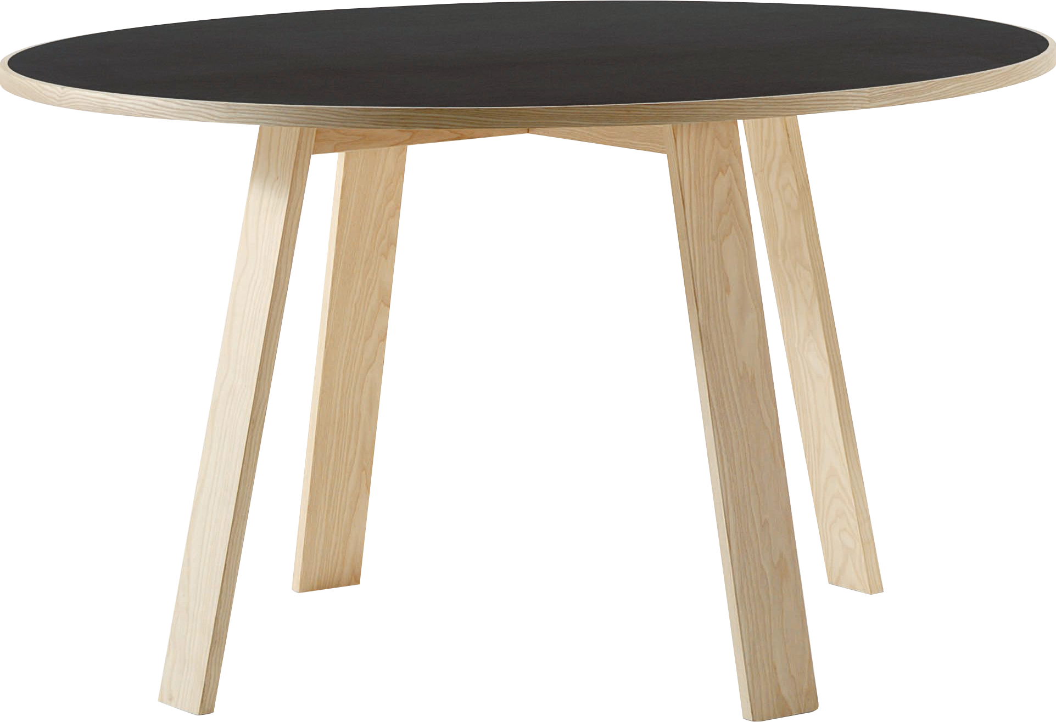
​
Welcome to Algebra 2
Mrs. Carter's Website
Delta Math

Slide 2
Chapter 14 Overview Right Triangles & Trigonometry
Lessons
10-2 Pythagorean Theorem
10-3 Special Right Triangles
14-1 Trigonometric Ratios
14-2 Solving Right Triangles
Activities
Bell Work
Notes
Real World Applications
Assignments
Complete & Submit Bell work
Complete & Submit Delta Math
Work on Challenge Questions
Study: Complete Independent Practice

Slide 3
Chapter 14 Right Triangles & Trigonometry Standard
B.G.SRT.B.2 Apply basic trigonometric ratios to solve right triangle problems.
B.G.SRT.B.3 Apply properties of 30° 60° 90°, 45° 45° 90°, similar, and congruent triangles.
B.G.SRT.B.4 Solve problems involving angles of elevation and angles of depression.

Slide 4
10-2 Pythagorean Theorem Objective
Determine the measures of unknown sides
A triangle that contains a right angle
SWBAT use the Pythagorean Theorem IOT solve problems involving right triangles.
a² + b² = c

Slide 5
10-2 Pythagorean Theorem
Key Concepts

Slide 6
10-2 Examples

Slide 7
10-2 Examples

Slide 8
10-2 Examples

Slide 9
10-2 Examples

Slide 10
10-2 Examples

Slide 11
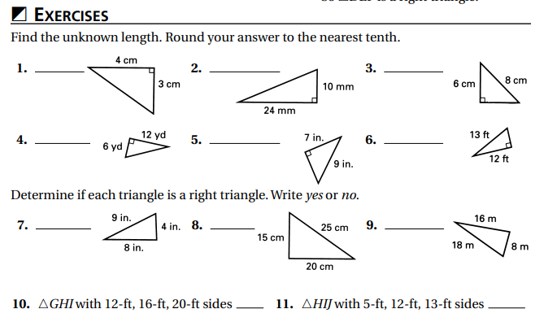
Independent Practice/Lesson Check 10-2

Slide 12
Independent Practice/Lesson Check 10-2

Slide 13
Chapter 14 Right Triangles & Trigonometry Standard
B.G.SRT.B.2 Apply basic trigonometric ratios to solve right triangle problems.
B.G.SRT.B.3 Apply properties of 30° 60° 90°, 45° 45° 90°, similar, and congruent triangles.
B.G.SRT.B.4 Solve problems involving angles of elevation and angles of depression.

Slide 14
10-3 Special Right Triangles Objective
A triangle that contains a right angle
SWBAT use properties of special right triangles IOT solve problems involving right triangles.
30-60-90
45-45-90

Slide 15
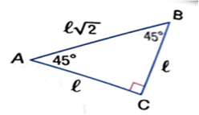
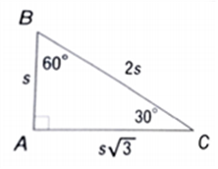
10-3 Special Right Triangles
Key Concepts

Slide 16
10-3 Examples

Slide 17
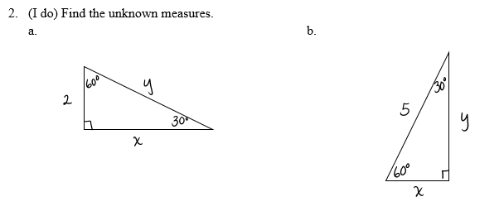
10-3 Examples

Slide 18
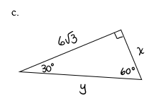
10-3 Examples

Slide 19
10-3 Examples

Slide 20
10-3 Examples

Slide 21
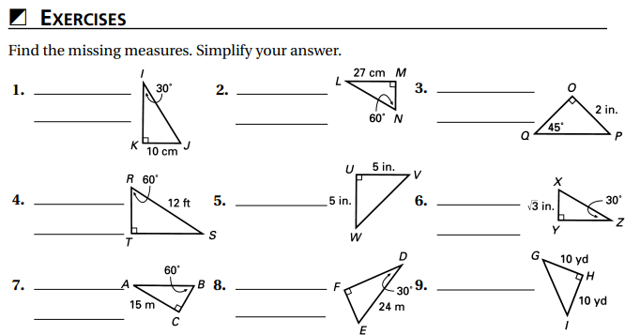
Independent Practice/Lesson Check 10-3

Slide 22
Independent Practice/Lesson Check 10-3

Slide 23
Chapter 14 Right Triangles & Trigonometry Standard
B.G.SRT.B.2 Apply basic trigonometric ratios to solve right triangle problems.
B.G.SRT.B.3 Apply properties of 30° 60° 90°, 45° 45° 90°, similar, and congruent triangles.
B.G.SRT.B.4 Solve problems involving angles of elevation and angles of depression.

Slide 24
14-1 Triangle Right Trigonometry Objective
A triangle that contains a right angle
SWBAT will use trigonometric ratios IOT solve problems involving right triangles.
sin
cos
tan

Slide 25
14-1 Right Triangle Trigonometry
Key Concepts

Slide 26
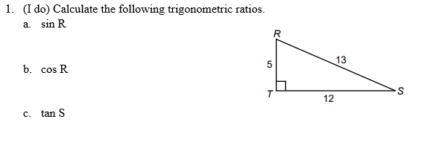
14-1 Examples

Slide 27
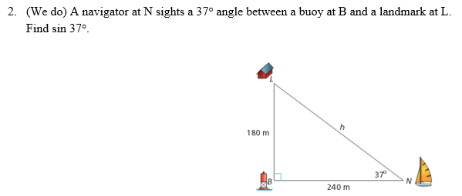
14-1 Examples

Slide 28
14-1 Examples

Slide 29
14-1 Examples

Slide 30
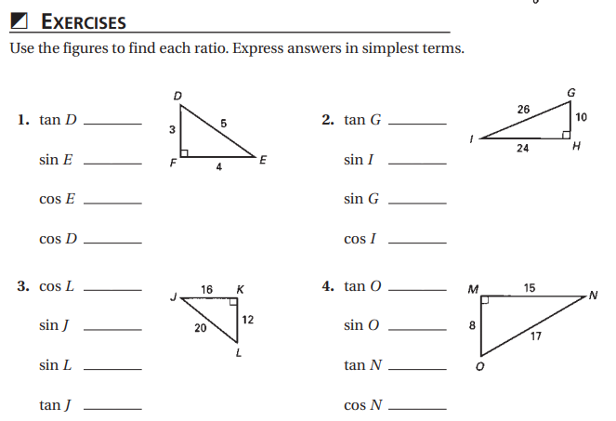
Independent Practice/Lesson Check 14-1

Slide 31
Independent Practice/Lesson Check 14-1

Slide 32
Chapter 14 Right Triangles & Trigonometry Standard
B.G.SRT.B.2 Apply basic trigonometric ratios to solve right triangle problems.
B.G.SRT.B.3 Apply properties of 30° 60° 90°, 45° 45° 90°, similar, and congruent triangles.
B.G.SRT.B.4 Solve problems involving angles of elevation and angles of depression.

Slide 33
14-2 Solve Right Triangles Objective
A triangle that contains a right angle
SWBAT will use trigonometric ratios IOT solve problems involving right triangles.
sin
cos
tan

Slide 34
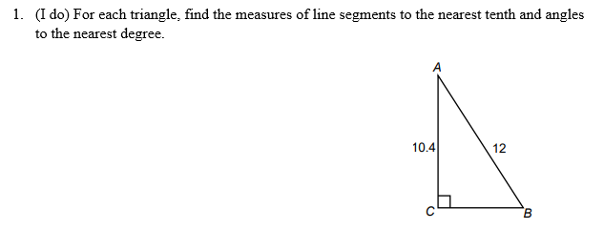
14-2 Right Triangle Trigonometry
Key Concepts

Slide 35
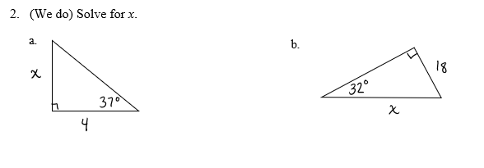
14-2 Examples

Slide 36
14-2 Examples

Slide 37
14-2 Examples

Slide 38
14-2 Examples

Slide 39
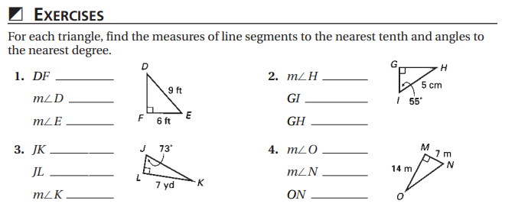
Independent Practice/Lesson Check 14-2

Slide 40
Independent Practice/Lesson Check 14-2

