Slide 1
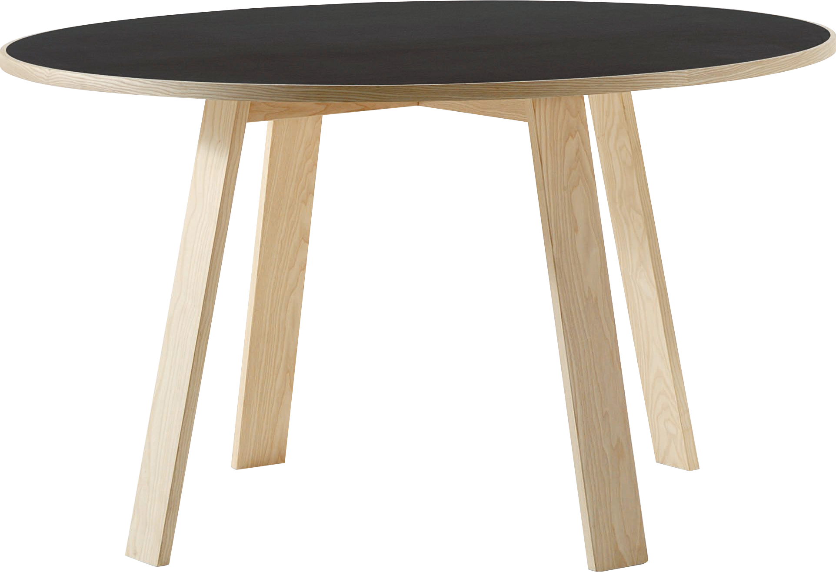
​
Welcome to Algebra 2
Mrs. Carter's Website
Delta Math

Slide 2
Chapter 1 Overview Essential Mathematics
Lessons
1-1 The language of Mathematics
1-2 Real Numbers
1-3 Union & Intersection of Sets
1-7 Distributive Property & Properties of Exponents
1-8 Exponents & Scientific Notation
Activities
Bell Work
Notes
Real World Applications
Assignments
Complete & Submit Bell work
Complete & Submit Delta Math
Work on Challenge Questions
Study: Complete Independent Practice

Slide 3
Chapter 1 Essential Mathematics Standards
B.N.RN.A.1. Use rational and irrational numbers in calculations and in real world context.
B.N.Q.A.3 Solve problems involving squares, square roots of numbers, cubes, and cube roots of number
B.A.SSE.A.1 Use properties of multiplication and division to solve problems containing scientific notation.
B.F.IF.C.5 Write a function defined by an expression in different but equivalent forms to reveal and explain different properties of the function.

Slide 4
1-1 The Language of Mathematics Objective
The use of commonly accepted symbols and methods to describe sets
SWBAT develop a thorough understanding of sets and set notation IOT understand set notation and how to use symbols to describe sets.
Lists of items

Slide 5
1-1 The Language of Mathematics
Key Concepts
Set
______________________- a collection of distinct items.
______________________- each distinct item in a set.
______________________- If A and B are sets, then A is a subset of B, written A $⊆$ B
when each element of A is also an element of B.
______________________- a set that contains a finite number of elements.
______________________- a set that contains an infinite number of elements.
________________ or _______________- a set that contains no elements.
Element
Subset
Finite Set
Infinite Set
Empty Set
Null Set

Slide 6
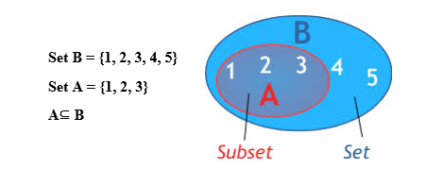
1-1 The Language of Mathematics
Key Concepts

Slide 8
1-1 Examples
I do
2. Write the following using symbols
set A contains elements 2, 4, 6 and 8.
b. set B is a subset of set A.
c. x is an element of set C.
d. 12 is not an element of {1, 3, 5, 7}.
e. set D is the null set or empty set.
Write “ the set of natural numbers” using the following notation:
set-builder notation
b. roster notation

Slide 9
1-1 Examples
We do
3. Rewrite {0, r} $∈$ {r} so that it is correct.
4. Determine all possible subsets of the set {a, b, c}.

Slide 10
1-1 The Language of Mathematics
Key Concepts
Variable
______________________- a symbol (usually a letter) standing for an unknown value in an equation.
______________________- statement that two numbers or expressions are equal.
______________________- any sentence that contains one or more variables.
______________________- the set of all possible values for the variable in an open sentence.
______________________- the set of all elements in the replacement set that makes the sentence true.
Equation
Open Sentence
Replacement Set
Solution Set

Slide 11
1-1 The Language of Mathematics
Key Concepts

Slide 12
1-1 Examples
They do
5. Determine which of the values -2 and 4 are solutions to the equation $4x+3=19$.
6. Josh’s earnings equaled the sum of Aimee’s and twice Nora’s earnings. Josh earned $104 and Aimee earned
$32. Using the equation $104=32+2x$ and the replacement set {32, 36, 40} for x. Find the amount Nora
earned.

Slide 13
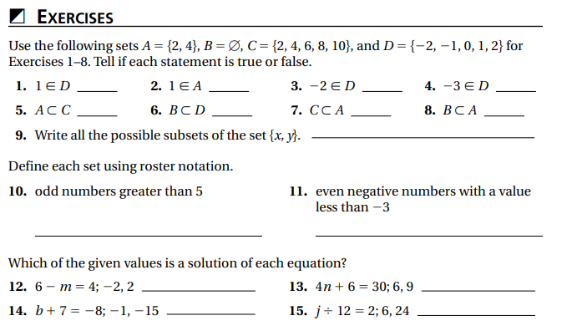
Independent Practice/Lesson Check 1-1

Slide 14
Independent Practice/Lesson Check 1-1

Slide 15
Chapter 1 Essential Mathematics Standards
B.N.RN.A.1. Use rational and irrational numbers in calculations and in real world context.
B.N.Q.A.3 Solve problems involving squares, square roots of numbers, cubes, and cube roots of number
B.A.SSE.A.1 Use properties of multiplication and division to solve problems containing scientific notation.
B.F.IF.C.5 Write a function defined by an expression in different but equivalent forms to reveal and explain different properties of the function.

Slide 16
1-2 Real Numbers Objective
Numbers that can be represented as the ratio of two integers
Natural #’s
Whole #’s
Integers
Rational #’s
Cannot be written as a fraction
SWBAT develop a thorough understanding of both rational and irrational numbers and number sets IOT make both historical and concrete connections between irrational numbers and the real world.
SWBAT identify and graph real numbers IOT perform operations with them.
Visually represent the location on a number line
Name
Locate
Label
Add, subtract, multiply, divide and find the absolute value of

Slide 17
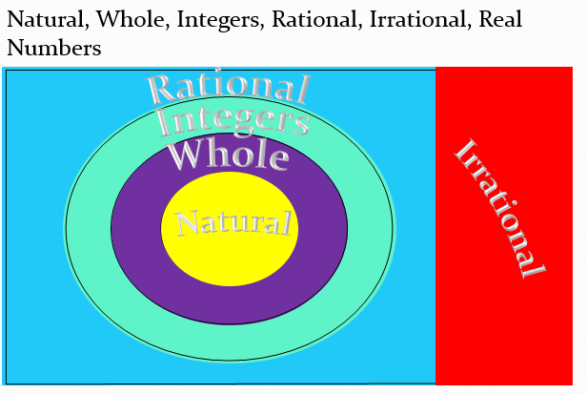
1-2 Real Numbers
Key Concepts
Coordinate
______________________- The number on the number line corresponding to a point.
______________________- The distance from zero to a given point.
Absolute Value

Slide 18
1-2 Real Numbers
Key Concepts

Slide 19
1-2 Examples
I do

Slide 20
1-2 Examples
I do

Slide 21
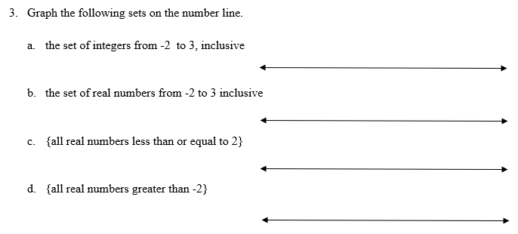
1-2 Examples
We do

Slide 22
1-2 Examples
They do

Slide 23
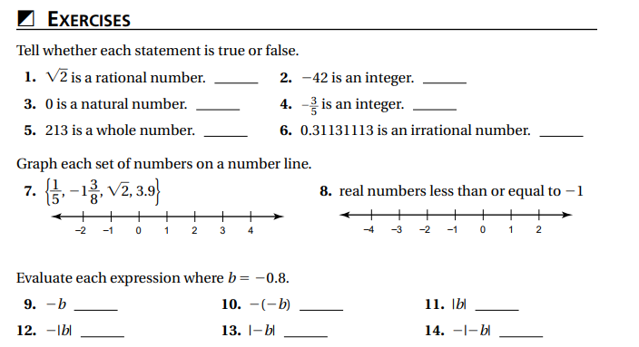
Independent Practice/Lesson Check 1-2

Slide 24
Independent Practice/Lesson Check 1-2

Slide 25
Chapter 1 Essential Mathematics Standards
B.N.RN.A.1. Use rational and irrational numbers in calculations and in real world context.
B.N.Q.A.3 Solve problems involving squares, square roots of numbers, cubes, and cube roots of number
B.A.SSE.A.1 Use properties of multiplication and division to solve problems containing scientific notation.
B.F.IF.C.5 Write a function defined by an expression in different but equivalent forms to reveal and explain different properties of the function.

Slide 26
1-3 Union & Intersection of Sets Objective
The use of commonly accepted symbols
Lists of items
SWBAT use math symbols to describe sets IOT describe the relationships among sets and elements of sets.

Slide 27
1-3 Union & Intersection of Sets
Key Concepts
Union
______________________- is formed by joining all the elements of one set with those of others.
______________________- is formed with the elements that are in common in one or more sets.
______________________-uses circles inside a rectangle to represent sets and set operations.
______________________ or ______________________-typically labeled as set U or represented by a rectangle in a Venn diagram.
______________________- the subset of all elements of U that ae not elements of set A.
______________________- two sets whose intersection is empty.
______________________- an inequality that combines two inequalities.
Intersection
Venn Diagram
Universe
Universal Set
Complement
Disjoint Sets
Compound Inequality

Slide 28
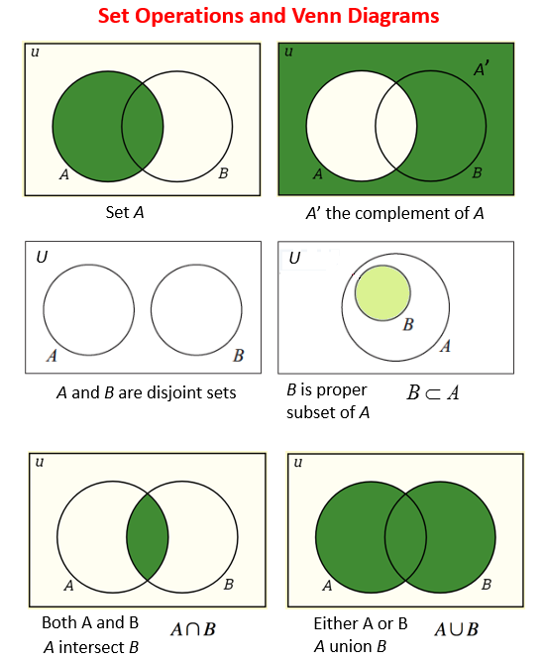
1-3 Union & Intersection of Sets
Key Concepts

Slide 29
1-3 Examples
I do
Write “the union of sets A and B” using the following notation:
Set-builder notation
b. Symbolized notation
2. Write “the intersection of sets A and B” using the following notation:
Set-builder notation
b. Symbolized notation

Slide 30
1-3 Examples
I do
3. Write “the complement of set A” using the following notation:
Set-builder notation
Symbolized notation

Slide 31
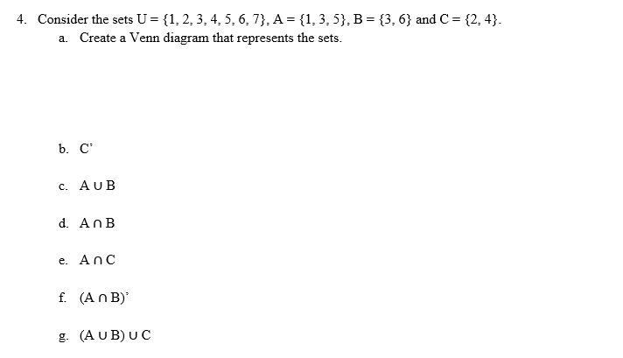
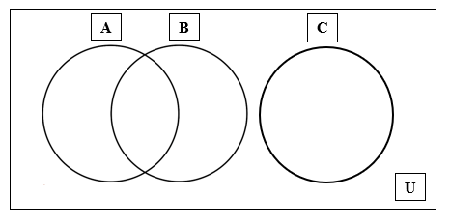
1-3 Examples

Slide 32
1-3 Examples
We do
Use the set of real numbers as the replacement set to graph the solution set for $x≥ −1$ and $x<4$.
6. Use the set of real numbers as the replacement set to graph the solution set for $x≥ 4$ or $x<−1$.

Slide 33
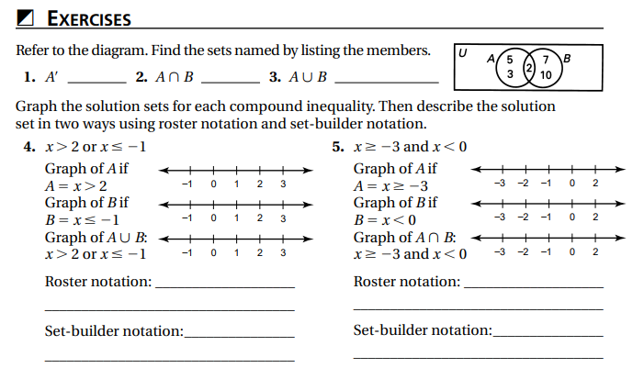
Independent Practice/Lesson Check 1-3

Slide 34
Independent Practice/Lesson Check 1-3

Slide 35
Chapter 1 Essential Mathematics Standards
B.N.RN.A.1. Use rational and irrational numbers in calculations and in real world context.
B.N.Q.A.3 Solve problems involving squares, square roots of numbers, cubes, and cube roots of number
B.A.SSE.A.1 Use properties of multiplication and division to solve problems containing scientific notation.
B.F.IF.C.5 Write a function defined by an expression in different but equivalent forms to reveal and explain different properties of the function.

Slide 36
1-7 Distributive Property & Properties of Exponents Objective
Rules accepted as fact
Determine a value for
Mathematical phrases
SWBAT use properties of exponents IOT evaluate and simplify expressions.
SWBAT will use the distributive property IOT evaluate and simplify expressions.
Process of breaking down expressions & equations
a(b + c) = ab + ac

Slide 37
1-7 Distributive Property & Properties of Exponents
Key Concepts
Exponential Form
______________________- a number written in this form has a base and an exponent.
______________________- tells what factor is being multiplied.
______________________- tells how many equal factors there are.
Base
Exponent

Slide 38
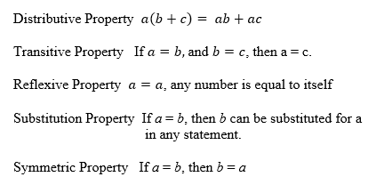
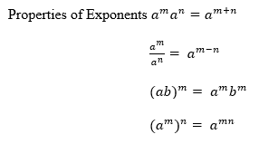
1-7 Distributive Property & Properties of Exponents
Key Concepts

Slide 39
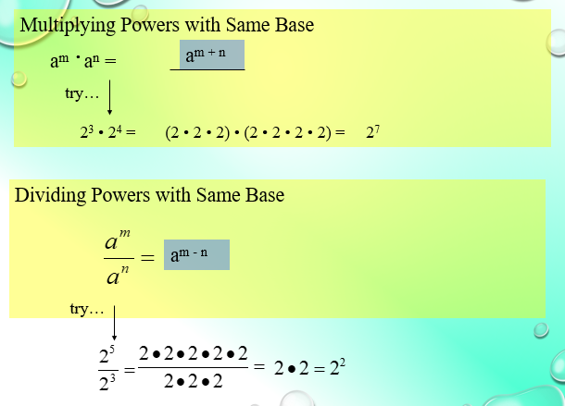
1-7 Distributive Property & Properties of Exponents
Key Concepts

Slide 40
1-7 Distributive Property & Properties of Exponents
Key Concepts

Slide 41
1-7 Examples
I do
Use the distributive Property to find the product of 16$∙15−16∙5$.
2. Evaluate the expression. Let $a= −2$ and $b=3$
$a^{2}$ b. $−a^{2}$ c. $ab^{2}$

Slide 42
1-7 Examples
I do
3. Simplify.
a. $x^{2}∙x^{7}$ b. ${{(a}^{3})}^{5}$ c. ${(5^{2}∙n)}^{2}$

Slide 43
1-7 Examples
We do
4. Simplify
a. $\frac{a^{7}}{a^{2}}$ b. ${(\frac{t}{3})}^{4}$
c. ${(\frac{x^{2}}{3})}^{4}$ d. $({\frac{c^{5}}{c^{2}})}^{3}$

Slide 44
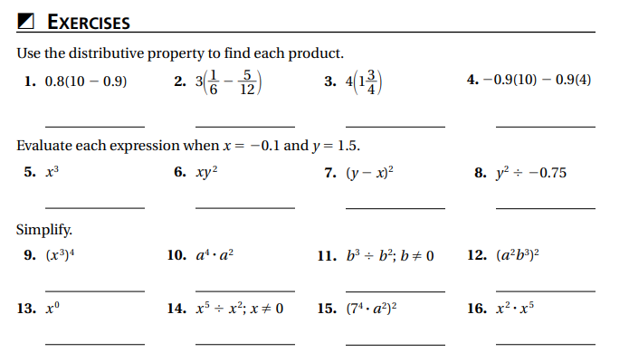
Independent Practice/Lesson Check 1-7

Slide 45
Independent Practice/Lesson Check 1-7

Slide 46
Chapter 1 Essential Mathematics Standards
B.N.RN.A.1. Use rational and irrational numbers in calculations and in real world context.
B.N.Q.A.3 Solve problems involving squares, square roots of numbers, cubes, and cube roots of number
B.A.SSE.A.1 Use properties of multiplication and division to solve problems containing scientific notation.
B.F.IF.C.5 Write a function defined by an expression in different but equivalent forms to reveal and explain different properties of the function.

Slide 47
1-8 Exponents & Scientific Notation Objective
Rules accepted as fact
Determine a value for
Mathematical phrases
SWBAT use properties of exponents IOT simplify and evaluate variable expressions with negative exponents.
SWBAT write numbers in scientific notation IOT multiply and divide numbers expressed in scientific notation.
Process of breaking down expressions & equations
Written in the form m x 10^{n}

Slide 48
1-8 Exponents & Scientific Notation
Key Concepts
Negative Exponent
______________________-derived from the quotient rule and used in scientific notation.
______________________- uses powers of 10 to write large and small numbers more concisely.
Scientific Notation

Slide 49
1-8 Examples
I do
Simplify each expression using the properties of exponent.
a. $a^{9}÷a^{−5}$ b. $x^{4}∙x^{−3}$ c. ${{ (a}^{3})}^{−5}$
2. Evaluate.
a. $a^{−5}$ when $a=2$ b. $pq^{3}$ when $p=2 and q=−2$

Slide 50
1-8 Examples
We do
3. Write the number in scientific notation.
a. 6,789,000 b. 0.000526 c. 0.006052
4. Write the number in standard form.
a. $3.6×{10}^{5}$ b. $4.3×{10}^{−4}$ c. $2.095×{10}^{−7}$

Slide 51
1-8 Examples
They do
5. The mass of an oxygen atom is $2.66×{10}^{−23}$ grams. What is the approximate mass of 1 billion oxygen atoms?

Slide 52
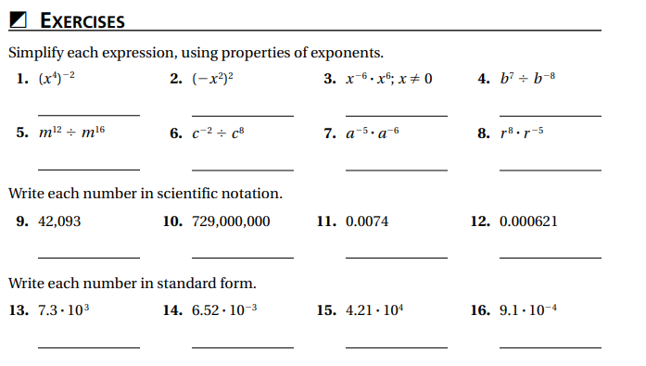
Independent Practice/Lesson Check 1-8

Slide 53
Independent Practice/Lesson Check 1-8

