Slide 1
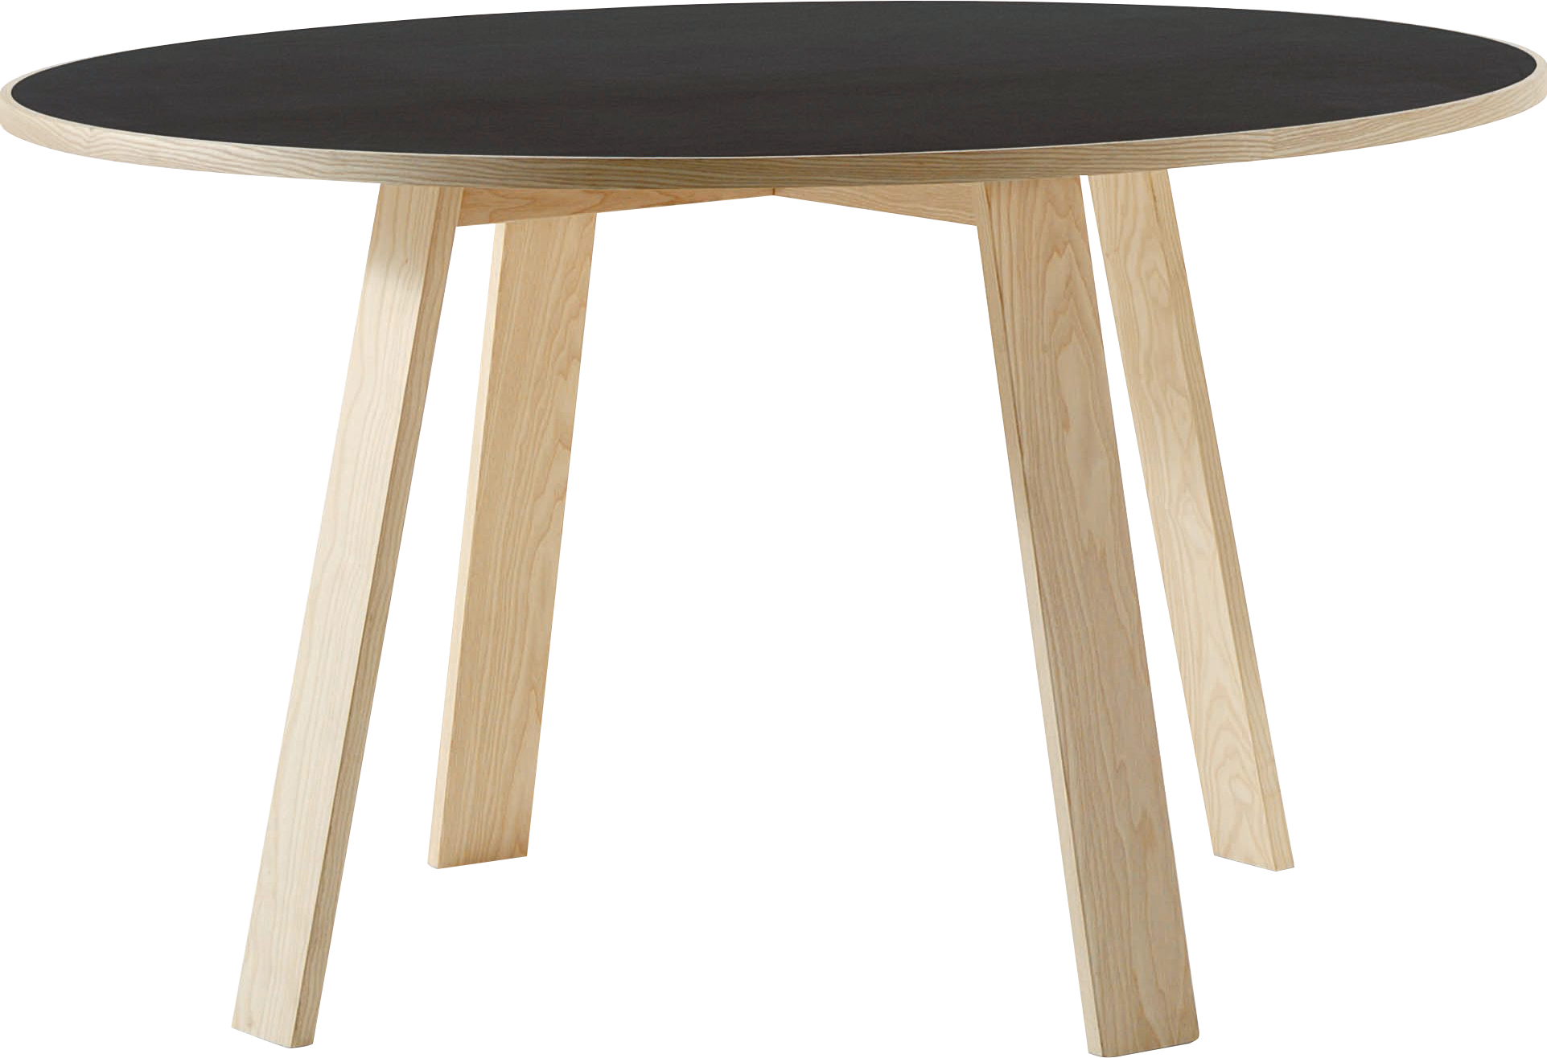
​
Welcome to Algebra 2
Mrs. Carter's Website
Delta Math

Slide 2
Chapter 2 Overview Linear Equations
Lessons
2-2 The Coordinate Plane, Relations and Functions
2-3 Linear Functions
2-5 Solving Multi-Step Equations
2-6 Solving Inequalities
2-7 Solving Linear Inequalities
Activities
Bell Work
Notes
Real World Applications
Assignments
Complete & Submit Bell work
Complete & Submit Delta Math
Work on Challenge Questions
Study: Complete Independent Practice

Slide 3
Chapter 2 Essential Algebra Standards
B.F.IF.A.1. Understand that a function from one set (called the domain) to another set (called the range) assigns to each element of the domain exactly one element of the range. If f is a function and x is an element of its domain, then f(x) denotes the output of f corresponding to the input x. The graph of f is the graph of the equation y = f(x).
B.F.IF.B.3 Recognize functions as mappings of an independent variable into a dependent variable.
B.A.CED.A.1 Create equations and inequalities in one variable and use them to solve real world problems.
B.A.CED.A.2 Create equations in two or more variables to represent relationships between quantities.
B.A.REI.D.5 Solve a linear inequality using multiple methods and interpret the solution as it applies to the context.

Slide 4
2-2 The Coordinate Plane, Relations and Functions Objectives
A collection of pairings from the domain and range
A relation in which each element of the domain is paired with exactly one element of the range
SWBAT will determine whether a relation is a function IOT identify the domain and range of a relation.
SWBAT use the coordinate plane IOT represent mathematical relationships using graphs.
Set of input values
Set of output values
Specifies the unique location of point
Diagram that relates the domain and range

Slide 5
2-2 The Coordinate Plane, Relations and Functions
Key Concepts
Coordinate Plane
______________________- pairs of numbers are graphed on this system.
______________________- the 4 sections created by both the x-axis and y-axis.
______________________- the horizontal line that divides the coordinate plane into a top half and a bottom half.
______________________- the vertical line that divides the coordinate plane into a left half and a right half.
______________________- the point at which the x-axis and y-axis cross.
______________________- the unique _________________ and___________________ that tell the location of a point.
Quadrant
X-axis
Y-axis
Origin
Ordered Pair
X-coordinate
Y-coordinate

Slide 6
2-2 The Coordinate Plane, Relations and Functions
Relation
______________________- set of ordered pairs.
______________________- the set of x-coordinates in a relation.
______________________- the set of x-coordinates in a relation.
______________________- the diagram that shows the relationship between the domain and range in a relation.
______________________- a relation in which each element of the domain is paired with exactly one element of the range.
______________________- the variable whose values make up the domain.
______________________- the variable whose values make up the range.
______________________- the test used to determine whether a relation is a function.
Domain
Range
Graph
Function
Independent Variable
Dependent Variable
Vertical Line Test

Slide 7
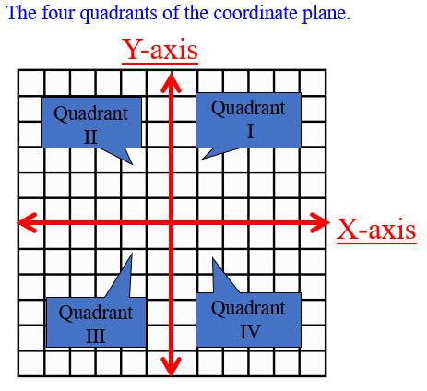
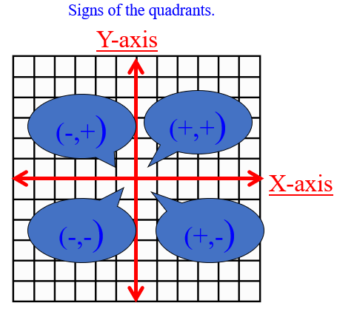
2-2 The Coordinate Plane, Relations and Functions
Origin
(0,0)

Slide 8
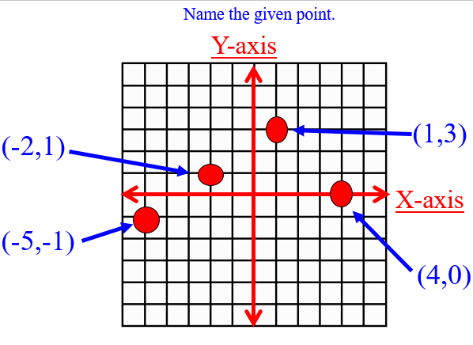
2-2 The Coordinate Plane, Relations and Functions

Slide 9
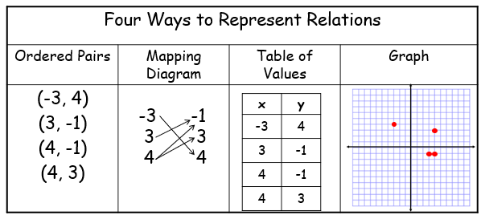
2-2 The Coordinate Plane, Relations and Functions

Slide 10
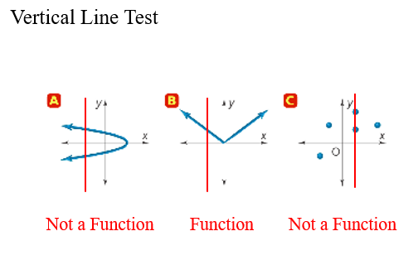
2-2 The Coordinate Plane, Relations and Functions

Slide 11
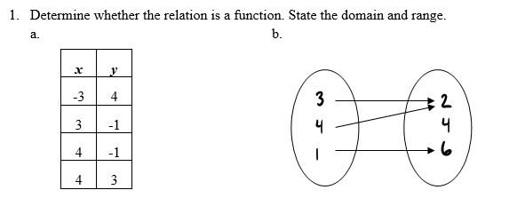
2-2 Examples
I do

Slide 12
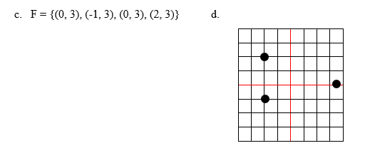
2-2 Examples
Example 1 con’t

Slide 13
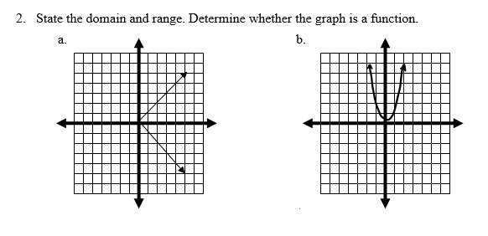
2-2 Examples
I do

Slide 14
2-2 Examples
We do

Slide 15
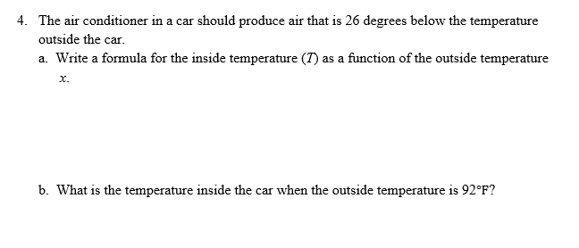
2-2 Examples
They do

Slide 16
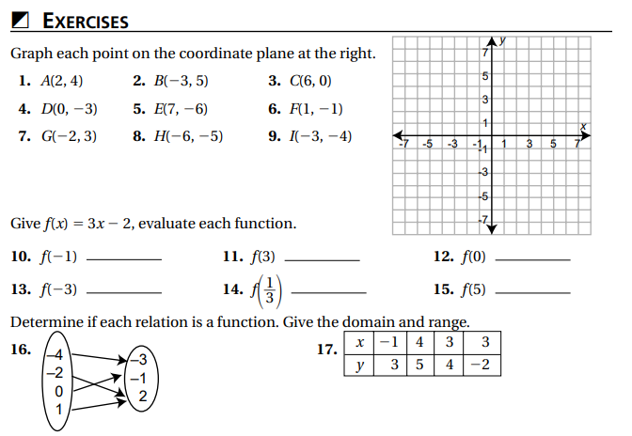
Independent Practice/Lesson Check 2-2

Slide 17
Independent Practice/Lesson Check 2-2

Slide 18
Chapter 2 Essential Algebra Standards
B.F.IF.A.1. Understand that a function from one set (called the domain) to another set (called the range) assigns to each element of the domain exactly one element of the range. If f is a function and x is an element of its domain, then f(x) denotes the output of f corresponding to the input x. The graph of f is the graph of the equation y = f(x).
B.F.IF.B.3 Recognize functions as mappings of an independent variable into a dependent variable.
B.A.CED.A.1 Create equations and inequalities in one variable and use them to solve real world problems.
B.A.CED.A.2 Create equations in two or more variables to represent relationships between quantities.
B.A.REI.D.5 Solve a linear inequality using multiple methods and interpret the solution as it applies to the context.

Slide 19
2-3 Linear Functions Objective
The use of commonly accepted symbols to write mathematical phrases
As it applies to a problem
SWBAT write an equation symbolically IOT express a contextual problem.
SWBAT will graph linear functions IOT solve linear equations by making a table.
Add, subtract, multiply, divide and find the absolute value of
An organized way of representing data.
Visually represent the relationship between the domain and range on the coordinate plane

Slide 20
2-3 Linear Functions
Key Concepts
Linear Function
______________________- a function whose graph is a line.
______________________- represents a linear function where a solution is any ordered pair (x, y) that makes the equation true.
______________________- the point in which a line crosses the y-axis.
______________________- the point in which a line crosses the x-axis.
______________________- values of x for which f(x) = 0. Also called x-intercept.
Linear Equation
Y-intercept
X-intercept
Zero

Slide 21
2-3 Linear Functions
Key Concepts
Standard Form Ax + By = C where A, B, and C must be integers.
An equation is LINEAR (the graph is a straight line) if it can be written in standard form

Slide 22
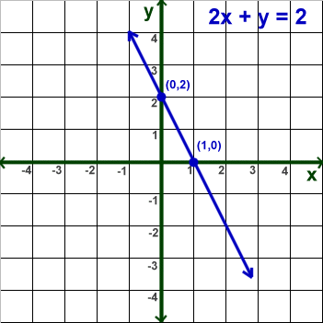
2-3 Linear Functions
Key Concepts
y-intercept
x-intercept
zero

Slide 23
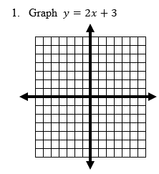
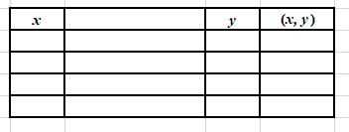
2-3 Examples
I do

Slide 24
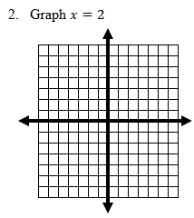
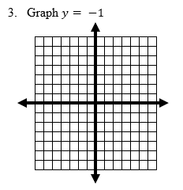
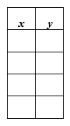
2-3 Examples
We do

Slide 25
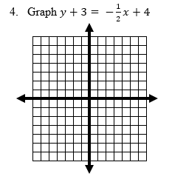
2-3 Examples
We do

Slide 26
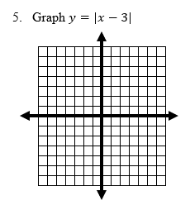
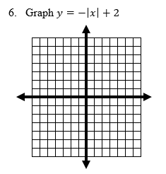
2-3 Examples
We do

Slide 27
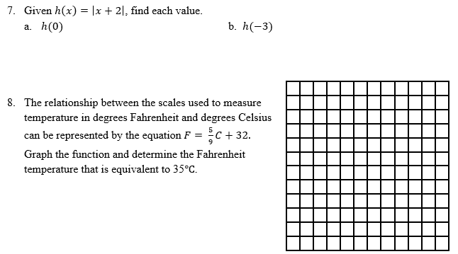
2-3 Examples
They do

Slide 28
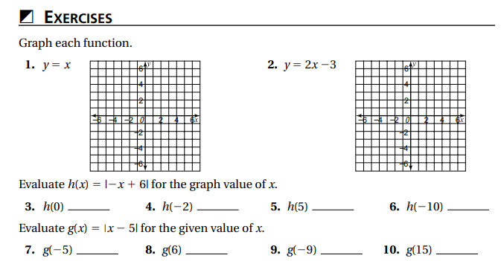
Independent Practice/Lesson Check 2-3

Slide 29
Independent Practice/Lesson Check 2-3

Slide 30
Chapter 2 Linear Functions & Equations Standards
B.F.IF.A.1. Understand that a function from one set (called the domain) to another set (called the range) assigns to each element of the domain exactly one element of the range. If f is a function and x is an element of its domain, then f(x) denotes the output of f corresponding to the input x. The graph of f is the graph of the equation y = f(x).
B.F.IF.B.3 Recognize functions as mappings of an independent variable into a dependent variable.
B.A.CED.A.1 Create equations and inequalities in one variable and use them to solve real world problems.
B.A.CED.A.2 Create equations in two or more variables to represent relationships between quantities.
B.A.REI.D.5 Solve a linear inequality using multiple methods and interpret the solution as it applies to the context.

Slide 31
2-5 Solving Multi-Step Equations Objective
Equations consisting of 2 or more variables
As it applies to a problem
SWBAT rewrite literal equations and formulas IOT use them in context.
SWBAT use properties of equality IOT solve equations.
Isolate the indicated variable
Rules used to solve equations

Slide 32
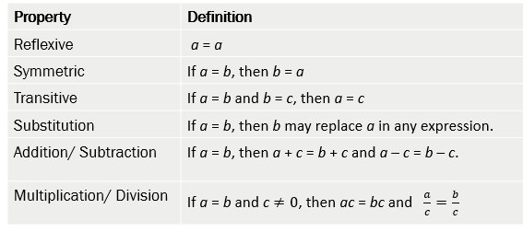
2-5 Solving Multi-Step Equations
Key Concepts

Slide 33
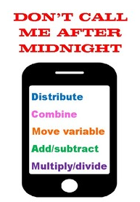
2-5 Solving Multi-Step Equations
Key Concepts
Solving Equations is easy to do if you remember: Don’t Call Me After Midnight!
D – Distribute
C – Combine Like Terms
M – Move variable to left side of equation
A- Add/subtract numbers
M – Multiply/divide numbers

Slide 34
2-5 Linear Functions
Key Concepts
Literal Equation
________________________________- an equation that uses at least 2 letters as variables. You can solve for any variable “in terms of” the other variables.
Examples
I do
1. Solve for h. $P =2b+2h$

Slide 35
2-5 Examples
We do
2. Solve and Check. $x+5=2x−3$
3. Solve and Check. $6\left(2x−1\right)= −36+6$

Slide 36
2-5 Examples
We do
4. Solve and Check. $6c+3−2c=1+5c$
5. Solve and Check. $15n−4\left(4+3n\right)= −5\left(2n−5\right)+ 11$

Slide 37
2-5 Examples
They do
Translate “when 12 is decreased by twice a number, the result is -14” into an equation. Then solve.
Translate “when the sum of twice a number and 3 is multiplied by 5, the result is the same as decreasing the product of 6and the number by 1” into an equation. Then solve.

Slide 38
2-5 Examples
Shawn bought 3 CD’S and a DVD. The CD’s were all the same price and the DVD was three less than twice the cost of one CD. The total cost of the 3 CD’s and the DVD was $42.
Find the cost of each CD.
b. Find the cost of the DVD.

Slide 39
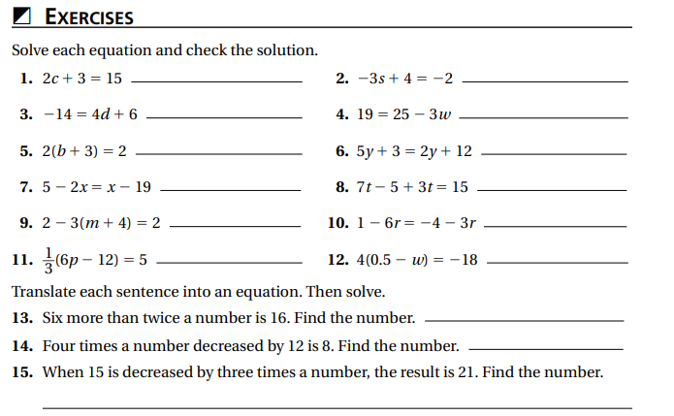
Independent Practice/Lesson Check 2-5

Slide 40
Independent Practice/Lesson Check 2-5

Slide 41
Chapter 2 Essential Algebra Standards
B.F.IF.A.1. Understand that a function from one set (called the domain) to another set (called the range) assigns to each element of the domain exactly one element of the range. If f is a function and x is an element of its domain, then f(x) denotes the output of f corresponding to the input x. The graph of f is the graph of the equation y = f(x).
B.F.IF.B.3 Recognize functions as mappings of an independent variable into a dependent variable.
B.A.CED.A.1 Create equations and inequalities in one variable and use them to solve real world problems.
B.A.CED.A.2 Create equations in two or more variables to represent relationships between quantities.
B.A.REI.D.5 Solve a linear inequality using multiple methods and interpret the solution as it applies to the context.

Slide 42
2-6 Solving Inequalities Objective
Create a diagram for the inequality
Determine the meaning of, in context.
SWBAT will solve and graph an inequality in one variable IOT interpret the solution of a linear inequality.
Letter used to represent an unknown quantity
Of or containing a line
Isolate the indicated variable
≤, ≥,<, >

Slide 43
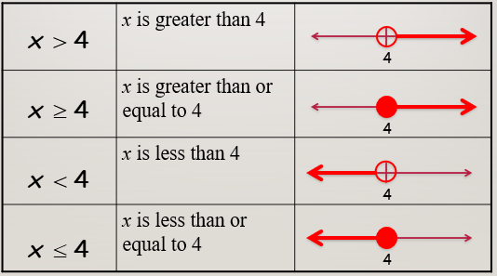
2-6 Solving Inequalities
Key Concepts
Examples
I do
What inequality represents the graph?

Slide 44
2-6 Examples
We do
2. Solve and graph the solution. $2x≥20$ 3. Solve and graph the solution. $−60s>8$

Slide 45
2-6 Examples
We do
4. Solve and graph the solution. $−\frac{3}{7}r≤21$ 5. Solve and graph the solution. $−3<\frac{x}{6}$

Slide 46
2-6 Examples
We do
7. Solve and graph. $4\left(3d+1\right)−5d≤8−2(5d+2)$
6. Solve and graph the solution. $−2k+9≥1$

Slide 47
2-6 Examples
They do
8. Of the students surveyed at Cordova High
School, fewer than eighty-four said they have
never purchased an item online. This is about
one eighth of those surveyed. How many
students were surveyed?
9. A reporter estimates that $\frac{2}{3}$ of the hours (h) spent
on a story increased by 15 hours is less than 27
hours. What values are possible for h?

Slide 48
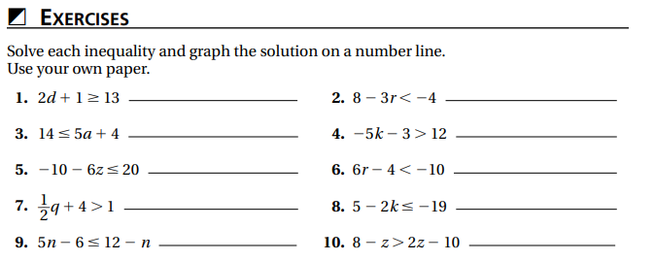
Independent Practice/Lesson Check 2-6

Slide 49
Independent Practice/Lesson Check 2-6

Slide 50
Chapter 2 Essential Algebra Standards
B.F.IF.A.1. Understand that a function from one set (called the domain) to another set (called the range) assigns to each element of the domain exactly one element of the range. If f is a function and x is an element of its domain, then f(x) denotes the output of f corresponding to the input x. The graph of f is the graph of the equation y = f(x).
B.F.IF.B.3 Recognize functions as mappings of an independent variable into a dependent variable.
B.A.CED.A.1 Create equations and inequalities in one variable and use them to solve real world problems.
B.A.CED.A.2 Create equations in two or more variables to represent relationships between quantities.
B.A.REI.D.5 Solve a linear inequality using multiple methods and interpret the solution as it applies to the context.

Slide 51
2-7 Solving Linear Inequalities Objective
Create a diagram for the inequality
Determine the meaning of, in context.
SWBAT will solve and graph an inequality in TWO variables IOT interpret the solution of a linear inequality.
Letter used to represent an unknown quantity
Of or containing a line
Isolate the indicated variable
≤, ≥,<, >

Slide 52
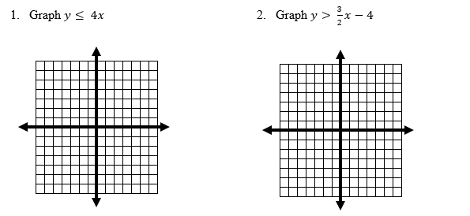
2-7 Examples
I do

Slide 53
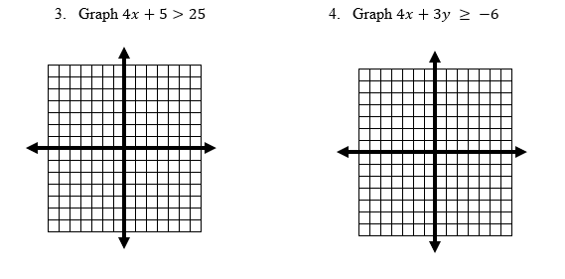
2-7 Examples
We do

Slide 54
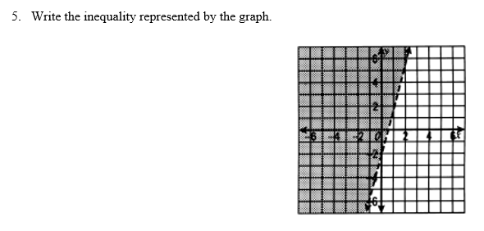
2-7 Examples
They do

Slide 55
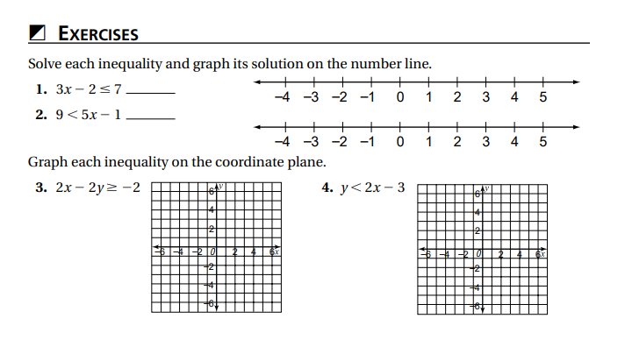
Independent Practice/Lesson Check 2-7

Slide 56
Independent Practice/Lesson Check 2-7

