Slide 1
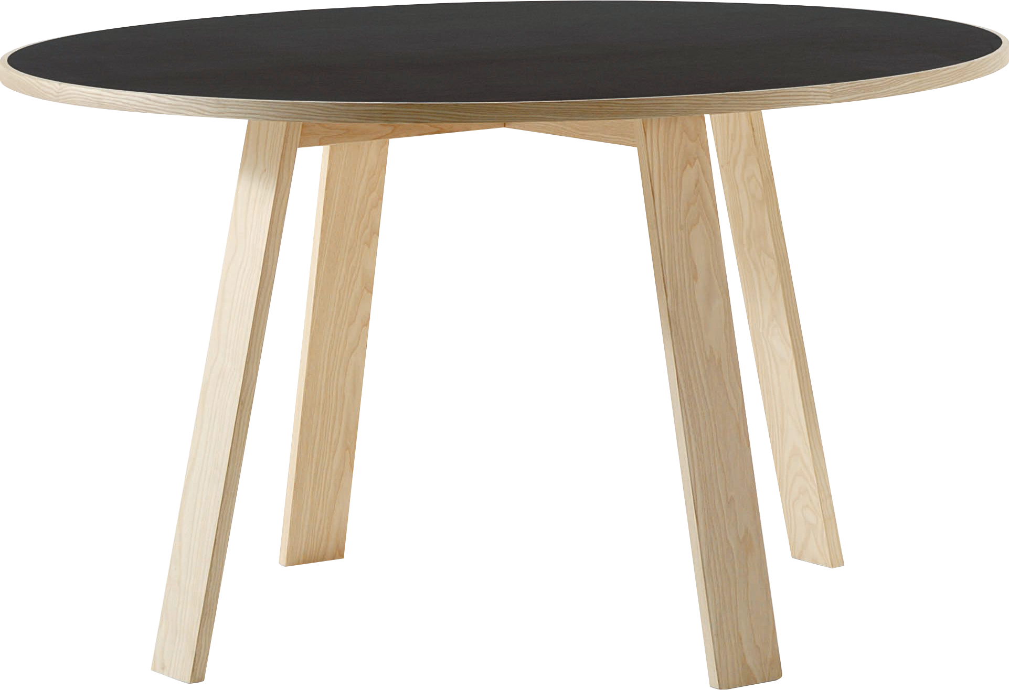
​
Welcome to Algebra 2
Mrs. Carter's Website
Delta Math

Slide 2
Chapter 4 Overview Polygons
Lessons
4-1 Triangles & Triangle Theorems
4-2 Congruent Triangles
4-7 Polygons & Angles
4-8 Parallelograms
4-9 Trapezoids
Activities
Bell Work
Notes
Real World Applications
Assignments
Complete & Submit Bell work
Complete & Submit Delta Math
Work on Challenge Questions
Study: Complete Independent Practice

Slide 3
Chapter 4 Polygons Standard
B.G.GMD.A.2 Use several angle properties to find an unknown angle measure.
.

Slide 4
4-1 Triangles & Triangle Theorems Objectives
Name
Locate
Label
Two rays that share a common vertex
SWBAT identify and use angle properties IOT classify triangles according to their sides and angles.
SWBAT identify and use angle properties IOT solve equations to find the measures of unknown angles.
Arrange into categories based on common characteristics
Isolate the variable

Slide 5
4-1 Triangles & Triangle Theorems
Key Concepts
______________________- an enclosed two-dimensional figure having at least 3 sides and angles.
______________________- a three-sided polygon.
______________________- equal
______________________- a polygon with all sides congruent.
______________________- a polygon with all angles congruent.
Polygon
Triangle
Congruent
Equilateral
Equiangular

Slide 6
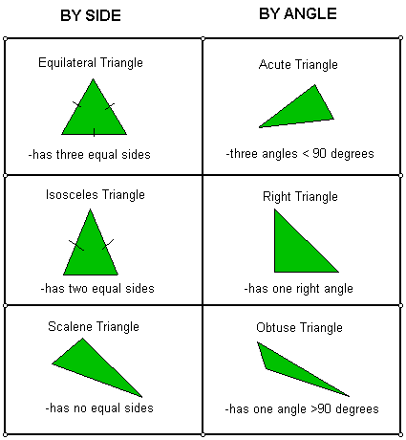
4-1 Triangles & Triangle Theorems
Key Concepts

Slide 7
4-1 Triangles & Triangle Theorems
Key Concepts

Slide 8
4-1 Triangles & Triangle Theorems
Key Concepts

Slide 9
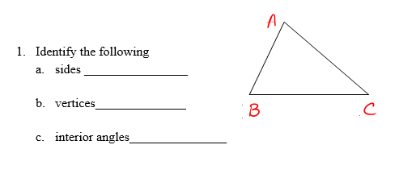
4-1 Examples
I do

Slide 10
4-1 Examples
We do

Slide 11
4-1 Examples
We do

Slide 12
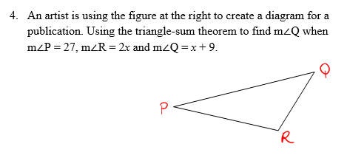
4-1 Examples
They do

Slide 13
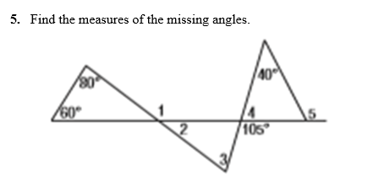
4-1 Examples
They do

Slide 14
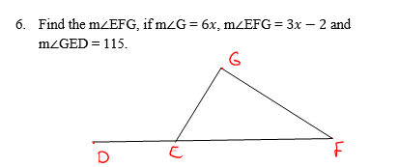
4-1 Examples
They do

Slide 15
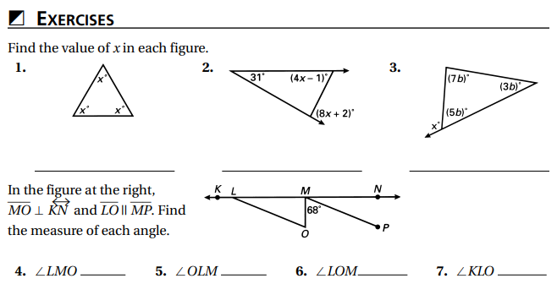
Independent Practice/Lesson Check 4-1

Slide 16
Independent Practice/Lesson Check 4-1

Slide 17
Chapter 4 Polygons Standard
B.G.GMD.A.2 Use several angle properties to find an unknown angle measure.
.

Slide 18
4-2 Congruent Triangles Objective
Having the same size and shape.
Rules accepted as fact.
SWBAT use definitions, properties and theorems IOT prove triangles are congruent.

Slide 19
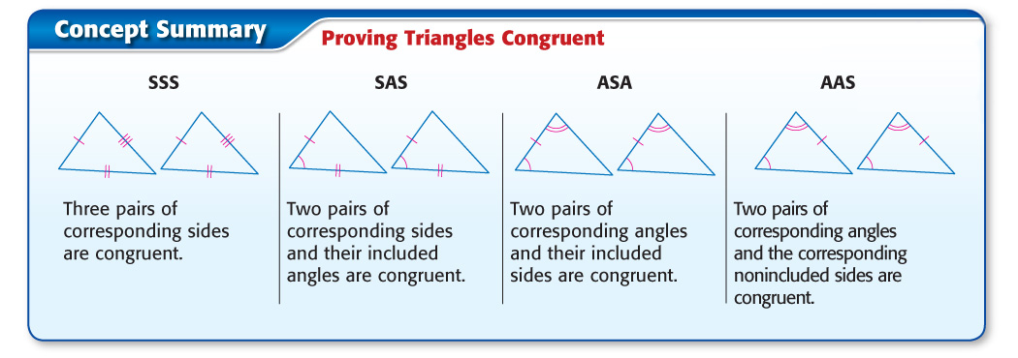
4-2 Congruent Triangles
Key Concepts

Slide 20
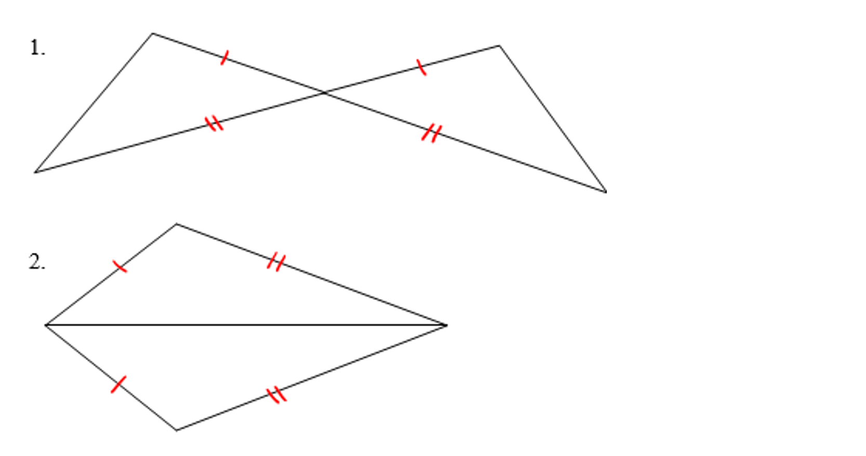
4-2 Examples
I do

Slide 21
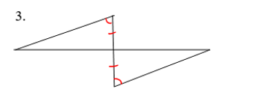
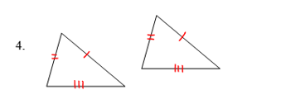
4-2 Examples
We do

Slide 22
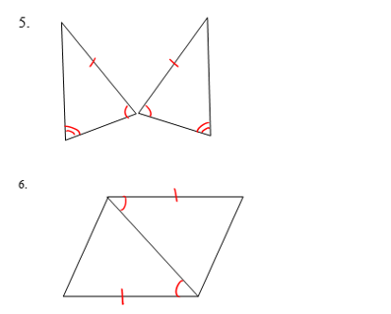
4-2 Examples
They do

Slide 23
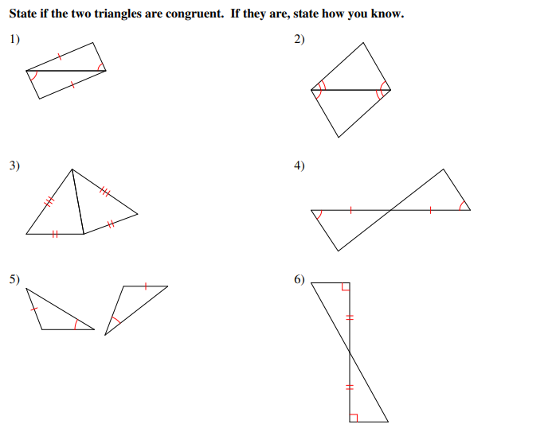
Independent Practice/Lesson Check 4-2

Slide 24
Independent Practice/Lesson Check 4-2

Slide 25
Chapter 4 Polygons Standard
B.G.GMD.A.2 Use several angle properties to find an unknown angle measure.
.

Slide 26
4-7 Polygons & Angles Objective
Angles considered to be inside of a polygon.
Angles considered to be on the outside of a polygon.
SWBAT use polygon angle formulas IOT determine the measures of interior and exterior angles in polygons.

Slide 27
4-7 Polygons & Angles
Key Concepts
______________________- a point that joins two consecutive sides in a polygon.
______________________- a polygon with all sides congruent.
______________________- a polygon having all angles less than 180.
______________________- a polygon having at least on angle greater than 180.
Vertex
Regular Polygon
Convex Polygon
Concave Polygon

Slide 28
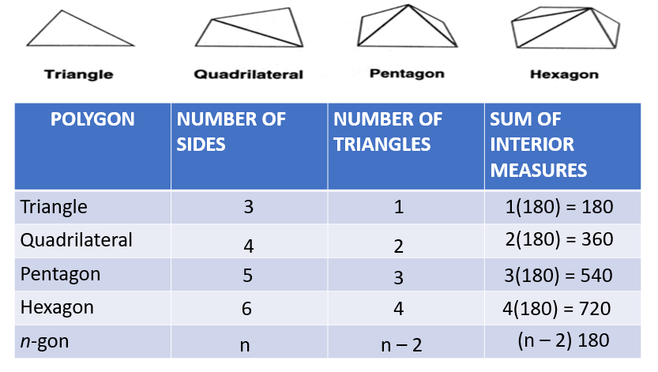
4-7 Polygons & Angles
Key Concepts

Slide 29
4-7 Polygons & Angles
Key Concepts

Slide 30
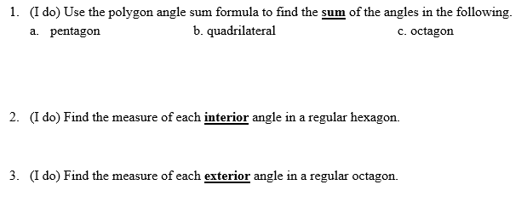
4-7 Examples

Slide 31
4-7 Examples

Slide 32
4-7 Examples

Slide 33
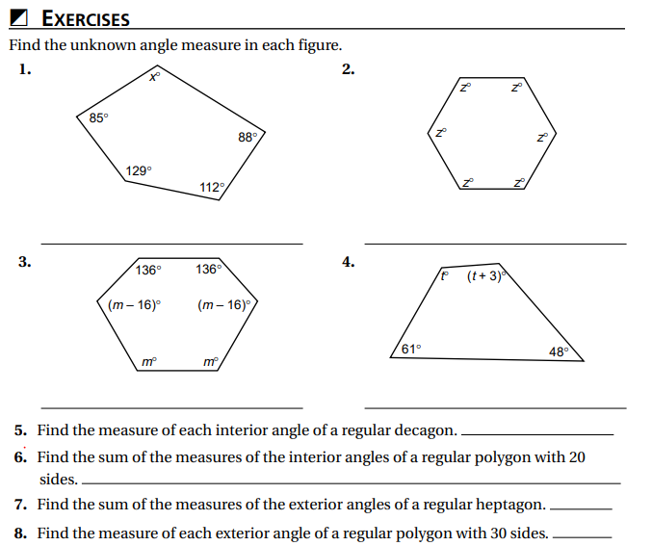
Independent Practice/Lesson Check 4-7

Slide 34
Independent Practice/Lesson Check 4-7

Slide 35
Chapter 4 Polygons Standard
B.G.GMD.A.2 Use several angle properties to find an unknown angle measure.
.

Slide 36
4-8 Parallelograms Objective
A polygon containing 2 pairs of parallel sides.
SWBAT apply properties of parallelograms IOT determine missing side lengths and angle measures.
Rules accepted as fact.

Slide 37
4-8 Parallelograms
Key Concepts

Slide 38
4-8 Parallelograms
Key Concepts

Slide 39
4-8 Parallelograms
Key Concepts

Slide 40
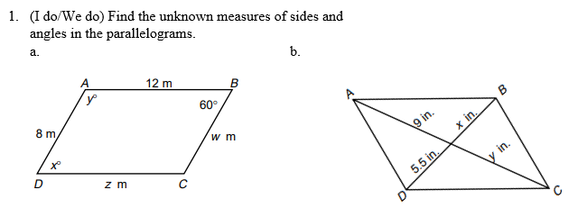
4-8 Examples

Slide 41
4-8 Examples
#1 con’t

Slide 42
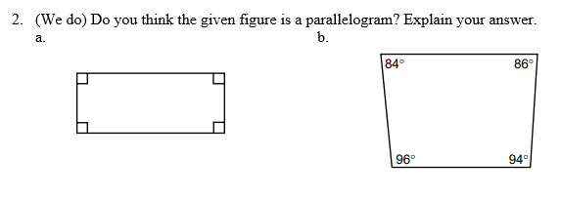
4-8 Examples

Slide 43
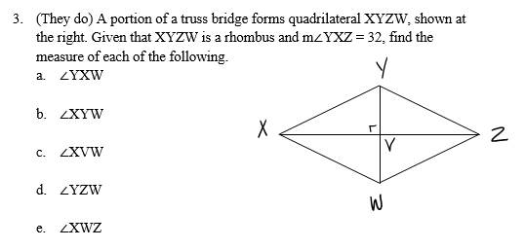
4-8 Examples

Slide 44
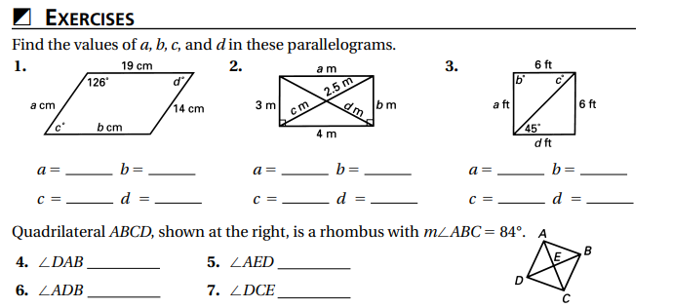
Independent Practice/Lesson Check 4-8

Slide 45
Independent Practice/Lesson Check 4-8

Slide 46
Chapter 4 Polygons Standard
B.G.GMD.A.2 Use several angle properties to find an unknown angle measure.
.

Slide 47
4-9 Trapezoids Objective
A polygon containing exactly one pair of parallel sides.
SWBAT apply properties of trapezoids IOT determine missing side lengths and angle measures.
Rules accepted as fact.

Slide 48
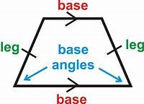
4-9 Trapezoids
Key Concepts
______________________- a quadrilateral with exactly one pair of parallel sides.
______________________- the parallel sides in a trapezoid.
______________________- the nonparallel in a trapezoid.
______________________- formed by a base and one of the legs.
______________________- a trapezoid with one pair of congruent base angles.
______________________- the segment that joins the midpoints of the nonparallel sides in a trapezoid.
Trapezoid
Bases
Legs
Base Angles
Isosceles Trapezoid
Median

Slide 49
4-9 Trapezoids
Key Concepts

Slide 50
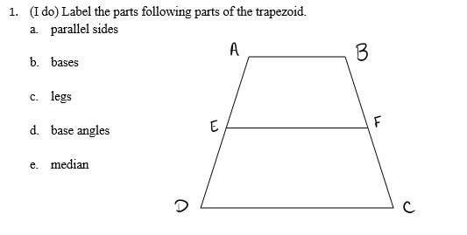
4-9 Examples

Slide 51
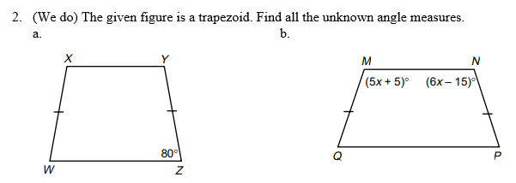
4-9 Examples

Slide 52
4-9 Examples

Slide 53
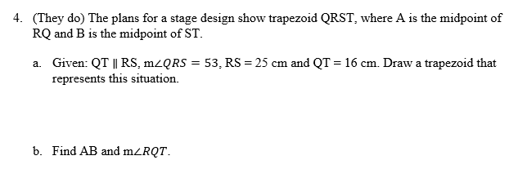
4-9 Examples

Slide 54
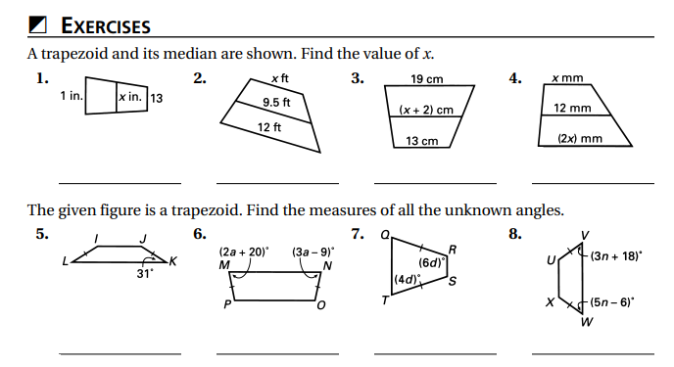
Independent Practice/Lesson Check 4-9

Slide 55
Independent Practice/Lesson Check 4-9

