Slide 1
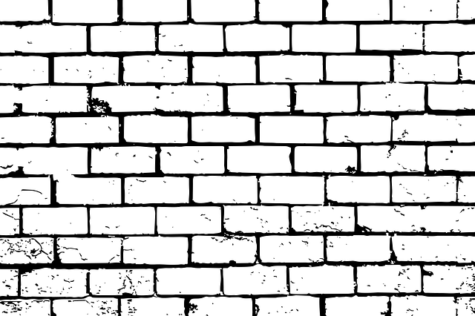
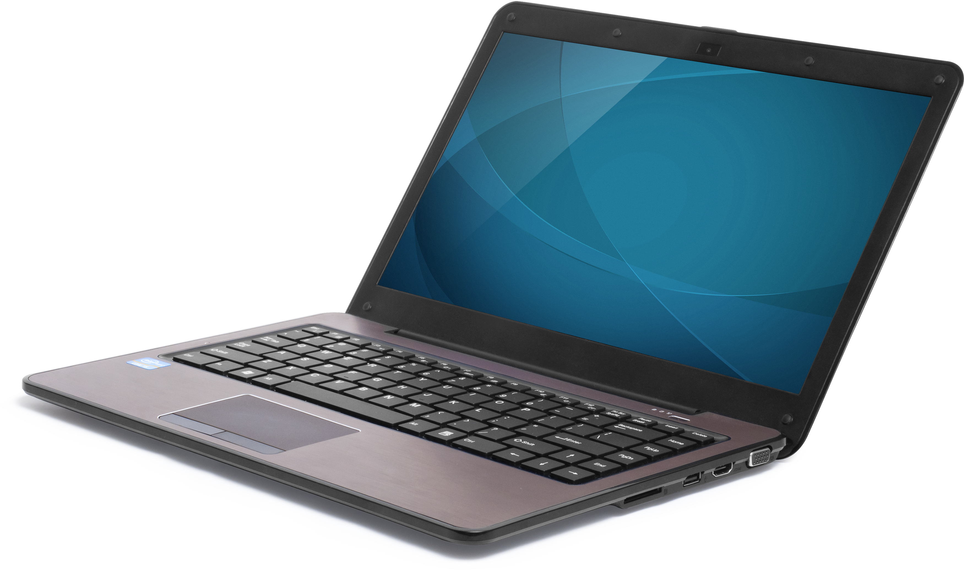
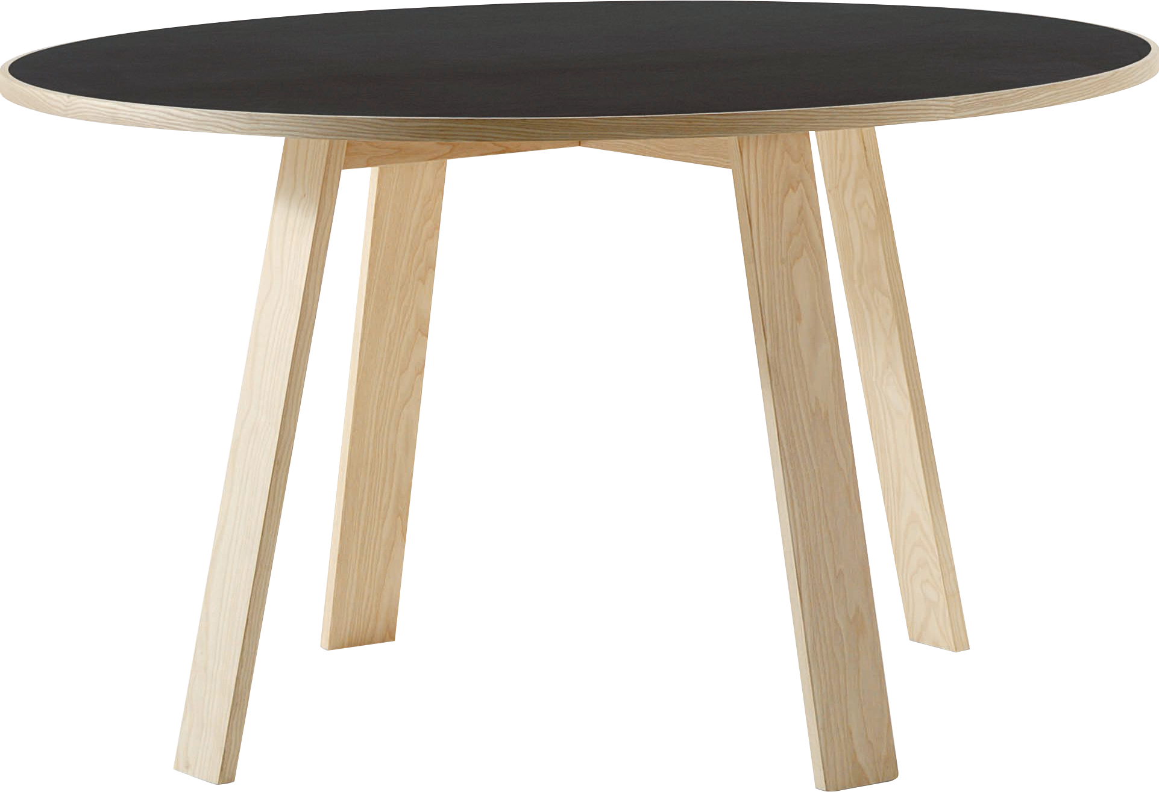
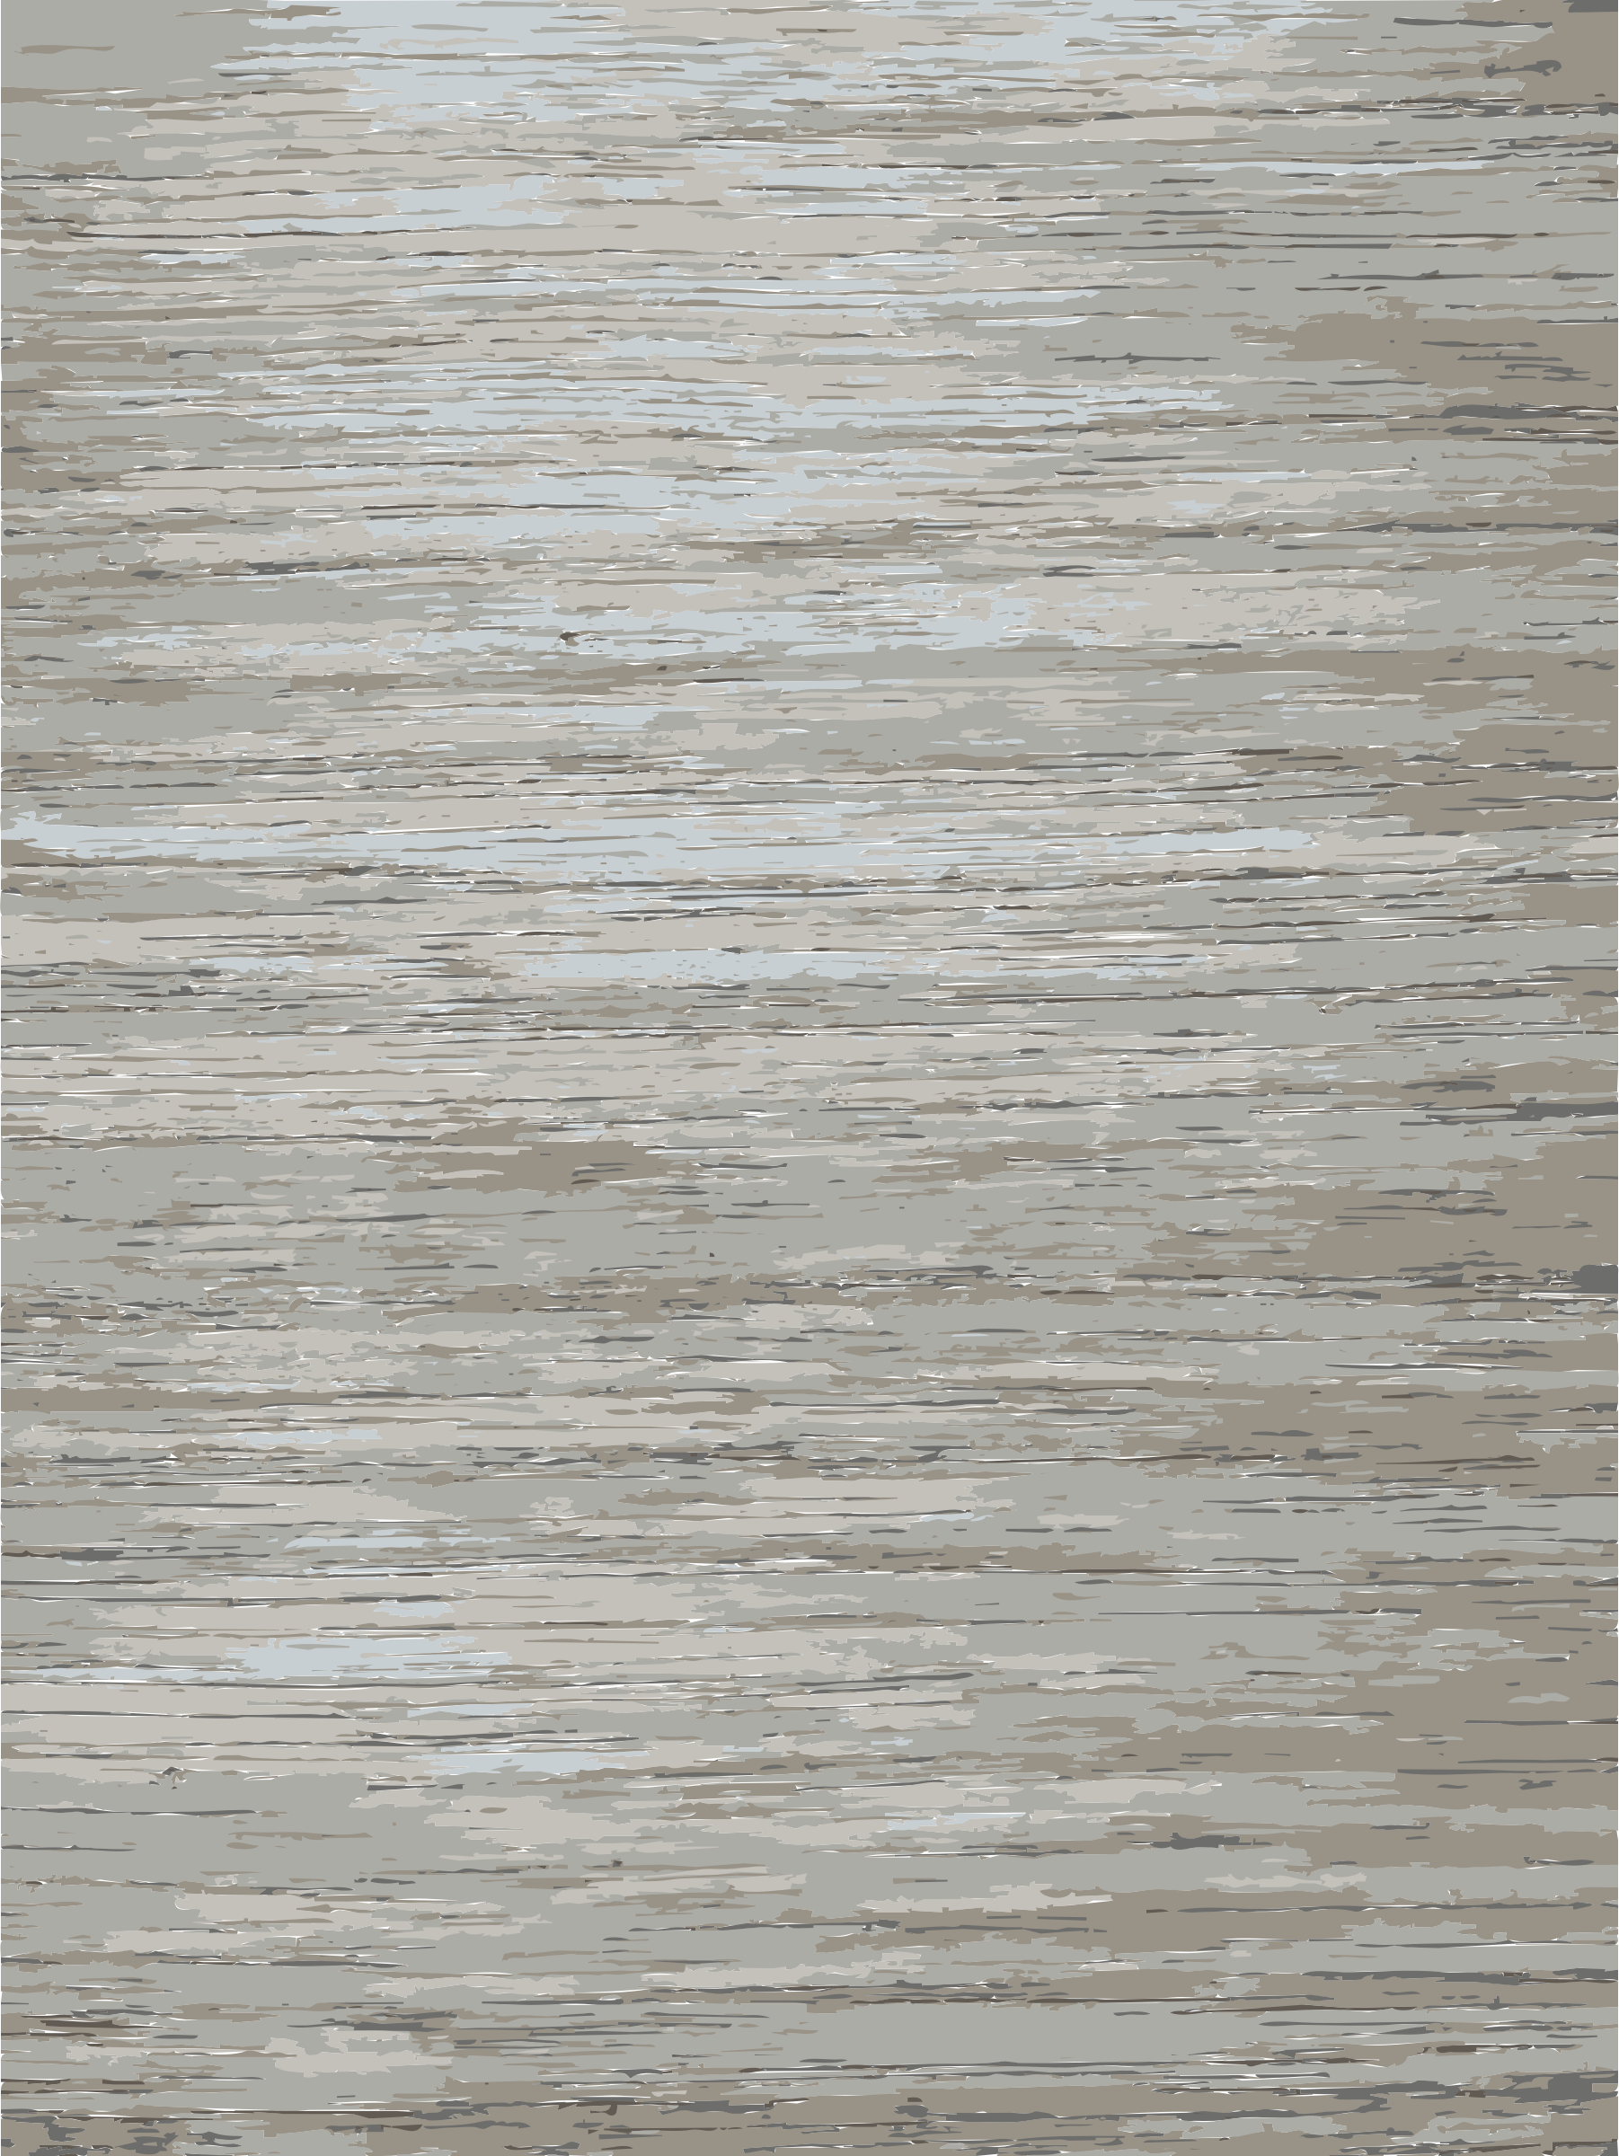
​
Welcome to Algebra 2
Mrs. Carter's Website
Delta Math

Slide 2
Chapter 5 Overview Perimeter, Circumference, & Area
Lessons
5-2 Perimeter, Circumference & Area
5-3 Probability & Area
5-4 Irregular Shapes
5-5 3-D Figures
5-6 Surface Area
5-7 Volume
Activities
Bell Work
Notes
Real World Applications
Assignments
Complete & Submit Bell work
Complete & Submit Delta Math
Work on Challenge Questions
Study: Complete Independent Practice

Slide 3
Chapter 5 Perimeter, Circumference, & Area Standard
B.G.GMD.A.1 Use relationships involving area, perimeter, and volume of geometric figures to compute another measure.
B.G.MG.A.1 Use appropriate technology to find the mathematical model for a set of non-linear data.
B.G.GMD.A.3 Apply a variety of strategies using relationships between perimeter, area, and volume to calculate desired measures in composite figures (i.e., combinations of basic figures).
B.G.MG.A.2 Solve problems involving surface area and volume in real-world
context.
.

Slide 4
5-2 Perimeter, Circumference, & Area Objectives
The distance around a circle.
The distance around a geometric figure.
SWBAT apply formulas IOT determine perimeter, area and circumference.
Substitute, simplify and solve.
The amount it takes to cover a geometric figure.

Slide 5
5-2 Perimeter, Circumference, & Area
Key Concepts
Perimeter
______________________- The distance around a geometric figure.
______________________- The amount it takes to cover a geometric figure.
______________________- The distance around a circle.
Area
Circumference

Slide 6
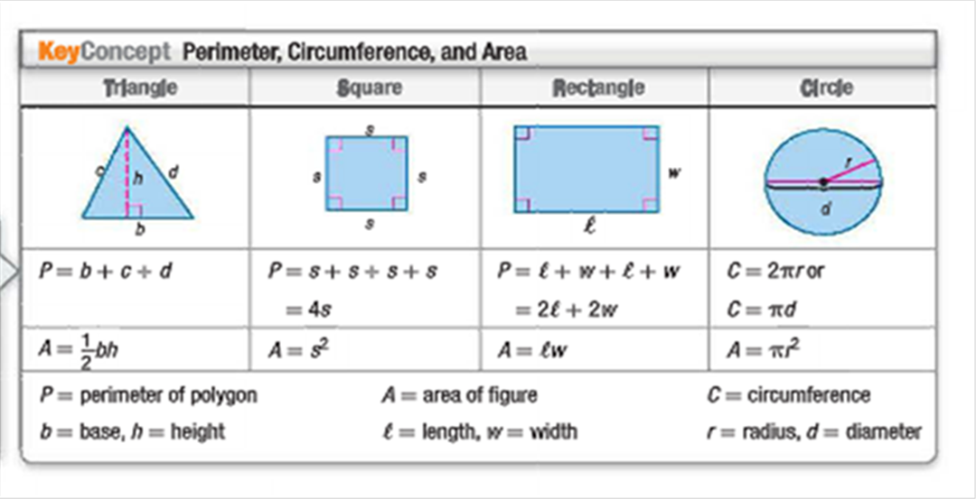
5-2 Perimeter, Circumference, & Area
Key Concepts

Slide 7
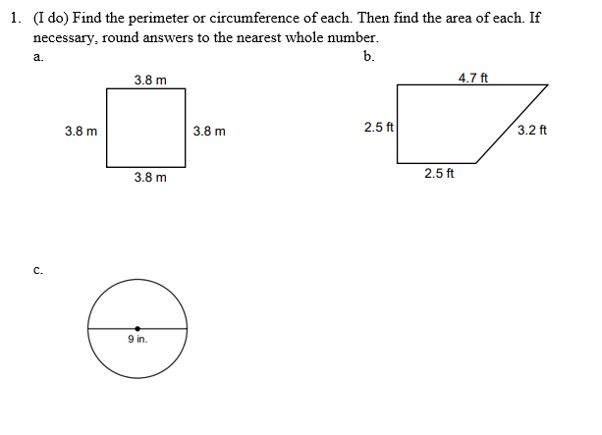
5-2 Examples

Slide 8
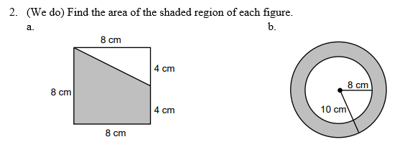
5-2 Examples

Slide 9
5-2 Examples

Slide 10
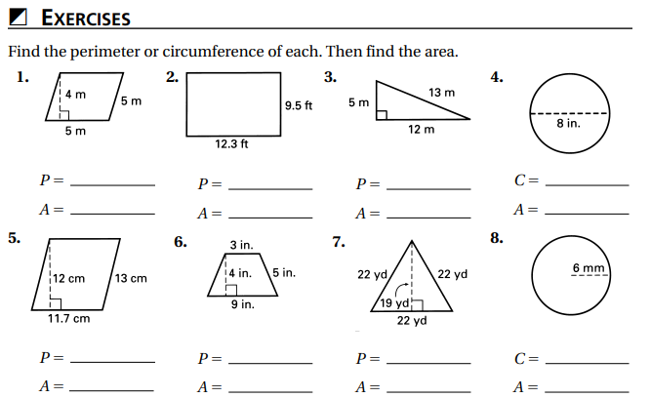
Independent Practice/Lesson Check 5-2

Slide 11
Independent Practice/Lesson Check 5-2

Slide 12
Chapter 5 Perimeter, Circumference, & Area Standard
B.G.GMD.A.1 Use relationships involving area, perimeter, and volume of geometric figures to compute another measure.
B.G.MG.A.1 Use appropriate technology to find the mathematical model for a set of non-linear data.
B.G.GMD.A.3 Apply a variety of strategies using relationships between perimeter, area, and volume to calculate desired measures in composite figures (i.e., combinations of basic figures).
B.G.MG.A.2 Solve problems involving surface area and volume in real-world
context.
.

Slide 13
5-3 Probability & Area Objectives
The likelihood an event will occur.
SWBAT use area IOT determine probabilities.

Slide 14
5-3 Probability & Area
Key Concepts
Probability
______________________- the likelihood an event will occur.
P(any event) = $\frac{number of favorable outcomes}{number of possible outcomes}$

Slide 15
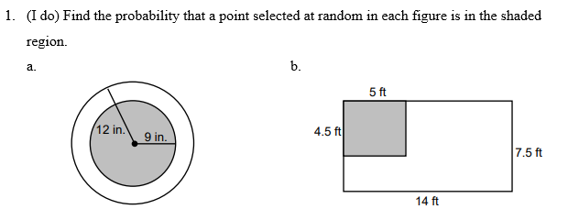
5-3 Examples

Slide 16
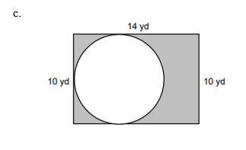
5-3 Examples
#1 cont

Slide 17
5-3 Examples
(We do) A treasure chest was buried long ago beneath what is now Cordova High school property. No one knows where the chest lies. If the school property is a rectangle measuring 600 ft by 540 ft, what is the probability that the chest could be found by excavating the baseball diamond, a square with sides of 90 ft each?

Slide 18
5-3 Examples
(They do) Twenty-five darts are randomly thrown at a circular dartboard and all the darts land within the dartboard. Four hit the bull’s-eye. If the diameter of the bulls-eye is 24 cm, what is the approximate area of the dartboard?

Slide 19
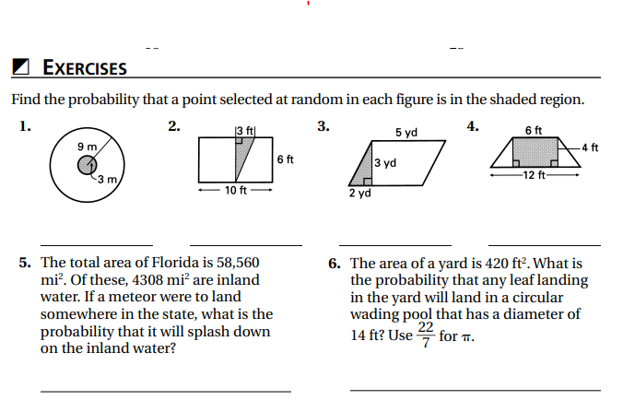
Independent Practice/Lesson Check 5-3

Slide 20
Independent Practice/Lesson Check 5-3

Slide 21
Chapter 5 Perimeter, Circumference, & Area Standard
B.G.GMD.A.1 Use relationships involving area, perimeter, and volume of geometric figures to compute another measure.
B.G.MG.A.1 Use appropriate technology to find the mathematical model for a set of non-linear data.
B.G.GMD.A.3 Apply a variety of strategies using relationships between perimeter, area, and volume to calculate desired measures in composite figures (i.e., combinations of basic figures).
B.G.MG.A.2 Solve problems involving surface area and volume in real-world
context.
.

Slide 22
5-4 Irregular Figures Objectives
SWBAT use area IOT determine the area if irregular shapes (or combined figures).
Substitute, simplify and solve.

Slide 23
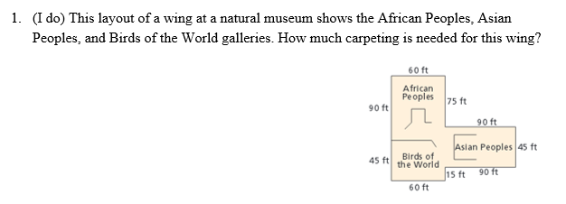
5-4 Irregular Figures
Key Concepts

Slide 24
5-4 Examples

Slide 25
5-4 Examples

Slide 26
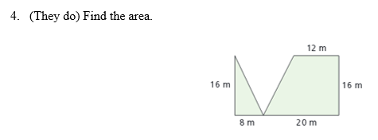
5-4 Examples

Slide 27
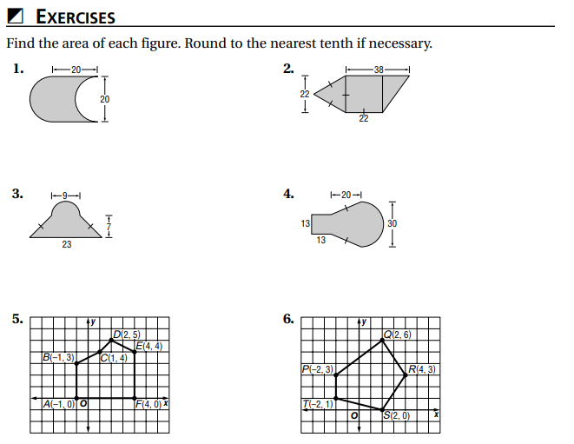
Independent Practice/Lesson Check 5-4

Slide 28
Independent Practice/Lesson Check 5-4

Slide 29
Chapter 5 Perimeter, Circumference, & Area Standard
B.G.GMD.A.1 Use relationships involving area, perimeter, and volume of geometric figures to compute another measure.
B.G.MG.A.1 Use appropriate technology to find the mathematical model for a set of non-linear data.
B.G.GMD.A.3 Apply a variety of strategies using relationships between perimeter, area, and volume to calculate desired measures in composite figures (i.e., combinations of basic figures).
B.G.MG.A.2 Solve problems involving surface area and volume in real-world
context.
.

Slide 30
5-5 Three-Dimensional Figures Objectives
The amount of space filling an object .
SWBAT analyze three-dimensional figures IOT determine the surface area and volume.
Name and identify parts needed
Figures having length, with and height
The amount it takes to cover a geometric figure.

Slide 31
5-5 Three-Dimensional Figures
Key Concepts
______________________- a solid figure having length, width and height.
______________________- a solid figure having many plane (2-D) faces.
______________________- the polygons that make up a polyhedron.
______________________- the segments joining the faces of a polyhedron.
______________________- a point (corner) joining the segments of a polyhedron.
3-D Figure
Polyhedron
Faces
Edges
Vertex

Slide 32
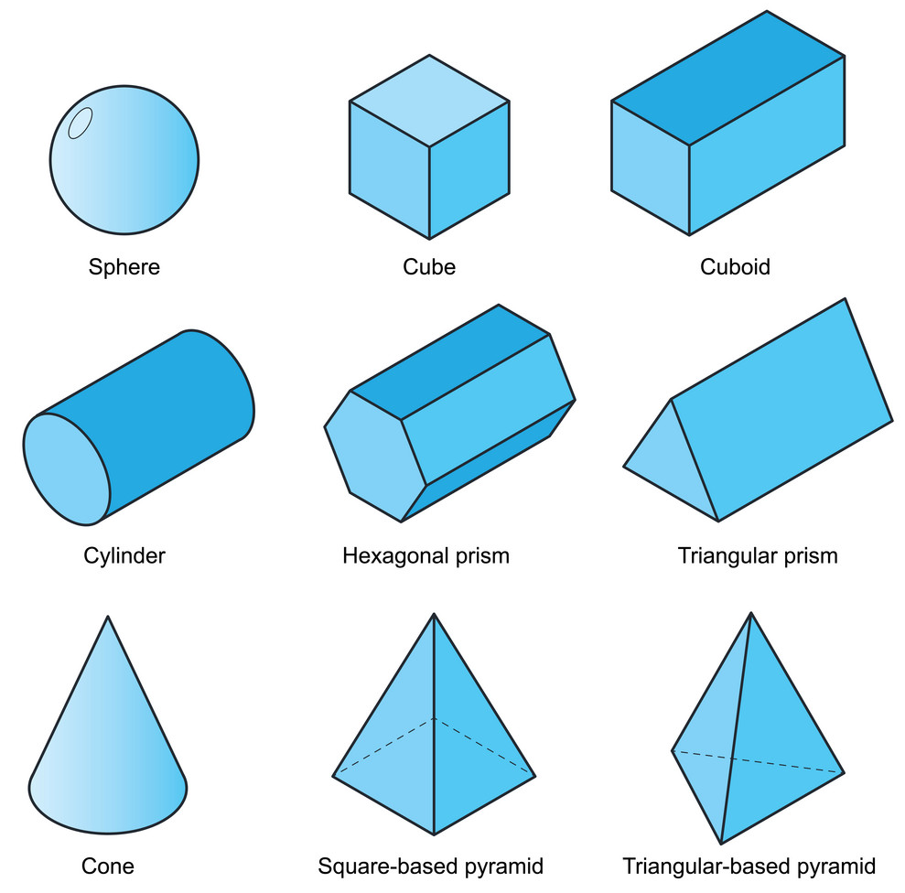
5-5 3-D Figures
Key Concepts

Slide 33
5-5 Examples

Slide 34
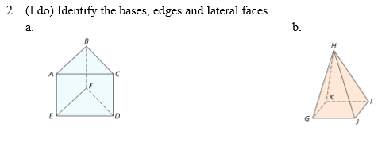
5-5 Examples

Slide 35
5-5 Examples

Slide 36
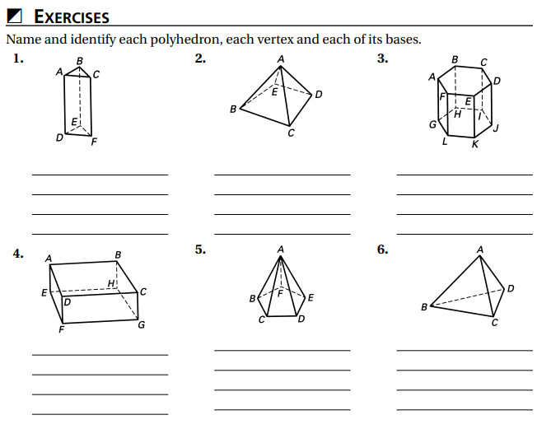
Independent Practice/Lesson Check 5-5

Slide 37
Independent Practice/Lesson Check 5-5

Slide 38
Chapter 5 Perimeter, Circumference, & Area Standard
B.G.GMD.A.1 Use relationships involving area, perimeter, and volume of geometric figures to compute another measure.
B.G.MG.A.1 Use appropriate technology to find the mathematical model for a set of non-linear data.
B.G.GMD.A.3 Apply a variety of strategies using relationships between perimeter, area, and volume to calculate desired measures in composite figures (i.e., combinations of basic figures).
B.G.MG.A.2 Solve problems involving surface area and volume in real-world
context.
.

Slide 39
5-6 Surface Area of Three-Dimensional Figures Objectives
The amount of space filling an object .
SWBAT analyze three-dimensional figures IOT determine the surface area and volume.
Name and identify parts needed
Figures having length, with and height
The amount it takes to cover a geometric figure.

Slide 40
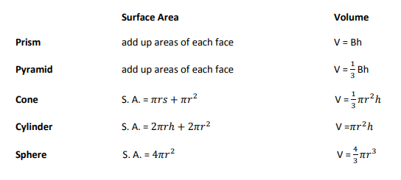
5-6 Surface Area
Key Concepts

Slide 41
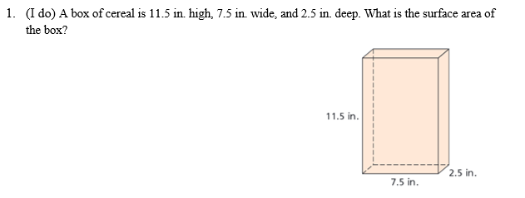
5-6 Examples

Slide 42
5-6 Examples

Slide 43
5-6 Examples

Slide 44
5-6 Examples

Slide 45
5-6 Examples

Slide 46
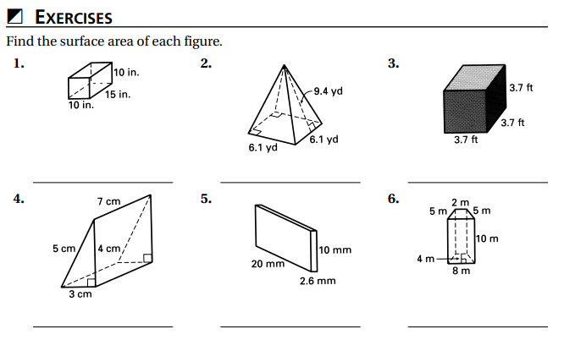
Independent Practice/Lesson Check 5-6

Slide 47
Independent Practice/Lesson Check 5-6

Slide 48
Chapter 5 Perimeter, Circumference, & Area Standard
B.G.GMD.A.1 Use relationships involving area, perimeter, and volume of geometric figures to compute another measure.
B.G.MG.A.1 Use appropriate technology to find the mathematical model for a set of non-linear data.
B.G.GMD.A.3 Apply a variety of strategies using relationships between perimeter, area, and volume to calculate desired measures in composite figures (i.e., combinations of basic figures).
B.G.MG.A.2 Solve problems involving surface area and volume in real-world
context.
.

Slide 49
5-7 Volume of Three-Dimensional Figures Objectives
The amount of space filling an object .
SWBAT analyze three-dimensional figures IOT determine the surface area and volume.
Name and identify parts needed
Figures having length, with and height
The amount it takes to cover a geometric figure.

Slide 50
5-7 Volume
Key Concepts

Slide 51
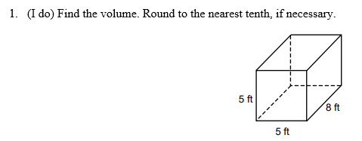
5-7 Examples

Slide 52
5-7 Examples

Slide 53
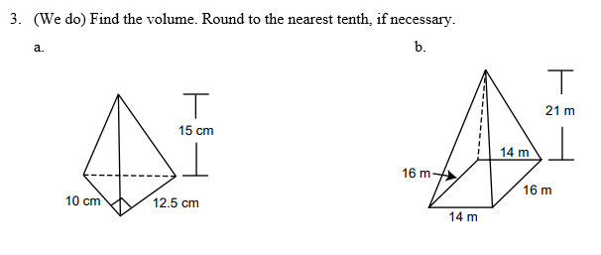
5-7 Examples

Slide 54
5-7 Examples

Slide 55
5-7 Examples

Slide 56
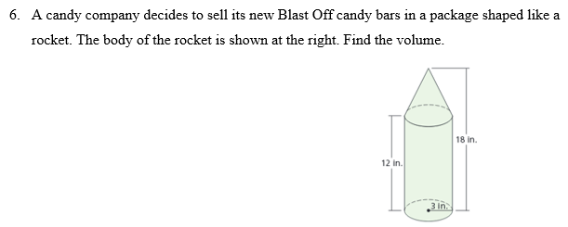
5-7 Examples

Slide 57
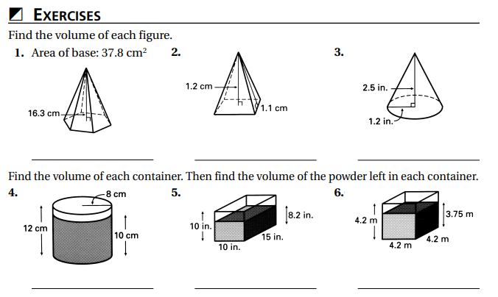
Independent Practice/Lesson Check 5-7

Slide 58
Independent Practice/Lesson Check 5-7

