Slide 1
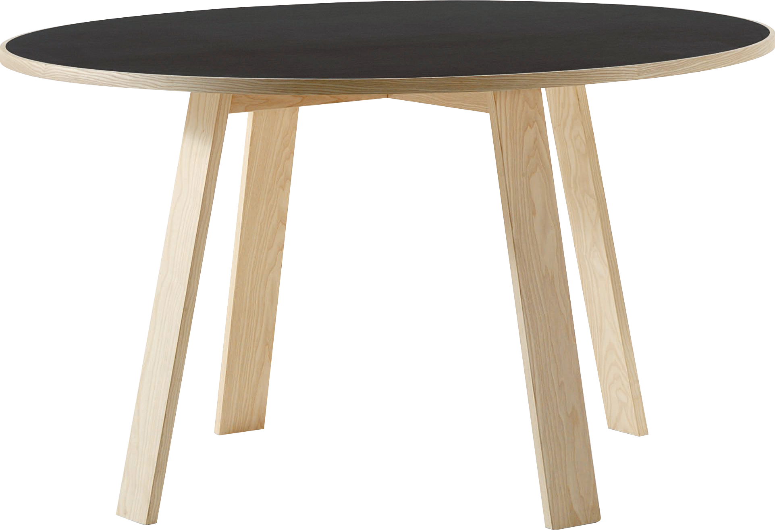
​
Welcome to Algebra 2
Mrs. Carter's Website
Delta Math

Slide 2
Chapter 6 Overview Linear Systems of Equations
Lessons
6-1 Slope of a Line & Slope-Intercept Form
6-3 Write Equations for Lines
6-4 Systems of Equations
6-5 Solving Systems of Equations by Substitution
6-6 Solving Systems by Adding & Multiplying
6-7 Solving Systems of Equations Using Matrices
6-8 Systems of Inequalities
Activities
Bell Work
Notes
Real World Applications
Assignments
Complete & Submit Bell work
Complete & Submit Delta Math
Work on Challenge Questions
Study: Complete Independent Practice

Slide 3
Chapter 6 Linear Systems of Equations Standards
B.S.ID.C.4 Interpret the slope (rate of change) and the intercept (constant term) of a linear model in the context of the data
B.F.IF.C.4 Graph linear, quadratic, absolute value, and piecewise functions expressed symbolically and show key features of the graph, by hand in simple cases and using technology for more complicated ones.
B.N.Q.A.1 Use units as a way to understand problems and to guide the solution of multi-step problems; choose and interpret units consistently in formulas; choose and interpret the scale and the origin in graphs and data displays.
B.A.CED.A.3 Rearrange formulas to highlight a quantity of interest, using the same reasoning as in solving equations
B.A.REI.C.3 Solve and explain the solutions to a system of equations using a variety of representations including combinations of linear and non-linear equations.
B.A.CED.A.2 Create equations in two or more variables to represent relationships between quantities.
B.A.REI..D.5 Solve a linear inequality using multiple methods and interpret the solution as it applies to the context.

Slide 4
6-1 Slope of a Line & Slope-Intercept Form Objectives
Of or containing a line
As it relates to this situation
SWBAT use linear equations IOT solve problems in context.
SWBAT write the slope-intercept form of an equation IOT graph the equation.
y = mx + b, where m is the slope and b is the y-intercept.
Diagram that relates the domain and range

Slide 5
6-1 Slope of a Line & Slope-Intercept Form
Key Concepts
Slope
______________________- the steepness, or rise over run, or rate of change given by the formula $m=\frac{y_{2}−y_{1}}{x_{2}−x_{1}}$
______________________- the point in which the graph crosses the x-axis.
______________________- the point in which the graph crosses the y-axis.
______________________- $y=mx+b$, where m = slope and (0, b) is the y-intercept.
X-intercept
Y-intercept
Slope-Intercept form

Slide 6
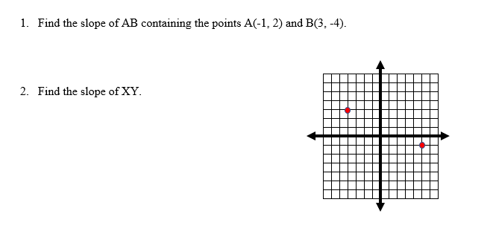
6-1 Examples
I do
X
Y

Slide 7
6-1 Examples
We do
3. Graph the line that passes through G(1, 1) and has a slope of $−\frac{3}{4}$.
4. Find the slope and y- intercept.
a. $y= \frac{2}{3}x−4$ b. $2x+3y=6$

Slide 8
6-1 Examples
We do
5. Write the equation for the line with the given slope and y-intercept.
a. m = 2, b = -4 b. m = 0, b = 1 c. m = $\frac{3}{4}$, b = 0

Slide 9
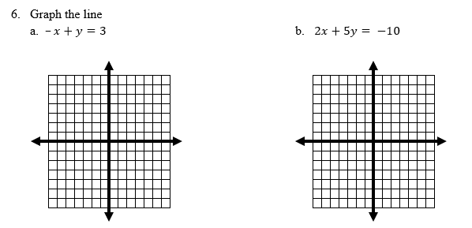
6-1 Examples
They do

Slide 10
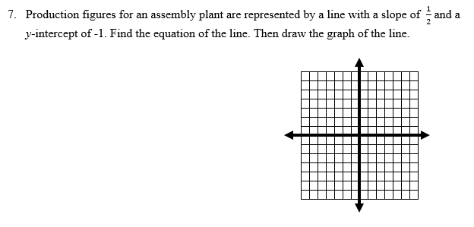
6-1 Examples

Slide 11
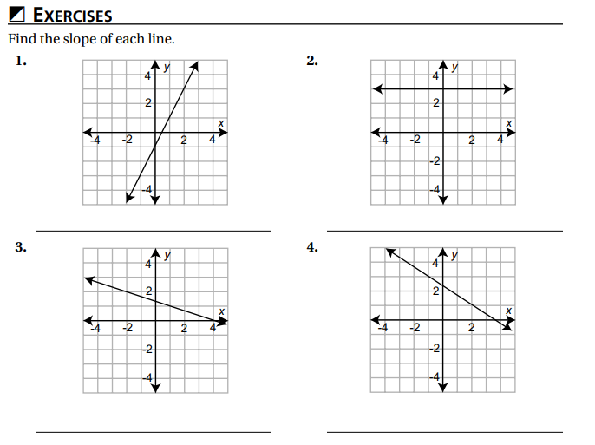
Independent Practice/Lesson Check 6-1

Slide 12
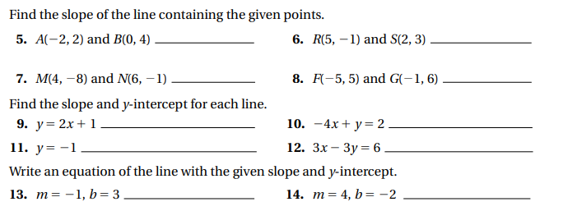
Independent Practice/Lesson Check 6-1 con’t

Slide 13
Independent Practice/Lesson Check 6-1

Slide 14
Independent Practice/Lesson Check 6-1 con’t

Slide 15
Chapter 6 Linear Systems of Equations Standards
B.S.ID.C.4 Interpret the slope (rate of change) and the intercept (constant term) of a linear model in the context of the data
B.F.IF.C.4 Graph linear, quadratic, absolute value, and piecewise functions expressed symbolically and show key features of the graph, by hand in simple cases and using technology for more complicated ones.
B.N.Q.A.1 Use units as a way to understand problems and to guide the solution of multi-step problems; choose and interpret units consistently in formulas; choose and interpret the scale and the origin in graphs and data displays.
B.A.CED.A.3 Rearrange formulas to highlight a quantity of interest, using the same reasoning as in solving equations
B.A.REI.C.3 Solve and explain the solutions to a system of equations using a variety of representations including combinations of linear and non-linear equations.
B.A.CED.A.2 Create equations in two or more variables to represent relationships between quantities.
B.A.REI..D.5 Solve a linear inequality using multiple methods and interpret the solution as it applies to the context.

Slide 16
6-3 Write Equations for Lines Objectives
$y−y_{1}=m(x−x_{1})$
As it relates to this situation
SWBAT write equations for lines in point-slope form IOT solve problems in context.

Slide 17
6-3 Write Equations for Lines
Key Concepts
Point-Slope Form
______________________- $y−y_{1}=m(x−x_{1})$ where m = slope and ($x_{1}, y_{1}$) is a point on the line.
______________________- $Ax+By=C$ where A, B and C are integer coefficients.
Standard Form

Slide 18
6-3 Examples
I do
Write an equation of the line with a slope of -2 and passes through the point P(-1, 3).
Write an equation of the line through A(1, -3) and B(3, 2).

Slide 19
6-3 Examples
We do
3. Write the equation of the line shown.
4. Write the equation $y=−\frac{1}{2}x+1$ in standard form.

Slide 20
6-3 Examples
We do
Write the equation of the line parallel to $y=−\frac{1}{3}x+1$ containing R(1, 1).
Write the equation of the line perpendicular $y=−\frac{1}{3}x+1$ containing R(1, 1).

Slide 21
6-3 Examples
They do
The temperature of water at the freezing point is 0$℃$ or 32$℉$. The temperature of water at the boiling point is 100$℃$ or 212$℉$. Use these two data points to find an equation to convert the temperature from Celsius to Fahrenheit.

Slide 22
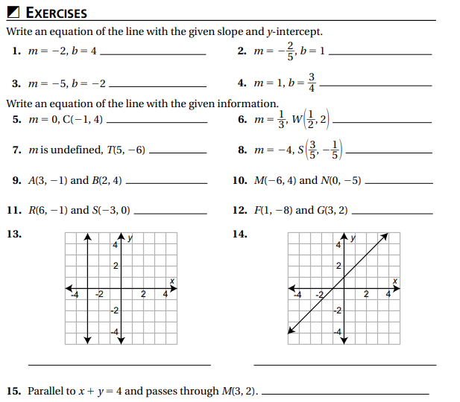
Independent Practice/Lesson Check 6-3

Slide 23
Independent Practice/Lesson Check 6-3

Slide 24
Chapter 6 Essential Algebra Standards
B.S.ID.C.4 Interpret the slope (rate of change) and the intercept (constant term) of a linear model in the context of the data
B.F.IF.C.4 Graph linear, quadratic, absolute value, and piecewise functions expressed symbolically and show key features of the graph, by hand in simple cases and using technology for more complicated ones.
B.N.Q.A.1 Use units as a way to understand problems and to guide the solution of multi-step problems; choose and interpret units consistently in formulas; choose and interpret the scale and the origin in graphs and data displays.
B.A.CED.A.3 Rearrange formulas to highlight a quantity of interest, using the same reasoning as in solving equations
B.A.REI.C.3 Solve and explain the solutions to a system of equations using a variety of representations including combinations of linear and non-linear equations.
B.A.CED.A.2 Create equations in two or more variables to represent relationships between quantities.
B.A.REI..D.5 Solve a linear inequality using multiple methods and interpret the solution as it applies to the context.

Slide 25
6-4 Systems of Equations Objective
Diagrams representing the relationship between independent and dependent variables.
2 equations consisting of 2 variables
SWBAT use graphical means IOT solve a linear system of equations.
SWBAT analyze a system IOT determine the number of solutions.
Rules used to solve equations

Slide 26
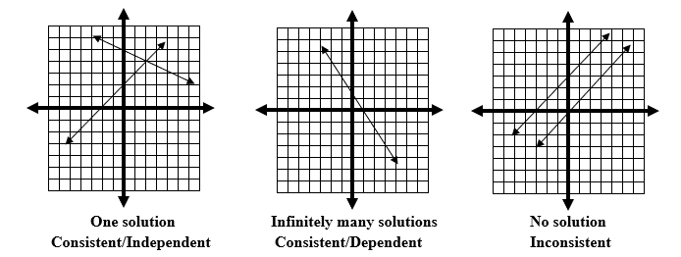
6-4 Systems of Equations
Key Concepts
Different slopes
Same slope & y-intercept
Same slope, different y-int

Slide 27
6-4 Systems of Equations
Key Concepts
System of Linear Equations
_____________________________- two linear equations with the same two variables.
______________________- the point of intersection of the lines in the system.
______________________- systems that have lines intersecting at one point.
______________________- systems in which the lines coincide and every point on the line is a solution. This system has infinitely many solutions.
______________________- systems that have lines that do not intersect.
Solution
Independent
Dependent
Inconsistent

Slide 28
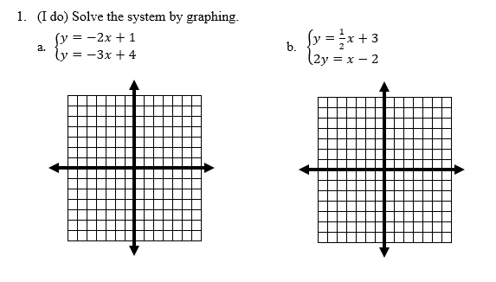
6-4 Examples

Slide 29
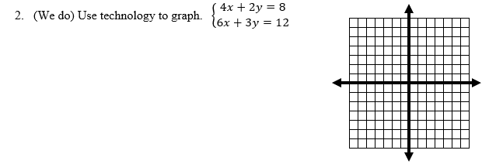
6-4 Examples

Slide 30
6-4 Examples

Slide 31
6-4 Examples

Slide 32
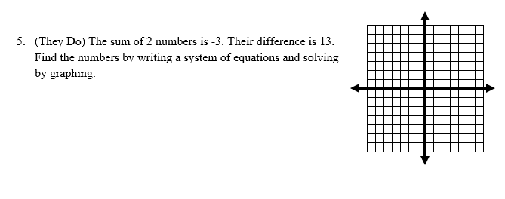
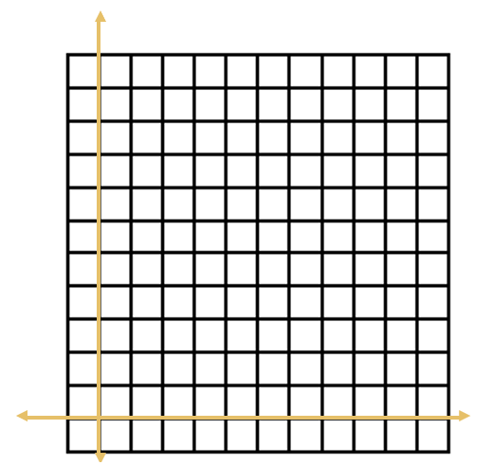
6-4 Examples

Slide 33
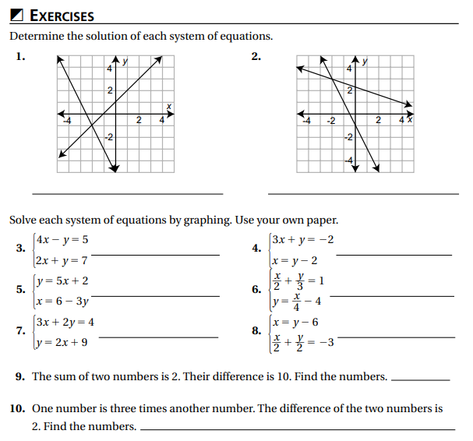
Independent Practice/Lesson Check 6-4

Slide 34
Independent Practice/Lesson Check 6-4

Slide 35
Chapter 6 Essential Algebra Standards
B.S.ID.C.4 Interpret the slope (rate of change) and the intercept (constant term) of a linear model in the context of the data
B.F.IF.C.4 Graph linear, quadratic, absolute value, and piecewise functions expressed symbolically and show key features of the graph, by hand in simple cases and using technology for more complicated ones.
B.N.Q.A.1 Use units as a way to understand problems and to guide the solution of multi-step problems; choose and interpret units consistently in formulas; choose and interpret the scale and the origin in graphs and data displays.
B.A.CED.A.3 Rearrange formulas to highlight a quantity of interest, using the same reasoning as in solving equations
B.A.REI.C.3 Solve and explain the solutions to a system of equations using a variety of representations including combinations of linear and non-linear equations.
B.A.CED.A.2 Create equations in two or more variables to represent relationships between quantities.
B.A.REI..D.5 Solve a linear inequality using multiple methods and interpret the solution as it applies to the context.

Slide 36
6-5 Solving Systems by Substitution Objective
Method of solving by replacing equivalent expressions for others.
2 equations consisting of 2 variables
SWBAT use substitution IOT solve a linear system of equations.

Slide 37
6-5 Solving Systems by Substitution
Key Concepts
Substitution
______________________- If a = b, a may replace b in any mathematical expression. This method can be used to solve systems of equations.
Steps for Solving Systems using Substitution:
Solve for one variable in one equation
Substitute that variable into the other equation.
Solve for a variable
Substitute the answer to solve for the other variable
Check your solution.

Slide 38
6-5 Examples

Slide 39
6-5 Examples

Slide 40
6-5 Examples
They do

Slide 41
Independent Practice/Lesson Check 6-5

Slide 42
Independent Practice/Lesson Check 6-5

Slide 43
Chapter 6 Essential Algebra Standards
B.S.ID.C.4 Interpret the slope (rate of change) and the intercept (constant term) of a linear model in the context of the data
B.F.IF.C.4 Graph linear, quadratic, absolute value, and piecewise functions expressed symbolically and show key features of the graph, by hand in simple cases and using technology for more complicated ones.
B.N.Q.A.1 Use units as a way to understand problems and to guide the solution of multi-step problems; choose and interpret units consistently in formulas; choose and interpret the scale and the origin in graphs and data displays.
B.A.CED.A.3 Rearrange formulas to highlight a quantity of interest, using the same reasoning as in solving equations
B.A.REI.C.3 Solve and explain the solutions to a system of equations using a variety of representations including combinations of linear and non-linear equations.
B.A.CED.A.2 Create equations in two or more variables to represent relationships between quantities.
B.A.REI..D.5 Solve a linear inequality using multiple methods and interpret the solution as it applies to the context.

Slide 44
6-6 Solving Systems by Elimination Objective
Method of solving that uses multiplication and addition to eliminate a variable.
2 equations consisting of 2 variables
SWBAT use elimination IOT solve a linear system of equations.

Slide 45
6-6 Solving Systems by Elimination
Key Concepts
Elimination
______________________- using the Addition Property of Equality or using additive inverses to cancel a variable.
Steps for Solving Systems using Elimination:
Put each equation in standard form
Modify (if needed) one or both equations so that a variable will be eliminated
Add equations
Solve for a variable
Substitute the variable back into an equation to solve for the other variable
Check your solution.

Slide 46
6-6 Examples

Slide 47
6-6 Examples

Slide 48
6-6 Examples
They do

Slide 49
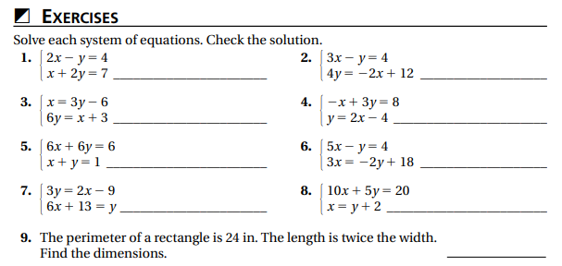
Independent Practice/Lesson Check 6-6

Slide 50
Independent Practice/Lesson Check 6-6

Slide 51
Chapter 6 Essential Algebra Standards
B.S.ID.C.4 Interpret the slope (rate of change) and the intercept (constant term) of a linear model in the context of the data
B.F.IF.C.4 Graph linear, quadratic, absolute value, and piecewise functions expressed symbolically and show key features of the graph, by hand in simple cases and using technology for more complicated ones.
B.N.Q.A.1 Use units as a way to understand problems and to guide the solution of multi-step problems; choose and interpret units consistently in formulas; choose and interpret the scale and the origin in graphs and data displays.
B.A.CED.A.3 Rearrange formulas to highlight a quantity of interest, using the same reasoning as in solving equations
B.A.REI.C.3 Solve and explain the solutions to a system of equations using a variety of representations including combinations of linear and non-linear equations.
B.A.CED.A.2 Create equations in two or more variables to represent relationships between quantities.
B.A.REI..D.5 Solve a linear inequality using multiple methods and interpret the solution as it applies to the context.

Slide 52
6-7 Solving Systems Using Matrices Objective
Rectangular array of elements.
2 equations consisting of 2 variables
SWBAT use matrices IOT solve a linear system of equations.

Slide 53
6-7 Solving Systems Using Matrices
Key Concepts
Matrix
______________________- a rectangular array of elements.
Steps for Solving Systems using a Matrix:
Put each equation in standard form.
Write the system of equations as a matrix.
Enter matrix into calculator.
Use Rref command to solve matrix.
The solution will be in the last column of the reduced matrix.
Check your solution.

Slide 54
6-7 Examples

Slide 55
6-7 Examples

Slide 56
6-7 Examples
They do
Enterprise Rental charges $25 per day plus $0.35 per mile. Avis charges $35 per day plus $0.25 per mile. Carter determines the trip he needs to take will cost $230 with Enterprise and $250 with Avis. How many miles and for how many days will Carter’s trip be?

Slide 57
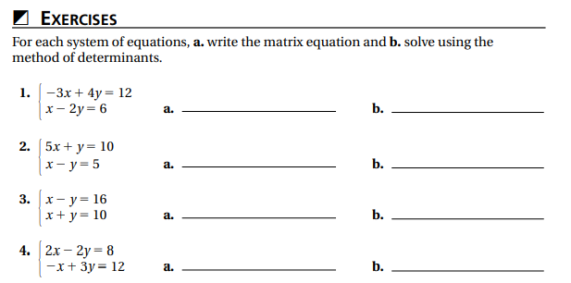
Independent Practice/Lesson Check 6-7

Slide 58
Independent Practice/Lesson Check 6-7

Slide 59
Chapter 6 Essential Algebra Standards
B.S.ID.C.4 Interpret the slope (rate of change) and the intercept (constant term) of a linear model in the context of the data
B.F.IF.C.4 Graph linear, quadratic, absolute value, and piecewise functions expressed symbolically and show key features of the graph, by hand in simple cases and using technology for more complicated ones.
B.N.Q.A.1 Use units as a way to understand problems and to guide the solution of multi-step problems; choose and interpret units consistently in formulas; choose and interpret the scale and the origin in graphs and data displays.
B.A.CED.A.3 Rearrange formulas to highlight a quantity of interest, using the same reasoning as in solving equations
B.A.REI.C.3 Solve and explain the solutions to a system of equations using a variety of representations including combinations of linear and non-linear equations.
B.A.CED.A.2 Create equations in two or more variables to represent relationships between quantities.
B.A.REI..D.5 Solve a linear inequality using multiple methods and interpret the solution as it applies to the context.

Slide 60
6-8 Systems of Inequalities Objective
Create an equation or inequality for a situation
2 inequalities consisting of 2 variables
SWBAT model a real-world situation using systems of linear inequalities.
SWBAT use graphs to solve a system of linear inequalities.
Diagrams representing the relationship between independent and dependent variables.

Slide 61
6-8 Systems of Inequalities
Key Concepts
System of Linear Inequalities
_________________________________- two or more inequalities with the same variables.
______________________- the intersection of the graphs of the inequalities.
Solution Set

Slide 62
6-8 Examples

Slide 63
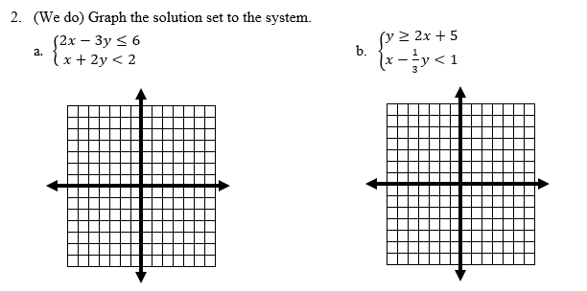
6-8 Examples

Slide 64
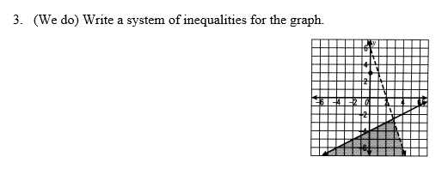
6-8 Examples

Slide 65
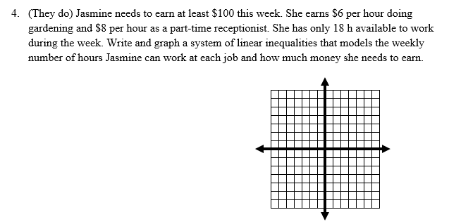
6-8 Examples

Slide 66
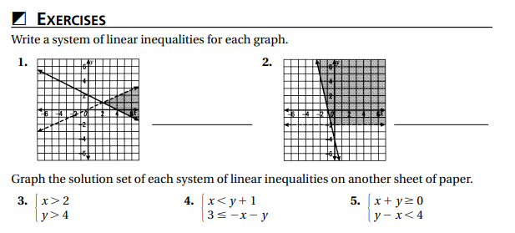
Independent Practice/Lesson Check 6-8

Slide 67
Independent Practice/Lesson Check 6-8

Slide 68
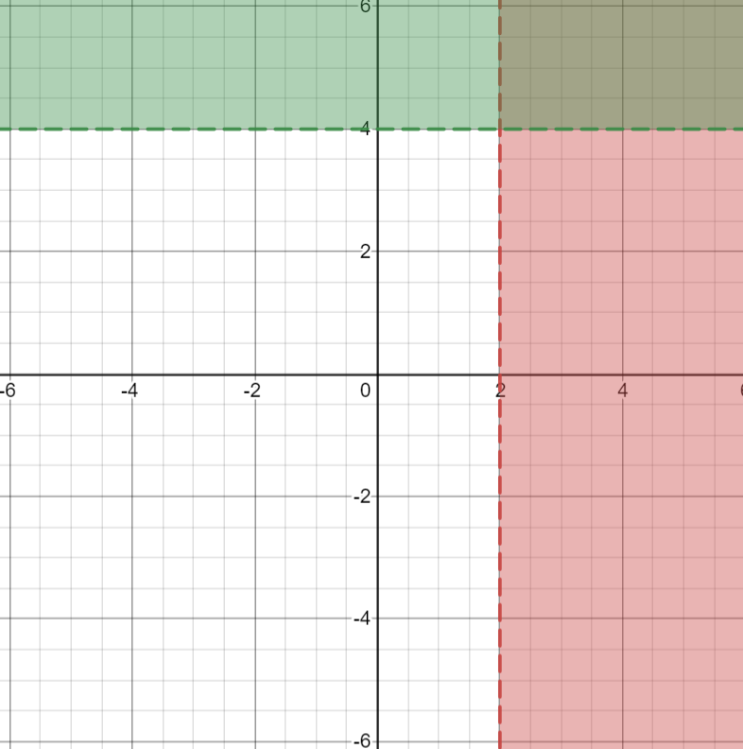
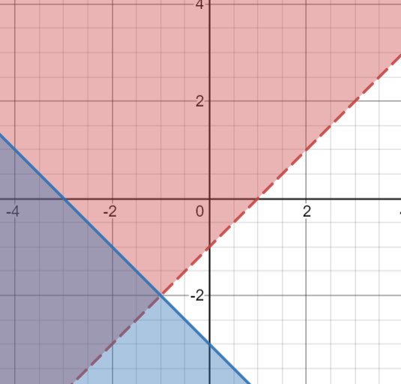
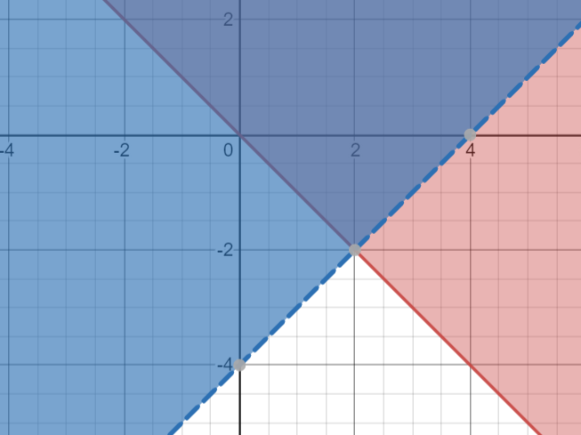
Independent Practice/Lesson Check 6-8

