Slide 1
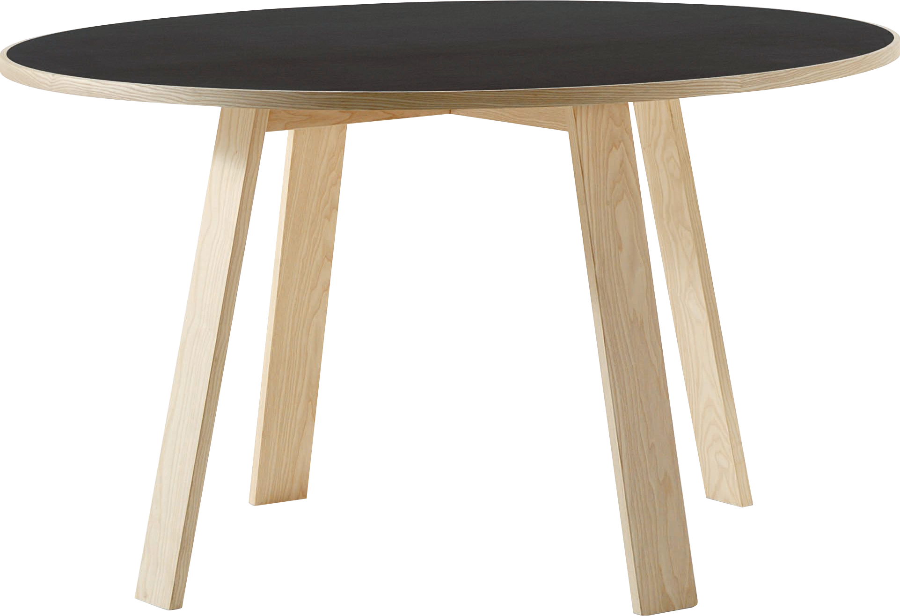
​
Welcome to Algebra 2
Mrs. Carter's Website
Delta Math

Slide 2
Chapter 7 Overview Similarity
Lessons
5-1 Ratios and Units of Measure
7-1 Ratios and Proportions
7-2 Similar Polygons
7-3 Scale Drawings
7-4 Postulates for Similar Triangles
7-5 Triangles and Proportional Segments
7-6 Parallel Lines and Proportional Segments
7-7 Problem Solving Skills: Indirect Measurements
Activities
Bell Work
Notes
Real World Applications
Assignments
Complete & Submit Bell work
Complete & Submit Delta Math
Work on Challenge Questions
Study: Complete Independent Practice

Slide 3
Chapter 7 Similarity Standards
B.A.SSE.A.2 Use algebraic structures to solve problems involving proportional reasoning in real-world context.
B.A.REI.A.1 Build functions and write expressions, equations, and inequalities for common algebra settings leading to a solution in context (e.g., rate and distance problems and problems that can be solved using proportions).
B.G.SRT.A.1 Apply similar triangles to solve problems, such as finding heights and distances.

Slide 4
5-1 Ratios & Units of Measure Objectives
A comparison of two or more quantities
SWBAT use ratios and rates IOT solve problems.
A comparison of two or more quantities

Slide 5
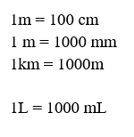
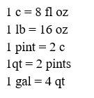
5-1 Ratios & Units of Measure
Key Concepts
Customary Units
Metric Units

Slide 6
5-1 Ratios & Units of Measure
Key Concepts
______________________- a ratio that compares two quantities.
______________________- a rate that has 1 as the denominator.
______________________- units used to measure lengths and distances. They include inches, feet, yards, and miles
______________________- this system is used around the world and includes meters.
Rate
Unit Rate
Customary Units
Metric System

Slide 7
5-1 Examples
I do

Slide 8
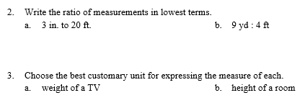
5-1 Examples
We do

Slide 9
5-1 Examples
We do

Slide 10
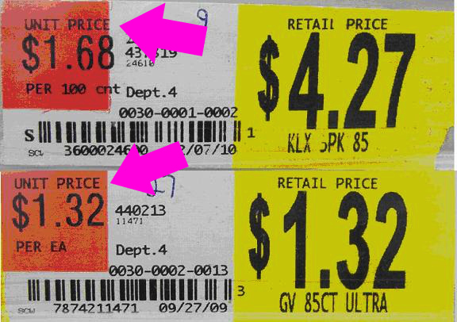
5-1 Examples

Slide 11
5-1 Examples
They do

Slide 12
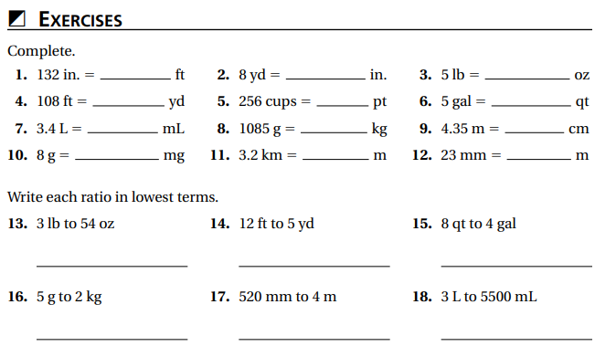
Independent Practice/Lesson Check 5-1

Slide 13
Independent Practice/Lesson Check 5-1

Slide 14
Chapter 7 Similarity Standards
B.A.SSE.A.2 Use algebraic structures to solve problems involving proportional reasoning in real-world context.
B.A.REI.A.1 Build functions and write expressions, equations, and inequalities for common algebra settings leading to a solution in context (e.g., rate and distance problems and problems that can be solved using proportions).
B.G.SRT.A.1 Apply similar triangles to solve problems, such as finding heights and distances.

Slide 15
7-1 Ratios & Units of Measure Objectives
A rate with 1 in the denominator
Having equal values
SWBAT find equivalent ratios IOT determine the unit rate.
SWBAT use ratios and proportions IOT solve problems.
A comparison of two or more quantities
An equation stating two ratios are equivalent

Slide 16
7-1 Ratios & Units of Measure
Key Concepts

Slide 17
7-1 Examples

Slide 18
7-1 Examples

Slide 19
7-1 Examples

Slide 20
7-1 Examples

Slide 21
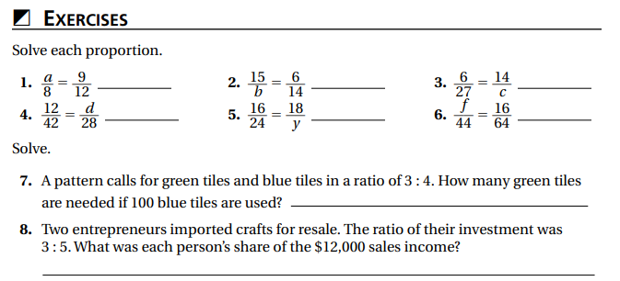
Independent Practice/Lesson Check 7-1

Slide 22
Independent Practice/Lesson Check 7-1

Slide 23
Chapter 7 Similarity Standards
B.A.SSE.A.2 Use algebraic structures to solve problems involving proportional reasoning in real-world context.
B.A.REI.A.1 Build functions and write expressions, equations, and inequalities for common algebra settings leading to a solution in context (e.g., rate and distance problems and problems that can be solved using proportions).
B.G.SRT.A.1 Apply similar triangles to solve problems, such as finding heights and distances.

Slide 24
7-2 Similar Polygons Objectives
Having the same shape, but not necessarily the same size.
SWBAT identify similar polygons IOT find unknown measures of similar polygons.

Slide 25
7-2 Similar Polygons
Key Concepts

Slide 26
7-2 Examples

Slide 27
7-2 Examples

Slide 28
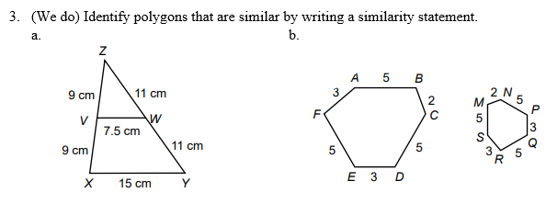
7-2 Examples

Slide 29
7-2 Examples

Slide 30
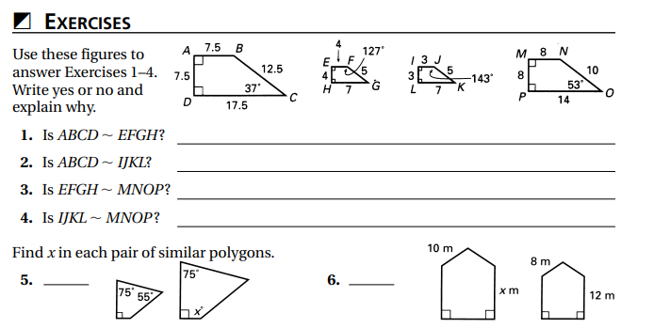
Independent Practice/Lesson Check 7-2

Slide 31
Independent Practice/Lesson Check 7-2

Slide 32
Chapter 7 Similarity Standards
B.A.SSE.A.2 Use algebraic structures to solve problems involving proportional reasoning in real-world context.
B.A.REI.A.1 Build functions and write expressions, equations, and inequalities for common algebra settings leading to a solution in context (e.g., rate and distance problems and problems that can be solved using proportions).
B.G.SRT.A.1 Apply similar triangles to solve problems, such as finding heights and distances.

Slide 33
7-3 Scale Drawings Objectives
Having equal values
SWBAT use scale drawings IOT find actual or scale length.

Slide 34
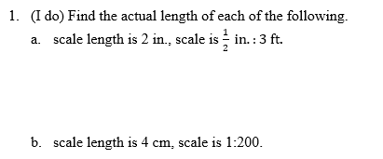
7-3 Examples

Slide 35
7-3 Examples

Slide 36
7-3 Examples

Slide 37
7-3 Examples

Slide 38
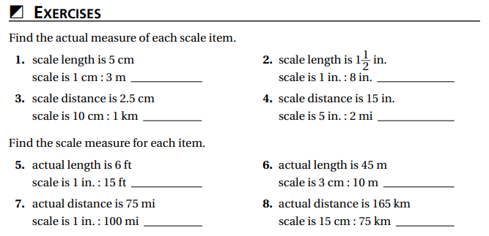
Independent Practice/Lesson Check 7-3

Slide 39
Independent Practice/Lesson Check 7-3

Slide 40
Chapter 7 Similarity Standards
B.A.SSE.A.2 Use algebraic structures to solve problems involving proportional reasoning in real-world context.
B.A.REI.A.1 Build functions and write expressions, equations, and inequalities for common algebra settings leading to a solution in context (e.g., rate and distance problems and problems that can be solved using proportions).
B.G.SRT.A.1 Apply similar triangles to solve problems, such as finding heights and distances.

Slide 41
7-4 Postulates & Similar Triangles Objectives
Rules used to determine whether tringles are similar
SWBAT use the AA, SSS, and SAS similarity postulates IOT determine if two triangles are similar and solve problems using similar triangles.
Having the same size and shape

Slide 42
7-4 Postulates & Similar Triangles
Key Concepts

Slide 43
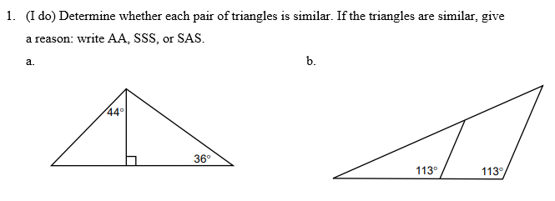
7-4 Examples

Slide 44
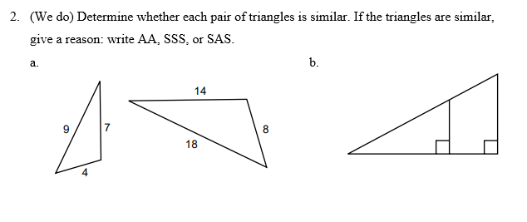
7-4 Examples

Slide 45
7-4 Examples

Slide 46
7-4 Examples

Slide 47
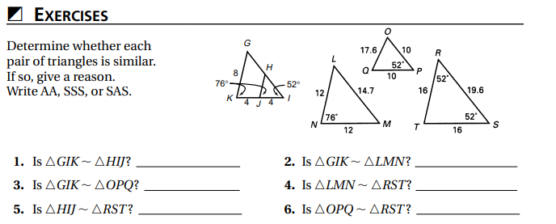
Independent Practice/Lesson Check 7-4

Slide 48
Independent Practice/Lesson Check 7-4

Slide 49
Chapter 7 Similarity Standards
B.A.SSE.A.2 Use algebraic structures to solve problems involving proportional reasoning in real-world context.
B.A.REI.A.1 Build functions and write expressions, equations, and inequalities for common algebra settings leading to a solution in context (e.g., rate and distance problems and problems that can be solved using proportions).
B.G.SRT.A.1 Apply similar triangles to solve problems, such as finding heights and distances.

Slide 50
7-5 Triangles & Proportional Segments Objectives
Having the same size, but not necessarily the same size
SWBAT prove triangles are similar IOT find unknown measures of sides of triangles.

Slide 51
7-5 Examples

Slide 52
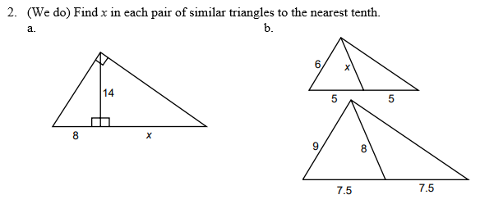
7-5 Examples

Slide 53
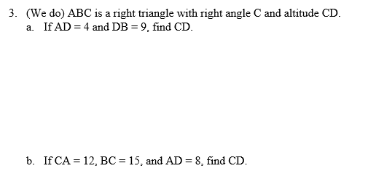
7-5 Examples

Slide 54
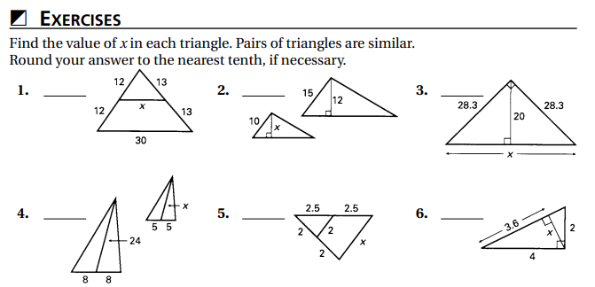
Independent Practice/Lesson Check 7-5

Slide 55
Independent Practice/Lesson Check 7-5

Slide 56
Chapter 7 Similarity Standards
B.A.SSE.A.2 Use algebraic structures to solve problems involving proportional reasoning in real-world context.
B.A.REI.A.1 Build functions and write expressions, equations, and inequalities for common algebra settings leading to a solution in context (e.g., rate and distance problems and problems that can be solved using proportions).
B.G.SRT.A.1 Apply similar triangles to solve problems, such as finding heights and distances.

Slide 57
7-6 Parallel Lines & Proportional Segments Objectives
Having the same size, but not necessarily the same size
SWBAT prove triangles are similar IOT find unknown measures of sides of triangles.

Slide 58
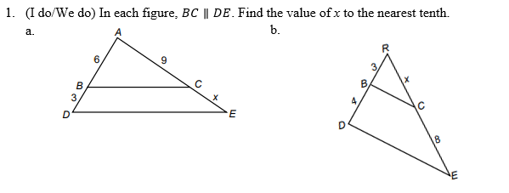
7-6 Examples

Slide 59
7-6 Examples
We do #1 con’t

Slide 60
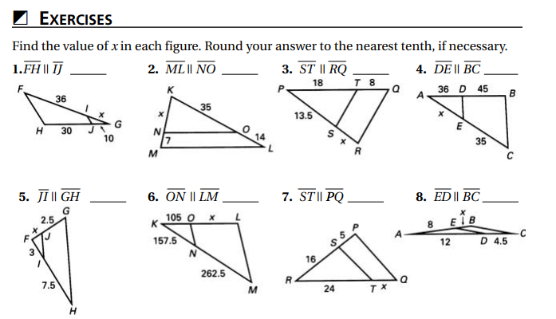
Independent Practice/Lesson Check 7-6

Slide 61
Independent Practice/Lesson Check 7-6

Slide 62
Chapter 7 Similarity Standards
B.A.SSE.A.2 Use algebraic structures to solve problems involving proportional reasoning in real-world context.
B.A.REI.A.1 Build functions and write expressions, equations, and inequalities for common algebra settings leading to a solution in context (e.g., rate and distance problems and problems that can be solved using proportions).
B.G.SRT.A.1 Apply similar triangles to solve problems, such as finding heights and distances.

Slide 63
7-7 Indirect Measurement Objectives
Method of finding lengths without measuring.
SWBAT use indirect measurement IOT solve problems.

Slide 64
7-7 Examples

Slide 65
7-7 Examples

Slide 66
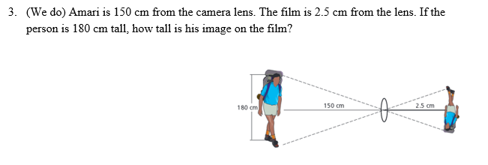
7-7 Examples

Slide 67
7-7 Examples

Slide 68
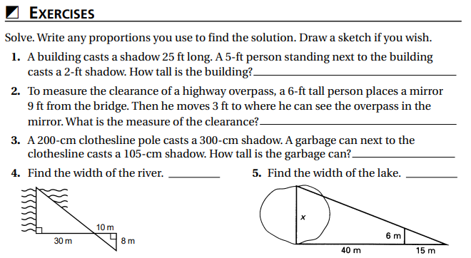
Independent Practice/Lesson Check 7-7

Slide 69
Independent Practice/Lesson Check 7-7

