Slide 1
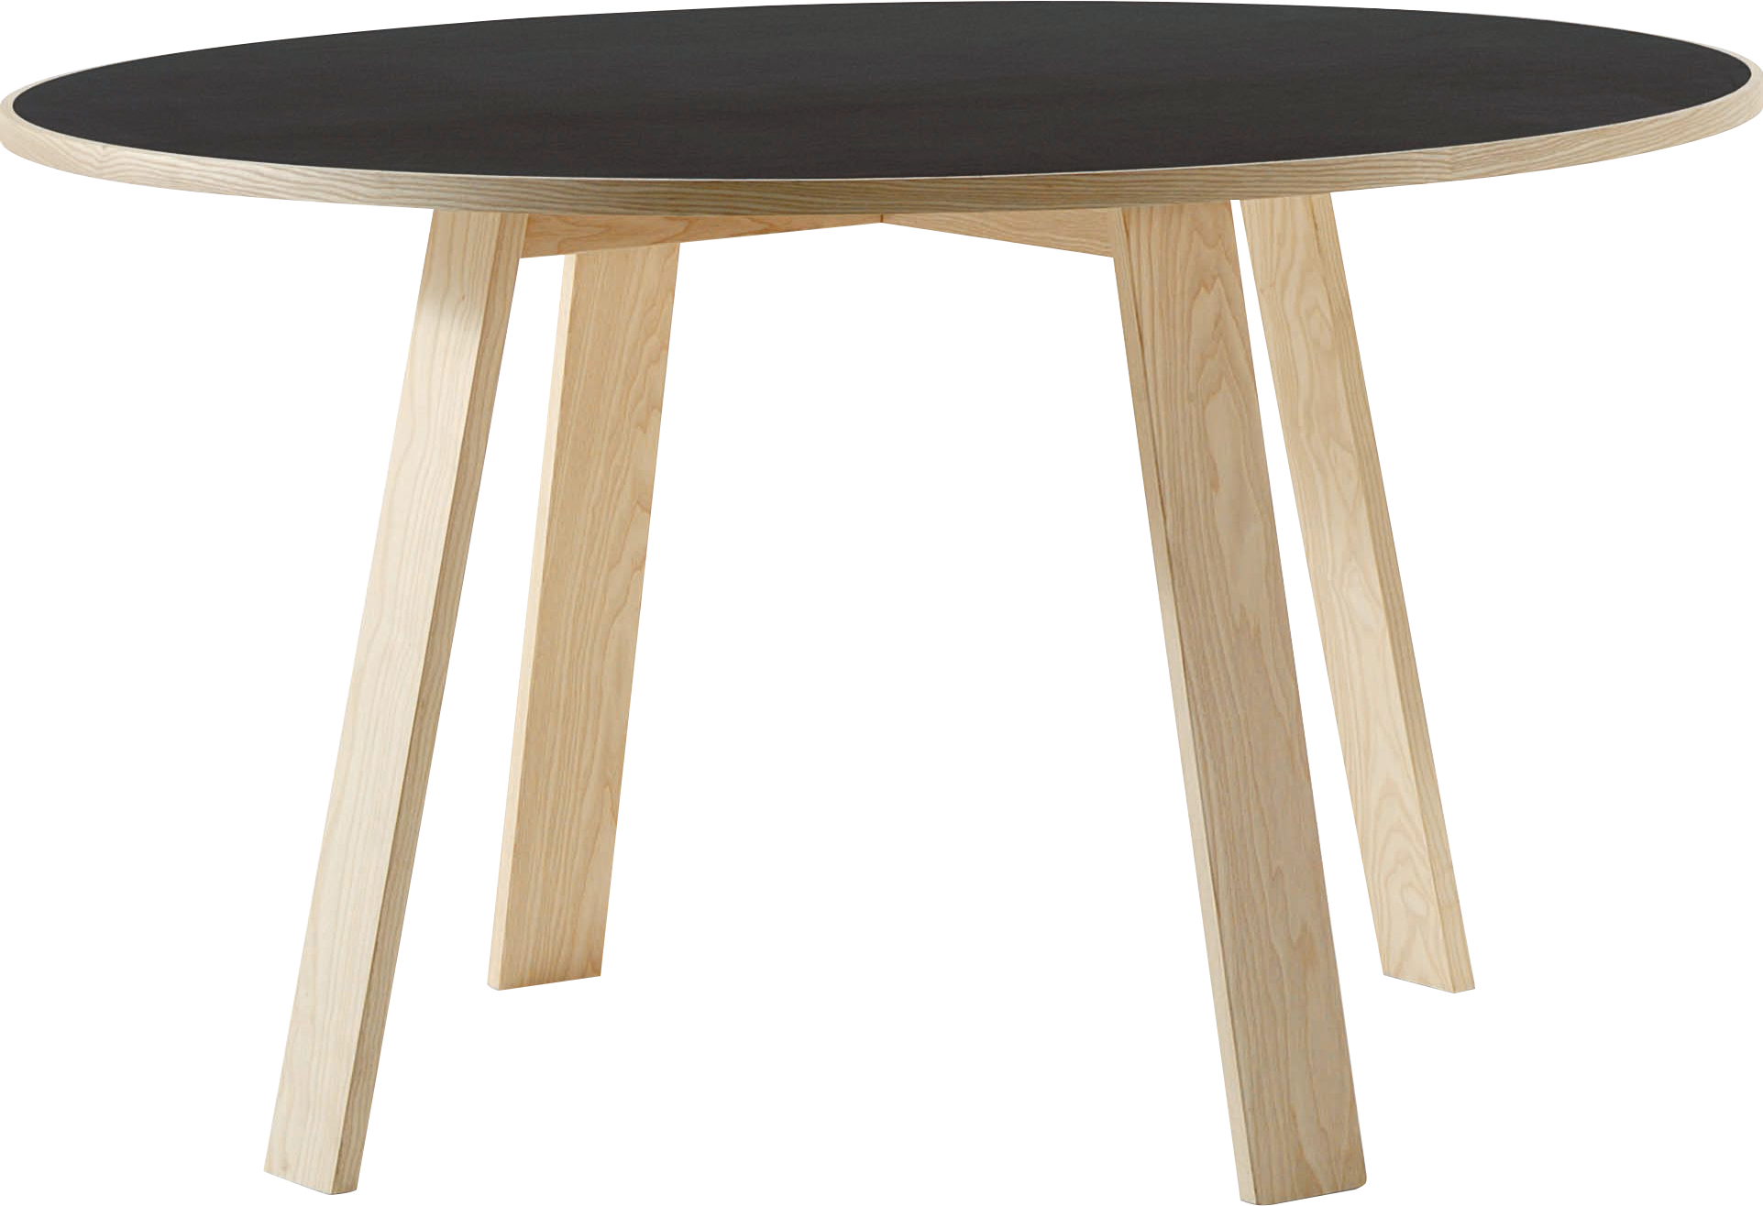
​
Welcome to Algebra 2
Mrs. Carter's Website
Delta Math

Slide 2
Chapter 9 Overview Percent & Probability
Lessons
9-1 Percent & Probability
9-3 Compound Events
9-4 Independent & Dependent Events
9-5 Permutations & Combinations
9-7 Box & Whisker Plots
9-8 Regression Models
Activities
Bell Work
Notes
Real World Applications
Assignments
Complete & Submit Bell work
Complete & Submit Delta Math
Work on Challenge Questions
Study: Complete Independent Practice

Slide 3
Chapter 9 Percent & Probability
B.S.CP.A.1 Understand and use basic counting techniques in contextual settings.
B.S.CP.A.2 Compute a probability when the event and/or sample space are not given or obvious.
B.S.CP.A.3 Recognize the concepts of conditional and joint probability in real world events.
B.S.CP.A.4 Recognize the concept of independence expressed in real-world contexts.
B.S.ID.A.1 Use statistics appropriate to the shape of the data to compare center (median, mean) and spread (interquartile range, standard deviation) of two or more different data sets.
B.S.ID.B2 Interpret and use data from tables, chart, and graphs.

Slide 4
9-1 Percent & Probability Objective
Common methods used to calculate probability
The likelihood an event will occur
SWBAT use theoretical, experimental and simulation methods IOT find the probability of an event.

Slide 5
9-1 Percent & Probability
Key Concepts
Simulation
___________________________________- a model of an event used to estimate the experimental probability of an event.
___________________________________- the set of all possible outcomes in an experiment.
__________________________________________________- when each outcome in a sample space has the same chance of occurring.
Simulation
Equally Likely Outcomes

Slide 6
9-1 Examples

Slide 7
9-1 Examples

Slide 8
9-1 Examples

Slide 9
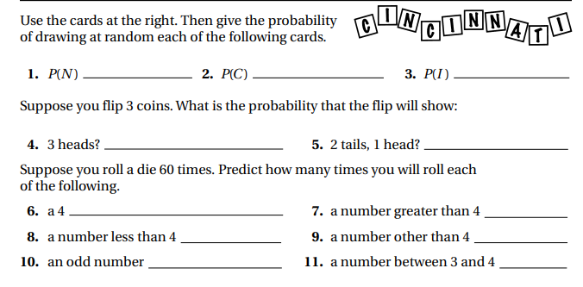
Independent Practice/Lesson Check 9-1

Slide 10
Independent Practice/Lesson Check 9-1

Slide 11
Chapter 9 Percent & Probability
B.S.CP.A.1 Understand and use basic counting techniques in contextual settings.
B.S.CP.A.2 Compute a probability when the event and/or sample space are not given or obvious.
B.S.CP.A.3 Recognize the concepts of conditional and joint probability in real world events.
B.S.CP.A.4 Recognize the concept of independence expressed in real-world contexts.
B.S.ID.A.1 Use statistics appropriate to the shape of the data to compare center (median, mean) and spread (interquartile range, standard deviation) of two or more different data sets.
B.S.ID.B2 Interpret and use data from tables, chart, and graphs.

Slide 12
9-3 Compound Events 9-4 Independent Events Objective
More than one outcome
SWBAT use theoretical and experimental probabilities IOT find the probability of a compound event.
SWBAT use theoretical and experimental probabilities IOT to determine whether events are independent or dependent
The likelihood an event will occur
Affected by the occurrence of other events
Unaffected by the occurrence of other events

Slide 13
9-3/9-4 Compound Events/Independent Events
Key Concepts
Dependent
______________________________________ - when the occurrence of one event affects how a second event can occur.
______________________________________- when the occurrence of one event does not affect how a second event can occur.
______________________________________- two events that cannot happen at the same time.
Independent
Mutually Exclusive

Slide 14
9-3/9-4 Examples

Slide 15
9-3/9-4 Examples

Slide 16
9-3/9-4 Examples

Slide 17
9-3/9-4 Examples

Slide 18
9-3/9-4 Examples

Slide 19
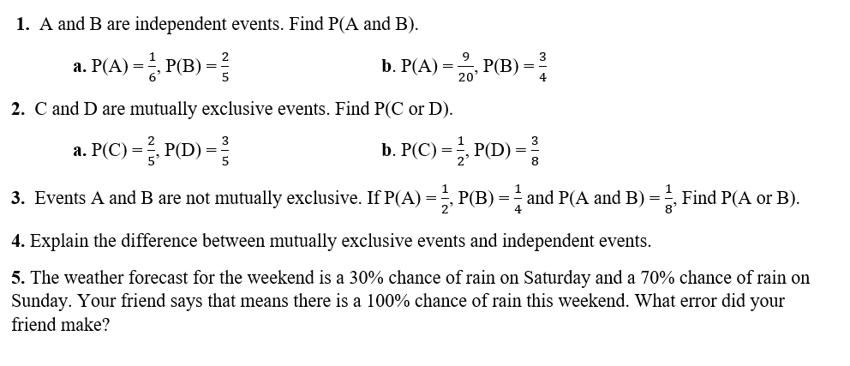
Independent Practice/Lesson Check 9-3/9-4

Slide 20
Independent Practice/Lesson Check 9-3/9-4

Slide 21
Chapter 9 Percent & Probability
B.S.CP.A.1 Understand and use basic counting techniques in contextual settings.
B.S.CP.A.2 Compute a probability when the event and/or sample space are not given or obvious.
B.S.CP.A.3 Recognize the concepts of conditional and joint probability in real world events.
B.S.CP.A.4 Recognize the concept of independence expressed in real-world contexts.
B.S.ID.A.1 Use statistics appropriate to the shape of the data to compare center (median, mean) and spread (interquartile range, standard deviation) of two or more different data sets.
B.S.ID.B2 Interpret and use data from tables, chart, and graphs.

Slide 22
9-5 Permutations & Combinations Objective
A method use to count items using multiplication
An arrangement in which the order does matter
SWBAT use the fundamental counting principle to determine the number of permutations and combinations.
An arrangement in which the order does not matter

Slide 23
9-5 Permutations & Combinations
Key Concepts
Fundamental Counting Principle
______________________________________________________ describes the method of using multiplication to count.
nPr-the number of ______________________________of n items in a set arranged r items at a time. (order matters)
nCr-the number of ______________________________of n items in a set chosen r items at a time. (order does NOT matter)
______________________$n!=n\left(n−1\right)∙…∙3∙2∙1$
Permutation
Combination
Factorial

Slide 24
9-5 Examples

Slide 25
9-5 Examples

Slide 26
9-5 Examples

Slide 27
Independent Practice/Lesson Check 9-5

Slide 28
Independent Practice/Lesson Check 9-5

Slide 29
Chapter 9 Percent & Probability
B.S.CP.A.1 Understand and use basic counting techniques in contextual settings.
B.S.CP.A.2 Compute a probability when the event and/or sample space are not given or obvious.
B.S.CP.A.3 Recognize the concepts of conditional and joint probability in real world events.
B.S.CP.A.4 Recognize the concept of independence expressed in real-world contexts.
B.S.ID.A.1 Use statistics appropriate to the shape of the data to compare center (median, mean) and spread (interquartile range, standard deviation) of two or more different data sets.
B.S.ID.B2 Interpret and use data from tables, chart, and graphs.

Slide 30
9-6 thru 9-8 Analyzing Data Objective
Information presented in graph, table or written forms
SWBAT interpret and use data IOT analyze and compare data.

Slide 31
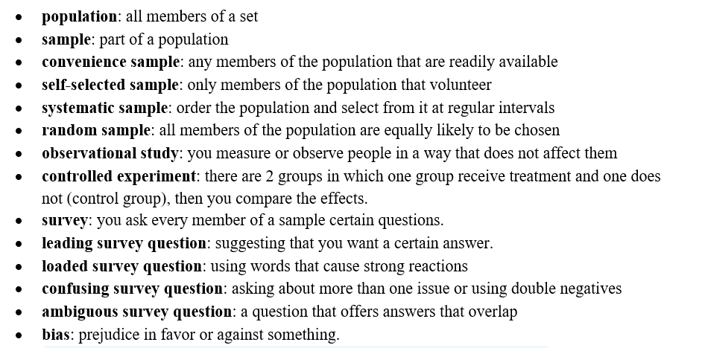
9-6 thru 9-8 Analyzing Data
Key Concepts

Slide 32
9-6 thru 9-8 Analyzing Data
Key Concepts

Slide 33
9-6 thru 9-8 Examples

Slide 34
9-6 thru 9-8 Examples

Slide 35
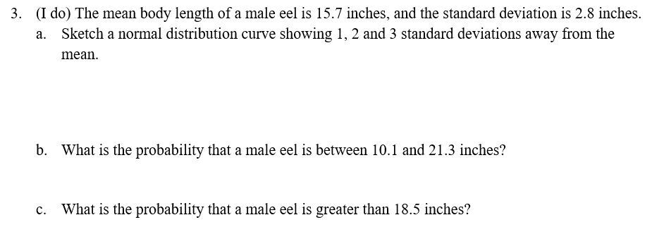
9-6 thru 9-8 Examples

Slide 36
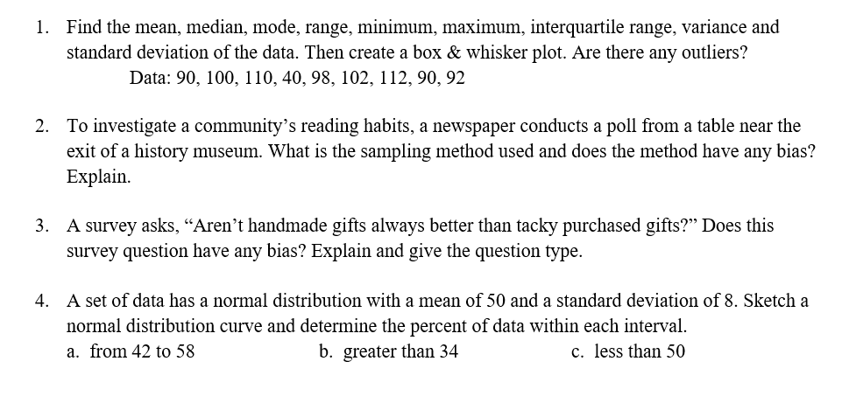
Independent Practice/Lesson Check 9-6 thru 9-8

Slide 37
Independent Practice/Lesson Check 9-6 thru 9-8

