Slide 1
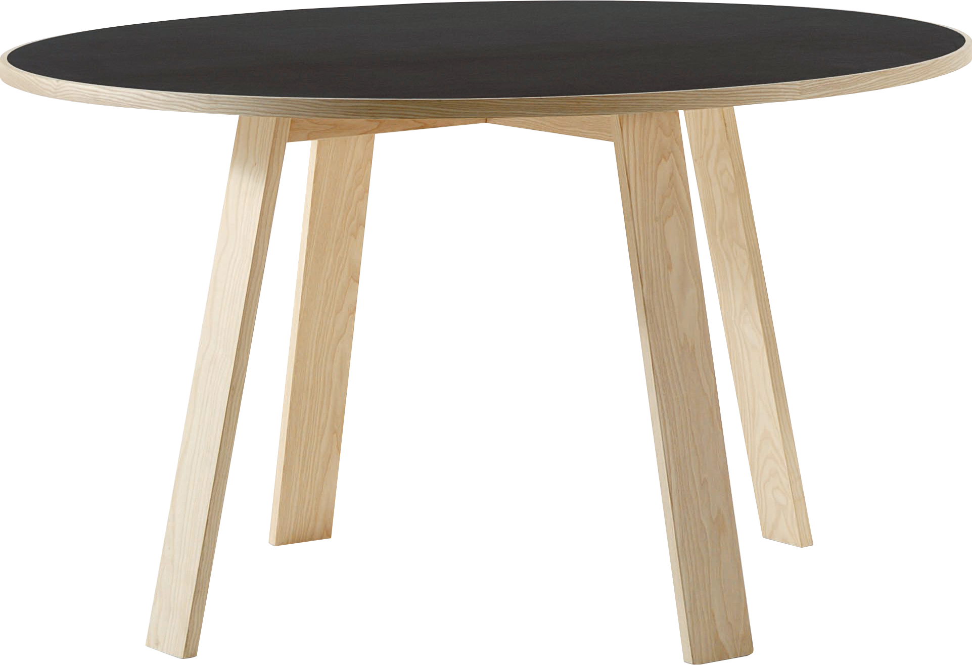
​
Welcome to Algebra 2
Mrs. Carter's Website
Delta Math

Slide 2
Weekly Overview
Lessons
1-4 Solving Equations
1-5 Solving Inequalities
Activities
Bell Work
Notes
Real World Applications
Assignments
Complete & Submit Bell work
Complete & Submit Delta Math
Complete & Submit 1-4 & 1-5 Enrichment
Complete Practice Problems

Slide 3
1-4 Standards Objectives
A2.FBF.A.1 Write a function that describes a relationship between two quantities.
A2.CED.A.2 Rearrange formulas to highlight a quantity of interest
I can solve one-, two-, and multi-step equations with no procedural errors.
I can solve literal equations for an indicated variable without procedural errors.

Slide 4
Bell Work
1. Write an algebraic expression for “three more
than twice the sum of x and 4.”
2. Simplify by combining like terms
$$12+x−5x^{3}+x^{2}−(x+1)$$

Slide 5
1-4 Solving Equations
Key Concepts
Property | Definition
Reflexive | a = a
Symmetric | If a = b, then b = a
Transitive | If a = b and b = c, then a = c
Substitution | If a = b, then b may replace a in any expression.
Addition/ Subtraction | If a = b, then a + c = b + c and a – c = b – c.
Multiplication/ Division | If a = b and c $≠0$, then ac = bc and $\frac{a}{c}=\frac{b}{c}$
Identity
___________________- an equation that is true for every value of the variable.
________________________________- an equation that uses at least 2 letters as variables. You can solve for any variable “in terms of” the other variables.
Literal Equation

Slide 6
Lesson 1-4 Notes
Examples
Solve the one-step equations.
a. $w−2=10$ (I do) b. $\frac{y}{4}= −3$ (We do)
2. Solve the two-step equations.
a. $−4z+1=26$ (I do) b. $\frac{2}{3}x−2=10$ (We do)

Slide 7
Lesson 1-4 Notes
Examples
3. Solve the multi-step equations.
a. $3\left(2x−1\right)=11x$ (We do) b. $−6y+27=3(y−3)$ (They do)

Slide 8
Lesson 1-4 Notes
Examples
4. (I do) Determine whether the equations are always true, sometimes true or never true.
a. $11+3−7=6x+5−3x$ b. $6x+5−2x=4+4x−1$

Slide 9
Lesson 1-4 Notes
Examples
5. (We do) Solve the literal equations.
a. $d=rt$ for $r$ b. $C=\frac{5}{9}(F−32)$ for $F$

Slide 10
Lesson 1-4 Notes
Examples
(They do) The cost to rent a moving truck is $75 plus $58 per hour. If Keisha paid $336 to rent the truck, how many hours did she rent the truck?
(They do) Avery charges $10 to babysit one child and $3.50 for each additional child. If Avery earned $38.00, how many children did she babysit?

Slide 11
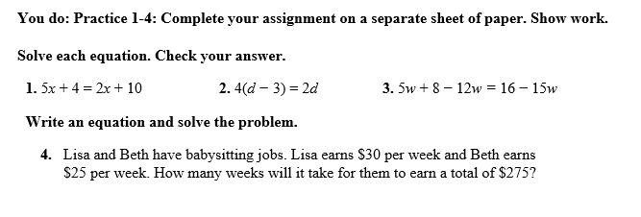
Independent Practice/Lesson Check 1-4

Slide 12
Independent Practice/Lesson Check 1-4

Slide 13
1-5 Standards Objectives
A2.FBF.A.1 Write an expression that describes a relationship between two quantities.
A2.FBF.A.1 Write a function that describes a relationship between two quantities.
I can write and graph linear inequalities without procedural errors.
I can solve one-, two-, and multi-step linear inequalities without procedural errors.
I can solve compound inequalities without procedural errors.

Slide 14
Bell Work
Solve for $a. \frac{a}{4}+2=6$
2. Solve for $x. −2\left(x+5\right)=80$

Slide 15
1-5 Solving Linear Inequalities
Key Concepts
x > 4 | x is greater than 4
x ≥ 4 | x is greater than or equal to 4
x < 4 | x is less than 4
x ≤ 4 | x is less than or equal to 4
Compound Inequality
__________________________ - two inequalities joined with the word and or the word or
AND means that a solution makes BOTH inequalities true.
OR means that a solution makes EITHER inequality true.

Slide 16
Lesson 1-5 Notes
Examples
Write an inequality that represents the sentence.
(I do) Two fewer than a number is at most ten. __________________________
b. (We do) The quotient of a number and 5 is no more than 14. _________________
c. (They do) A person must be at least 48 inches to ride. ________________________
$$n−2≤10$$
$$\frac{n}{5}≤14$$
$$p≥48$$

Slide 17
Lesson 1-5 Notes
Examples
2. Graph the inequalities
a. (I do) $n≤5$ b. (We do)$x>−2$ c. (We do) $4≤ a$
3. (They do) Solve the inequality and graph the solution.
a. $2x+6>13$ b. $−3\left(2x−5\right)+1 ≤4$

Slide 18
Lesson 1-5 Notes
Examples
(They do) A music download service has two subscription plans. The first plan has a $9 membership fee and then charges $1 per download. The second plan charges a $25 membership fee and $.50 per download. How many songs must you download for the second plan to cost less than the first plan?
5. Is the inequality, always, sometimes or never true?
(I do) $−2\left(3x+1\right)>−6x+7$ b. (We do) $5\left(2x−3\right)−7x ≤3x+8$

Slide 19
Lesson 1-5 Notes
Examples
6. ( I do) Solve the compound inequality and graph $7<2x+1$ and $3x≤18$.
7. (We do) Solve the compound inequality and graph $7+k≥6$ or $8+k<3$.

Slide 20
Lesson 1-5 Notes
Examples
8. (They do) Solve the compound inequality and graph $−6≤2x−4≤12$

Slide 21
Lesson 1-5 Notes
Examples
9. Write the solution set as a graph and as an interval.
(I do) $n≤−3$ ______________
(We do)$−1≤n≤5$ ______________
c. (They do) $x>2$ ______________
d. (I do) $x>0 and x≤6$ ______________
e. (We do) $x≤−3 or x≥−2$ ______________

Slide 22
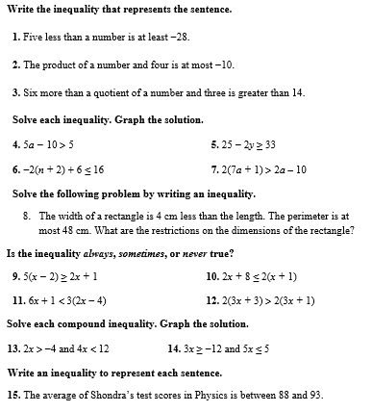
Independent Practice/Lesson Check 1-5

Slide 23
Independent Practice/Lesson Check 1-5

