Slide 1
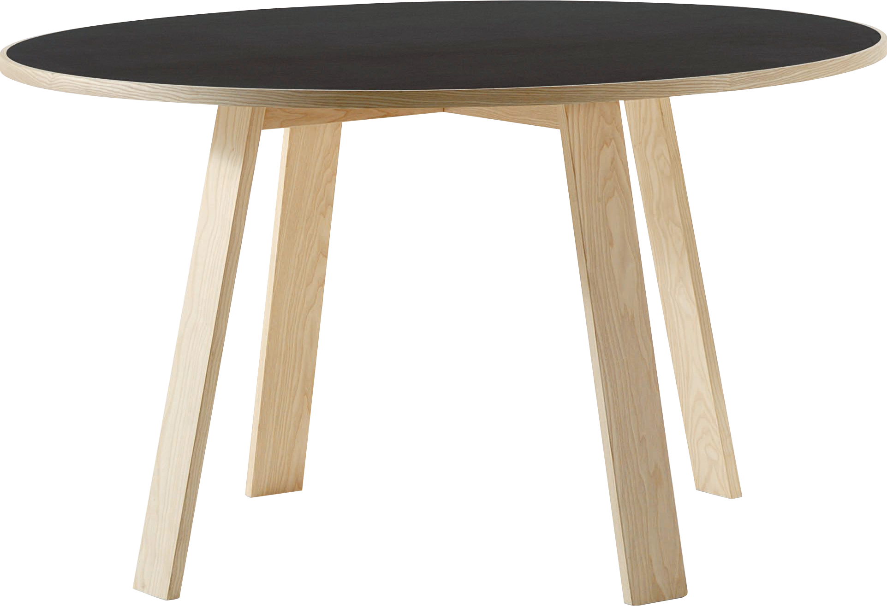
​
Welcome to Algebra 2
Mrs. Carter's Website
Delta Math

Slide 2
Weekly Overview
Lessons
4-5 Quadratic Equations
4-6 Factoring Quadratic Expressions
4-7 The Quadratic Formula
Activities
Bell Work
Notes
Real World Applications
Assignments
Complete & Submit Bell work
Complete & Submit Delta Math
Complete & Submit Quadratic Project
Complete Practice Problems

Slide 3
4-5 Quadratic Equations Standards Objectives
A2.A.REI.B.3 Solve quadratic equations and inequalities in one variable. Solve quadratic equations by inspection (e.g., for $x^{2}$ = 49), taking square roots, completing the square, knowing and applying the quadratic formula, and factoring, as appropriate to the initial form of the equation. Recognize when the quadratic formula gives complex solutions and write them as a ± bi for real numbers a and b.
SWBAT will use factoring techniques, graphs and table IOT solve quadratic equations.
SWBAT identify the zeros of a polynomial when given an expression IOT graph the function.

Slide 4
4-5 Quadratic Equations Objective
Find an answer by isolating the variable
Having an x² term and no higher exponent
SWBAT use factoring techniques, graphs and tables IOT solve quadratic equations.
A diagram representing a connection or relationship among two or more quantities.
Organized chart of information

Slide 5
4-5 Quadratic Equations
Key Concepts
Root
__________________________-a solution of a quadratic equation.
__________________________-a solution of a quadratic equation.
__________________________-a solution of a quadratic equation.
* These solutions can be found by _____________________, ______________________,
________________________________ or using the ______________________________.
Zero
x-intercept
Graphing
Factoring
Completing the Square
Quadratic Formula

Slide 6
Lesson 4-5 Notes
Examples
Solve the quadratic by factoring.
a. ( I do) $x^{2}+x−6=0$ b. (We do) $x^{2}−7x=−12$
(They do) $5x^{2}−8=18x$ d. (You do) $a^{2}−4a=0$

Slide 7
Lesson 4-5 Notes
Examples
2. Solve the quadratic 2$x^{2}+7x=15$ by graphing.

Slide 8
Lesson 4-5 Notes
Examples
3. The function $y=−0.03x^{2}+1.60x$ models the path of a kicked soccer ball. The height is y, the
distance is x and the units are meters.
a. How high does the soccer ball go?
b. How far does the soccer ball travel?

Slide 9
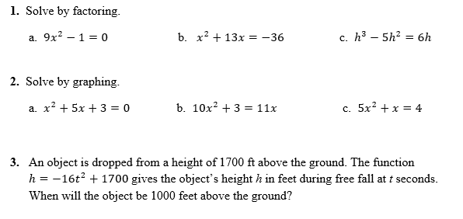
Independent Practice/Lesson Check 4-5

Slide 10
Independent Practice/Lesson Check 4-5

Slide 11
4-6 Completing the Square Standards Objectives
A2.A.REI.B.3 Solve quadratic equations and inequalities in one variable. Solve quadratic equations by inspection (e.g., for $x^{2}$= 49), taking square roots, completing the square, knowing and applying the quadratic formula, and factoring, as appropriate to the initial form of the equation. Recognize when the quadratic formula gives complex solutions and write them as a ± bi for real numbers a and b.
SWBAT complete the square IOT solve quadratic equations.
SWBAT identify the zeros of a polynomial when given an expression IOT graph the function.

Slide 12
4-6 Completing the Square Objective
Find an answer by isolating the variable
SWBAT complete the square IOT solve quadratic equations.
The process used to convert a quadratic to a perfect square quadratic

Slide 13
4-6 Completing the Square
Key Concepts
Perfect Square Trinomial
___________________________- the product you obtain when you square a binomial.
Examples
(I do) Solve by finding the square roots.
a. $4x^{2}=36$ b. $7x^{2}−10=25$ c. $2x^{2}+9=13$

Slide 14
Lesson 4-6 Notes
Examples
2. (We do) Find the value that completes the square.
a. $x^{2}−10x$ b. $x^{2}+6x$
3. (We do) Solve by completing the square.
a. $x^{2}+6x+9=49$ b. $x^{2}−12x+7=0$ c. ${3x}^{2}−12x+6=0$

Slide 15
Lesson 4-6 Notes
Examples
4. Write the equation in vertex form y = $x^{2}+6x−4$ by completing the square.

Slide 16
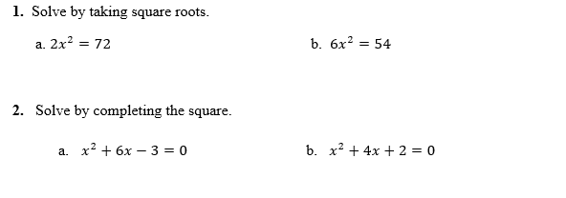
Independent Practice/Lesson Check 4-6

Slide 17
Independent Practice/Lesson Check 4-6

Slide 18
4-7 The Quadratic Formula Standards Objectives
A2.A.REI.B.3 Solve quadratic equations and inequalities in one variable. Solve quadratic equations by inspection (e.g., for $x^{2}$= 49), taking square roots, completing the square, knowing and applying the quadratic formula, and factoring, as appropriate to the initial form of the equation. Recognize when the quadratic formula gives complex solutions and write them as a ± bi for real numbers a and b.
SWBAT use and apply the quadratic equation IOT solve quadratic equations.
SWBAT use the discriminant IOT determine the number of solutions to a quadratic equation.
SWBAT identify the zeros of a polynomial when given an expression IOT graph the function

Slide 19
4-7 The Quadratic Formula Objective
Find an answer by isolating the variable
SWBAT use and apply the quadratic formula IOT solve quadratic equations.
SWBAT use the discriminant IOT determine the number of solutions to a quadratic equation.
Mathematically simplify
The part of the quadratic formula under the radical

Slide 20
4-7 The Quadratic Formula
Key Concepts
___________________________-the value of the expression $b^{2}−4ac$
___________________________, expressed as $\frac{−b±\sqrt{b^{2}−4ac}}{2a}$ can be used to solve quadratic functions.
Discriminant
The Quadratic Formula
Discriminant Rules
If $b^{2}−4ac>0$, there are 2 real solutions.
If $b^{2}−4ac=0$, there is 1 real solution.
If $b^{2}−4ac<0$, there are 0 real solutions.

Slide 21
Lesson 4-7 Notes
Examples
(I do) What are the solutions to $3x^{2}+23x=−4$0? Use the Quadratic Formula.
(We do) What are the solutions to $3x^{2}+2x−4=0$? Use the Quadratic Formula.

Slide 22
Lesson 4-7 Notes
Examples
3. (They do) What is the number of real solutions of $−2x^{2}−3x+7=0$? Use the discriminant.
(They do) CHS is selling pumpkin seeds as a fundraiser for the Halloween dance. The total profit p depends on the amount x that CHS charges for each box of seeds. The equation $p=−0.5x^{2}+25x−150$models the profit. What is the smallest amount you can charge and make a profit of at least $150?

Slide 23
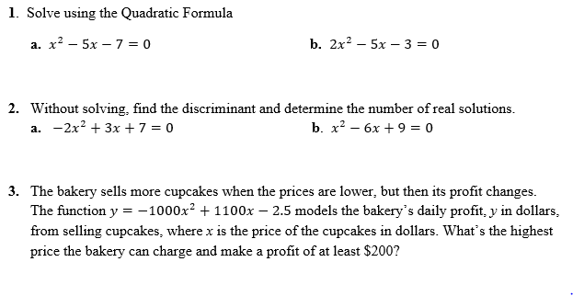
Independent Practice/Lesson Check 4-7

Slide 24
Independent Practice/Lesson Check 4-7

