Slide 1
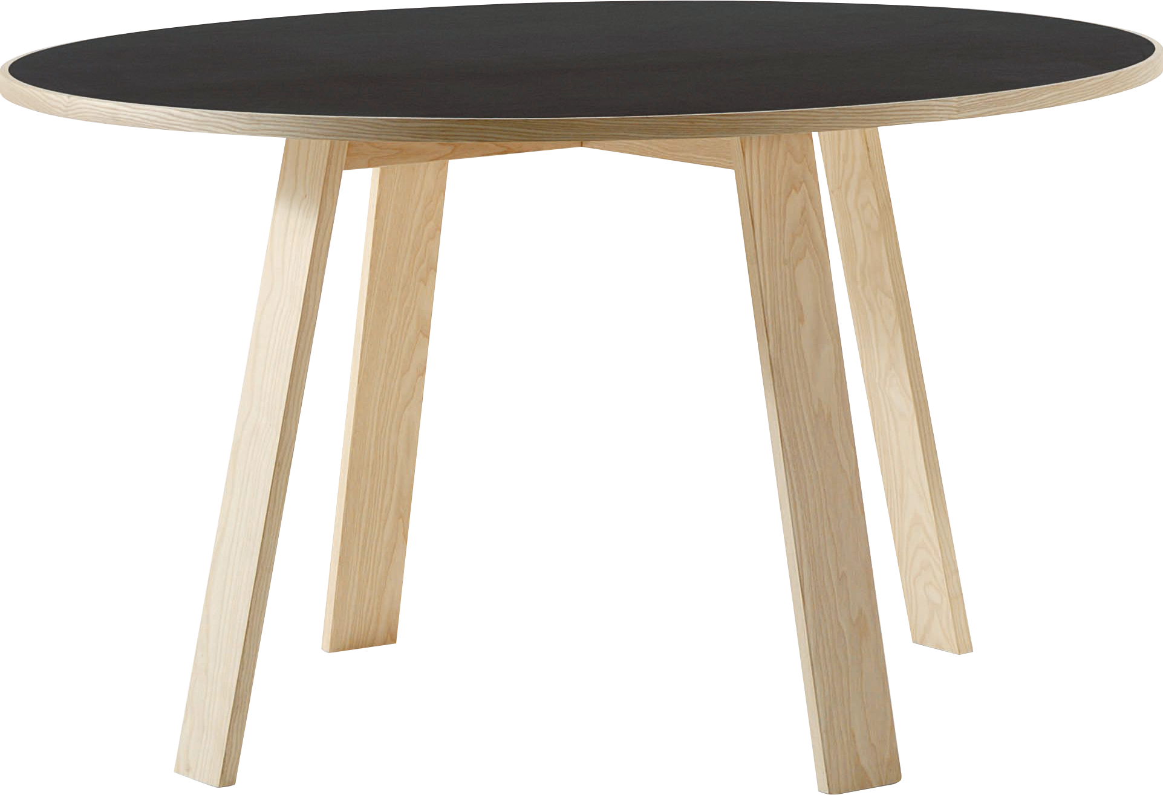
​
Welcome to Algebra 2
Mrs. Carter's Website
Delta Math

Slide 2
Weekly Overview
Lessons
7-1 Exploring Exponential Models
7-2 Properties of Exponential Functions
7-3 Logarithmic Functions as Inverses
Activities
Bell Work
Notes
Real World Applications
Assignments
Complete & Submit Bell work
Complete & Submit Delta Math
Complete & Submit Enrichment
Complete Practice Problems

Slide 3
7-1 Exploring Exponential Models Standards Objectives
A2. F.LE.A.1 Construct linear and exponential functions, including arithmetic and geometric sequences, given a graph, a description of a relationship, or input-output pairs.
A2. F.LE.B.3 Interpret the parameters in a linear or exponential function in terms of a context.
A2.F.IF.B.3 Graph functions expressed symbolically and show key features of the graph, by hand and using technology. a. Graph square root, cube root, and piecewise defined functions, including step functions and absolute value functions. c. Graph exponential and logarithmic functions, showing intercepts and end behavior.
A2.F.IF.B.5 Compare properties of two functions each represented in a different way
A2. F.IF.A.2 Calculate and interpret the average rate of change of a function (presented symbolically) Estimate the rate of change from a graph.
A2.A.REI.D.6 Explain why the x-coordinates of the points where the graphs of the equations y = f(x) and y = g(x) intersect are the solutions of the equation f(x) = g(x); find the approximate solutions using technology. Include cases where f(x) and/or g(x) are linear, polynomial, rational, absolute value, exponential, and logarithmic functions.
A2.F.BF.B.3 Identify the effect on the graph of replacing f(x) by f(x) + k, k f(x), f(kx), and f(x + k) for specific values of k; find the value of k given the graphs. Experiment with cases and illustrate an explanation of the effects on the graph using technology.
SWBAT model exponential growth and decay functions IOT graph exponential functions and observe its transformation from the parent exponential function.
SWBAT develop a general growth/decay rate formula in the context of compound interest IOT compute future values of investments with compounding interest rates.

Slide 4
7-1 Exploring Exponential Models Objective
b > 1
0 < b < 1
Of the form y=ab^{x}
SWBAT model exponential growth and decay functions IOT graph exponential functions and observe its transformation from the parent exponential function.
SWBAT develop a general growth/decay rate formula in the context of compound interest IOT compute future values of investments with compounding interest rates.
A change in the form of translations (shifts), stretches, compressions and reflections (flips).
The addition of interest to a principal, interest on interest.
Calculate the value

Slide 5
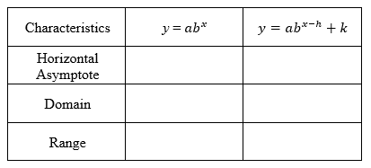
7-1 Exploring Exponential Models
Key Concepts
_____________________________________- a function with the general form y = ab^{x}, where x is a real number, a ≠ 0, b = 1 + r, b > 0, and b ≠ 0.
A ________________________is when b > 1 and a _______________________ is when 0 < b < 1.
_______________________- a line that a graph approaches as x or y increases in absolute value.
_______________________-model for exponential growth and decay.
Exponential Function
Growth Factor
Decay Factor
Asymptote
$$A=P{(1±r)}^{t}$$
y = 0
y = k
(-$∞, ∞)$
(-$∞, ∞)$
(0$, ∞)$
(k$, ∞)$

Slide 6
Lesson 7-1 Notes
Examples
(I do) Graph $y={3(2)}^{x}$. Identify the y-intercept, asymptote, domain and range.

Slide 7
Lesson 7-1 Notes
Examples
2. Without graphing, determine whether the functions represent exponential growth or decay.
(I do) $y=3{(\frac{2}{3})}^{x}$
(We do) $y=0.25{(2)}^{x}$
c. (We do) You invest $1000 into a college savings account for 4 years, The account pays 5% interest annually.

Slide 8
Lesson 7-1 Notes
Examples
(They do) You invested $1000 in a savings account at the end of 6th grade. The account
pays 5% annual interest. How much money will be in the account at the end of 12th grade?

Slide 9
Lesson 7-1 Notes
Examples
4. (They do) The population of the Iberian lynx is 150 in 2003 and is 120 in 2004. If this trend
continues and the population is decreasing exponentially, how many Iberian lynx will there be in 2014?

Slide 10
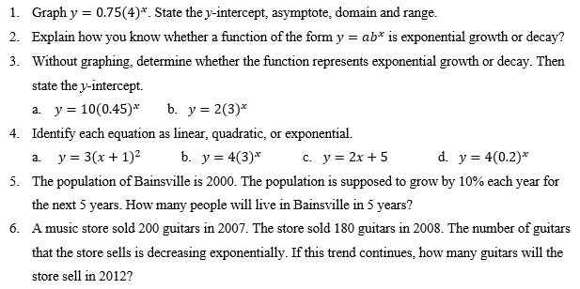
Independent Practice/Lesson Check 7-1

Slide 11
Independent Practice/Lesson Check 7-1

Slide 12
7-2 Properties of Exponential Functions Standards Objectives
A2. F.LE.A.1 Construct linear and exponential functions, including arithmetic and geometric sequences, given a graph, a description of a relationship, or input-output pairs.
A2. F.LE.B.3 Interpret the parameters in a linear or exponential function in terms of a context.
A2.F.IF.B.3 Graph functions expressed symbolically and show key features of the graph, by hand and using technology. a. Graph square root, cube root, and piecewise defined functions, including step functions and absolute value functions. c. Graph exponential and logarithmic functions, showing intercepts and end behavior.
A2.F.IF.B.5 Compare properties of two functions each represented in a different way
A2. F.IF.A.2 Calculate and interpret the average rate of change of a function (presented symbolically) Estimate the rate of change from a graph.
A2.A.REI.D.6 Explain why the x-coordinates of the points where the graphs of the equations y = f(x) and y = g(x) intersect are the solutions of the equation f(x) = g(x); find the approximate solutions using technology. Include cases where f(x) and/or g(x) are linear, polynomial, rational, absolute value, exponential, and logarithmic functions.
A2.F.BF.B.3 Identify the effect on the graph of replacing f(x) by f(x) + k, k f(x), f(kx), and f(x + k) for specific values of k; find the value of k given the graphs. Experiment with cases and illustrate an explanation of the effects on the graph using technology.
SWBAT explore the properties of functions of the form y=a$b^{x}$ IOT graph exponential functions that have base e.
SWBAT write an exponential function for continuously compounded interest using $A=Pe^{rt}$ IOT compute future values of investments.

Slide 13
7-2 Properties of Exponential Functions Objective
Attributes or characteristics
Parent exponential function
Of the form y=ab^{x}
SWBAT explore the properties of functions of the form y=a$b^{x}$ IOT graph exponential functions that have base e.
SWBAT write an exponential function for continuously compounded interest using $A=Pe^{rt}$ IOT compute future values of investments.
An irrational number approximately equal to 2.71828
Continuously compounded interest formula
Calculate the value

Slide 14
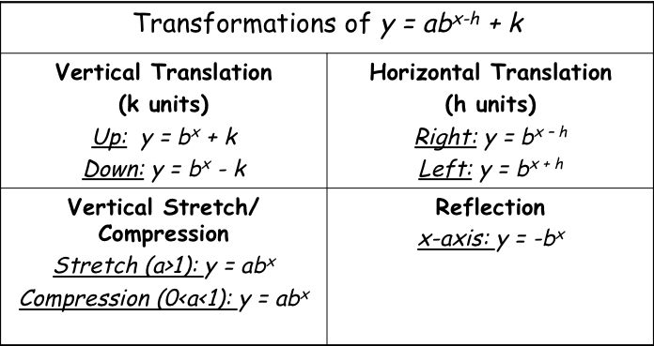
7-2 Properties of Exponential Functions
Key Concepts
If the graph shifts up or down, so does the horizontal asymptote
*Remember____________________________________________________________
_______- an irrational number approximately equal to 2.71828 and is useful for describing continuous growth or decay.
____________-continuously compounded interest formula.
e
A = P$e^{rt}$

Slide 15
Lesson 7-2 Notes
Examples
(I do) Suppose you invest $1000 at an annual interest rate of 4.8% compounded continuously. How much will you have in the account after 3 years?

Slide 16
Lesson 7-2 Notes
Examples
2. (I do) Graph both on the same axis. Label the asymptote, state the domain, range and describe the
transformation.
a. $y=3{(2)}^{x}$ and $y=−3({2)}^{x}$ b. $y=6{(\frac{1}{2})}^{x}$ and $y=6({\frac{1}{2})}^{x−3}−2$.

Slide 17
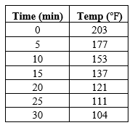
Lesson 7-2 Notes
Examples
(They do) The best temperature to brew coffee is between 195$℉$ and 205$℉$. Coffee is cool enough to drink at 185$℉$. The table shows temperatures from a sample cup of coffee. How long does it take for a cup of coffee to be cool enough to drink? Use an exponential model.

Slide 18
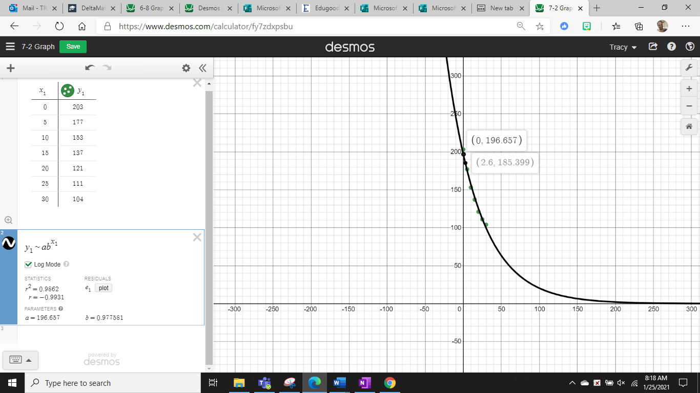

Slide 19
Lesson 7-2 Notes
Examples
4. (They do) The half-life of Phosphorus-32 is 14.3 days. Write an exponential decay function for a 50-mg sample. Find the amount remaining after 84 days.

Slide 20
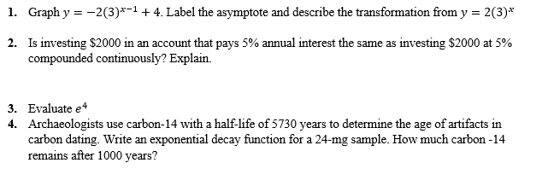
Independent Practice/Lesson Check 7-2

Slide 21
Independent Practice/Lesson Check 7-2

Slide 22
7-3 Logarithmic Functions as Inverses Standards Objectives
A2. F.LE.A.1 Construct linear and exponential functions, including arithmetic and geometric sequences, given a graph, a description of a relationship, or input-output pairs.
A2. F.LE.B.3 Interpret the parameters in a linear or exponential function in terms of a context.
A2.F.IF.B.3 Graph functions expressed symbolically and show key features of the graph, by hand and using technology. a. Graph square root, cube root, and piecewise defined functions, including step functions and absolute value functions. c. Graph exponential and logarithmic functions, showing intercepts and end behavior.
A2.F.IF.B.5 Compare properties of two functions each represented in a different way
A2. F.IF.A.2 Calculate and interpret the average rate of change of a function (presented symbolically) Estimate the rate of change from a graph.
A2.A.REI.D.6 Explain why the x-coordinates of the points where the graphs of the equations y = f(x) and y = g(x) intersect are the solutions of the equation f(x) = g(x); find the approximate solutions using technology. Include cases where f(x) and/or g(x) are linear, polynomial, rational, absolute value, exponential, and logarithmic functions.
A2.F.BF.B.3 Identify the effect on the graph of replacing f(x) by f(x) + k, k f(x), f(kx), and f(x + k) for specific values of k; find the value of k given the graphs. Experiment with cases and illustrate an explanation of the effects on the graph using technology.
SWBAT write and graph logarithmic expressions IOT evaluate logarithmic expressions.

Slide 23
7-3 Logarithmic Functions as Inverses Objective
Determine its’ value
SWBAT write and graph logarithmic expressions IOT evaluate logarithmic expressions.
Inverse of exponential function

Slide 24
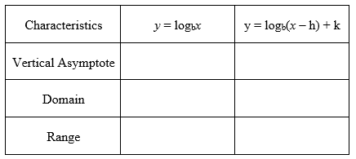
7-3 Logarithmic Functions as Inverses
Key Concepts
_____________________- has base b of a positive number y is defined as follows: If ___________, then ______________.
______________________________- a logarithm that uses base 10.
____________________________________- the inverse of an exponential function.
Logarithm
$$y=ab^{x}$$
$$\log_{b}{y}=x$$
Common Logarithm
Logarithmic Function
$$x=0$$
$$x=h$$
$$(0, ∞)$$
$$(h ∞)$$
$$(−∞, ∞)$$
$$(−∞, ∞)$$

Slide 25
Lesson 7-3 Notes
Examples
(I do) Write in logarithmic form.
a. $4^{−3}=\frac{1}{64}$ b. $6^{2}=36$ c. ${17}^{0}=1$
2. (I do) Write in exponential form.
a. $\log_{2}{8=3}$ b. $\log{1000=3}$ c. $\log_{8}{\frac{1}{4}=−\frac{2}{3}}$
3. (We do) Evaluate.
$\log_{3}{81}$ b. $\log_{5}{125}$ c. $\log_{8}{2}$

Slide 26
Lesson 7-3 Notes
Examples
4. (They do) Graph. State the asymptote, domain and range. Then describe the transformation.
a. ${y=log}_{4}{x}$ b. ${y=log}_{5}\left(x−1\right)+2$

Slide 27
Lesson 7-3 Notes
Examples
(They do) The formula $\log{\frac{I_{1}}{I_{2}}=M_{1}−M_{2}}$ compares the intensity levels of earthquakes where I is the intensity level determined by a seismograph M is the magnitude. How many times more intense is a 9.3 earthquake than an 8.7 earthquake?

Slide 28
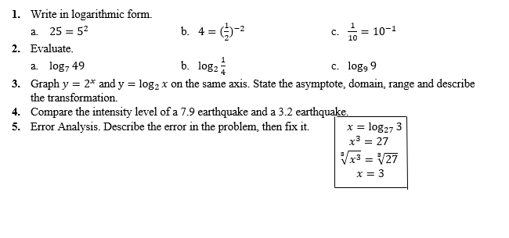
Independent Practice/Lesson Check 7-3

Slide 29
Independent Practice/Lesson Check 7-3

