Slide 1
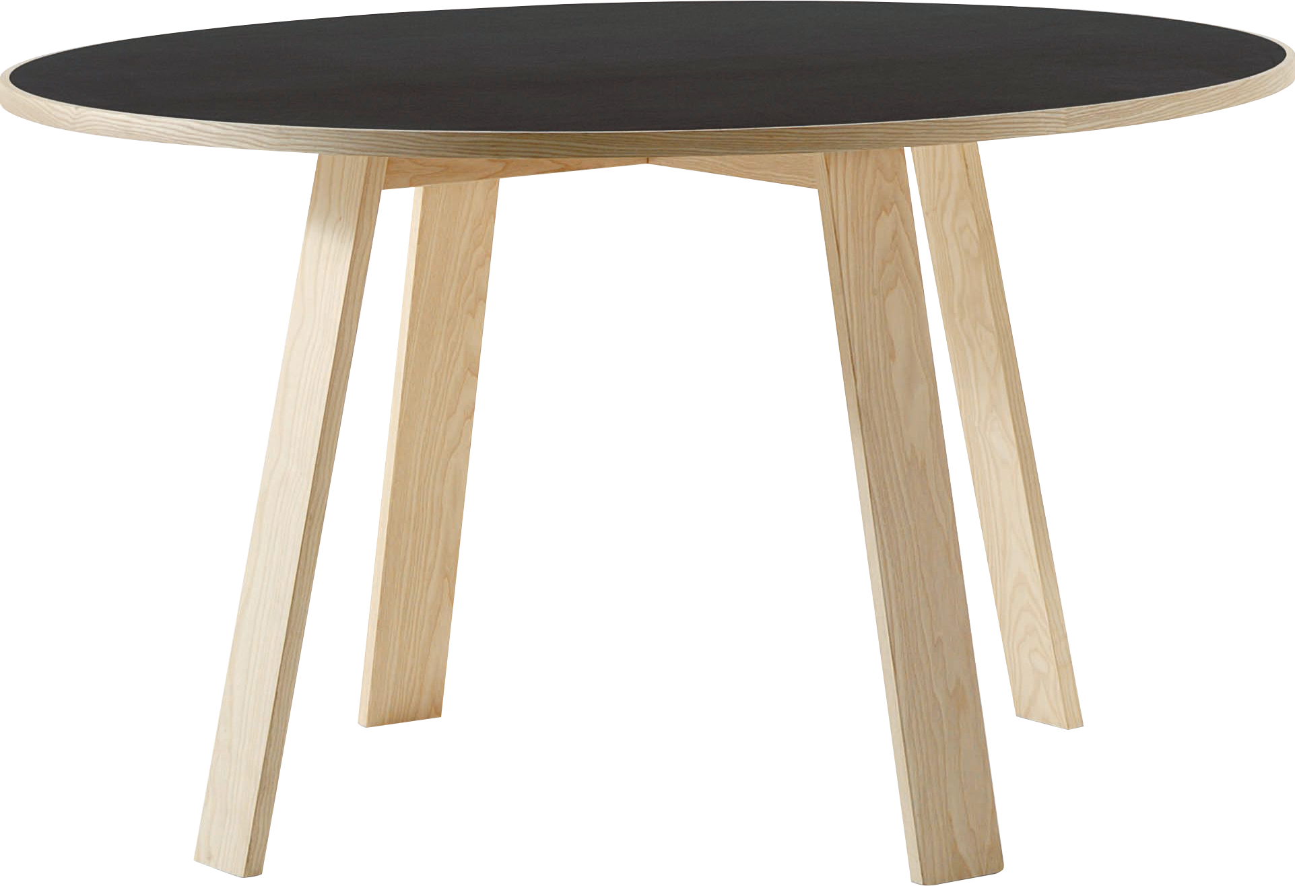
​
Welcome to Algebra 2
Mrs. Carter's Website
Delta Math

Slide 2
Weekly Overview
Lessons
9-4 Arithmetic Series
9-5 Geometric Series
Activities
Bell Work
Notes
Real World Applications
Assignments
Complete & Submit Bell work
Complete & Submit Delta Math
Complete & Submit Enrichment
Complete Practice Problems

Slide 3
9-4 Arithmetic Series Standards Objectives
A2. F.BF. A.1a Write a function that describes a relationship between two quantities.
A2. F.BF.A.2 Know and write arithmetic and geometric sequences with an explicit formula and use them to model situations.
A2. F.LE.A.1 Construct linear and exponential functions, including arithmetic and geometric sequences, given a graph, a table, a description of a relationship, or input-output pairs.
SWBAT define arithmetic series IOT find their sums

Slide 4
9-4 Arithmetic Series Objective
The indicated sum of the terms of an arithmetic sequence
SWBAT define arithmetic series IOT find their sums.
Write a rule for
Ordered list of numbers

Slide 5
9-4 Arithmetic Series
Key Concepts
Series
__________________- the indicated sum of the terms of a sequence
__________________- has a first and last term
__________________- continues without end
____________________- a series whose terms form an arithmetic sequence.
Finite Series
Infinite Series
Arithmetic Series

Slide 6
Lesson 9-4 Notes
Examples
(I do) Find the sum of the finite arithmetic series 7 + 8 + 9 + 10 + … + 15
(I do) What is the sum of the even numbers from 2 to 100?

Slide 7
Lesson 9-4 Notes
Examples
(We do) What is summation notation for the series 7 + 11 + 15 + … + 207?
4. (We do) Expand and find the sum of
$$\sum_{n=0}^{4}{3n+1}$$

Slide 8
Lesson 9-4 Notes
Examples
(We do) What is the sum of the series $\sum_{n=1}^{5}{2n−1}$?
(They do) Use the calculator to determine the sum of the series $\sum_{n=1}^{20}{n^{3}−10n^{2}}$?

Slide 9
Lesson 9-4 Notes
Examples
(They do) A student has taken three math tests so far this semester. His scores for the first three tests were 75, 79 and 83.
Suppose his test scores continue to improve at the same rate. What will be his grade on the sixth and final test?
b. What will be his total score for all six tests?

Slide 10
Independent Practice/Lesson Check 9-4

Slide 11
Independent Practice/Lesson Check 9-4

Slide 12
9-5 Geometric Series Standards Objectives
A2. F.BF. A.1a Write a function that describes a relationship between two quantities.
A2. F.BF.A.2 Know and write arithmetic and geometric sequences with an explicit formula and use them to model situations.
A2. F.LE.A.1 Construct linear and exponential functions, including arithmetic and geometric sequences, given a graph, a table, a description of a relationship, or input-output pairs.
SWBAT define arithmetic series IOT find their sums

Slide 13
9-5 Geometric Series Objective
The indicated sum of the terms of a geometric sequence
SWBAT define geometric series IOT find their sums.
Write a rule for
Ordered list of numbers

Slide 14
9-5 Geometric Series
Key Concepts
Geometric Series
____________________________- the sum of the terms of a geometric sequence.
An infinite series ______________________ when | r | < 1. (It has a sum)
An infinite series ______________________ when | r | $≥$ 1. (does not have a sum)
Converges
Diverges

Slide 15
Lesson 9-5 Notes
Examples
1. (I do) What is the sum of the finite geometric series?
a. 3 + 6 + 12 + 24 + … + 3072; n = 11 b. ( do) $\sum_{n=0 }^{20}{4(}{\frac{1}{2})}^{n}$

Slide 16
Lesson 9-5 Notes
Examples
2. (I do) Write the series using summation notation. Then evaluate.
4 + 12 + 36 +… ; n = 15

Slide 17
Lesson 9-5 Notes
Examples
(We do) Does the series converge or diverge? If it converges, what is the sum?
a. $1+\frac{1}{2}+\frac{1}{4}+…$ b. $\sum_{n=0}^{∞}{ (\frac{2}{3})(−{\frac{5}{4})}^{n}}$

Slide 18
Lesson 9-5 Notes
Examples
4. (We do) The height a ball bounces is less than the height of the previous bounce due to friction. The heights of the bounces form a geometric sequence. Suppose a ball is dropped from one meter and rebounds 95% of the height of the previous bounce. What is the total distance traveled by the ball when it comes to rest?

Slide 19
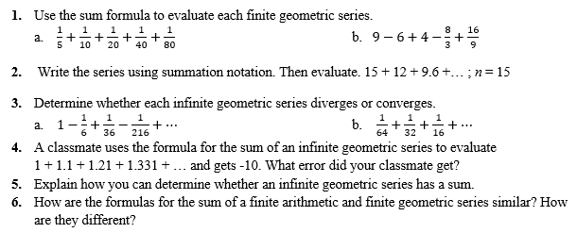
Independent Practice/Lesson Check 9-5

Slide 20
Independent Practice/Lesson Check 9-5

