Slide 1
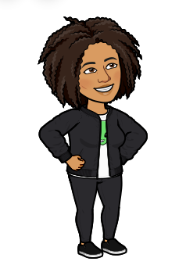
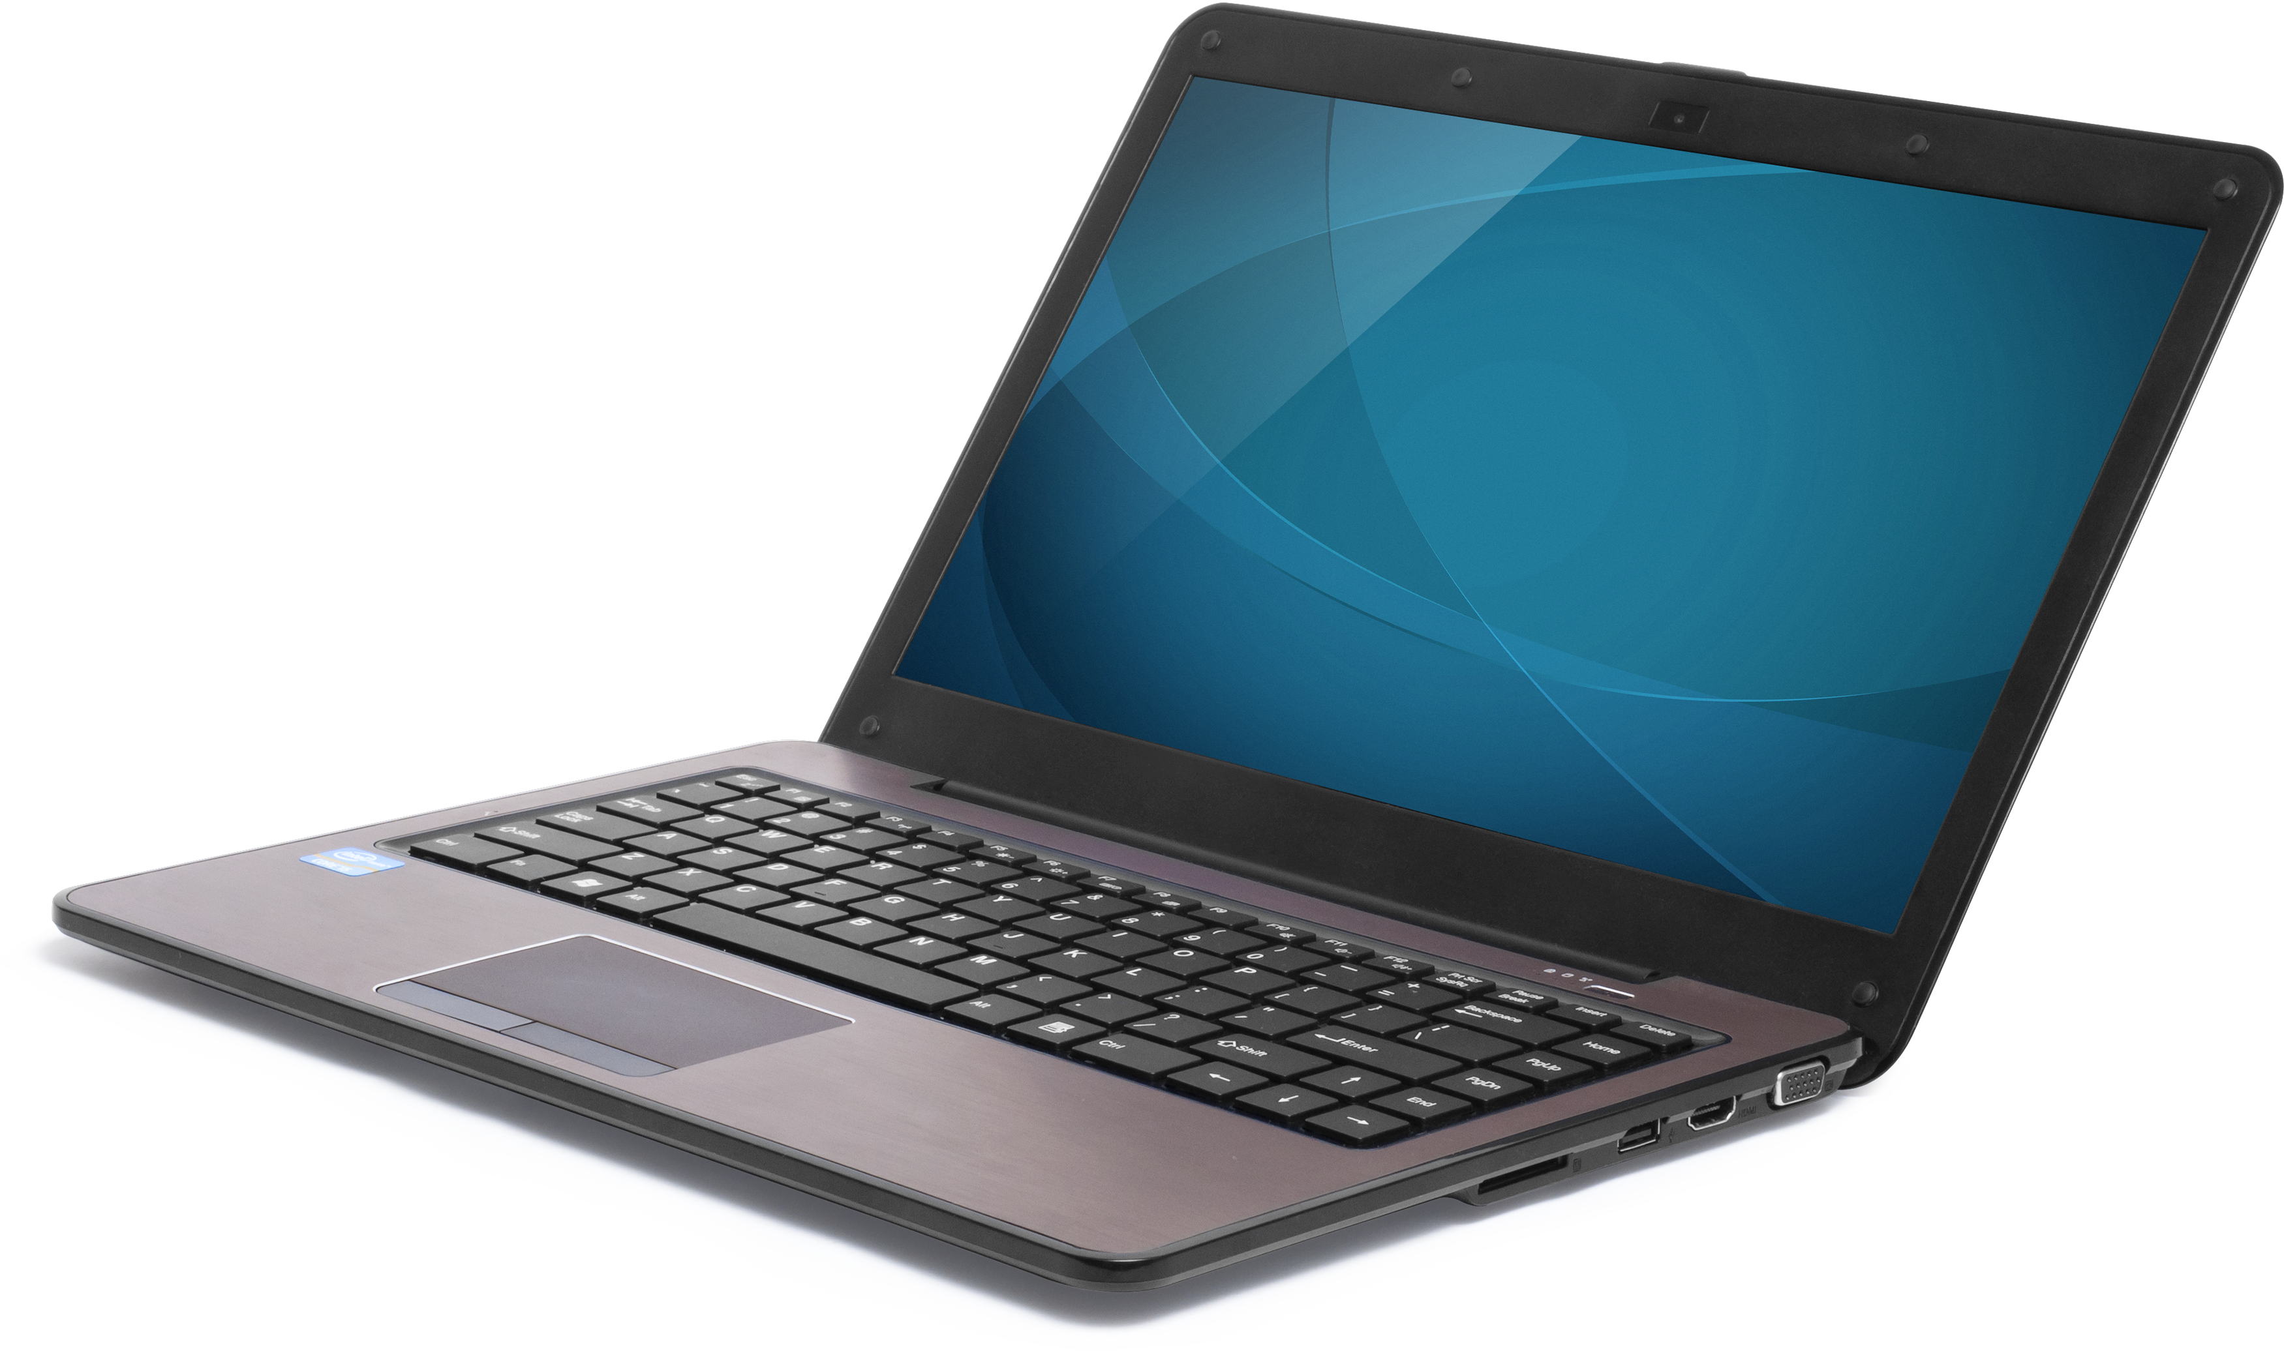
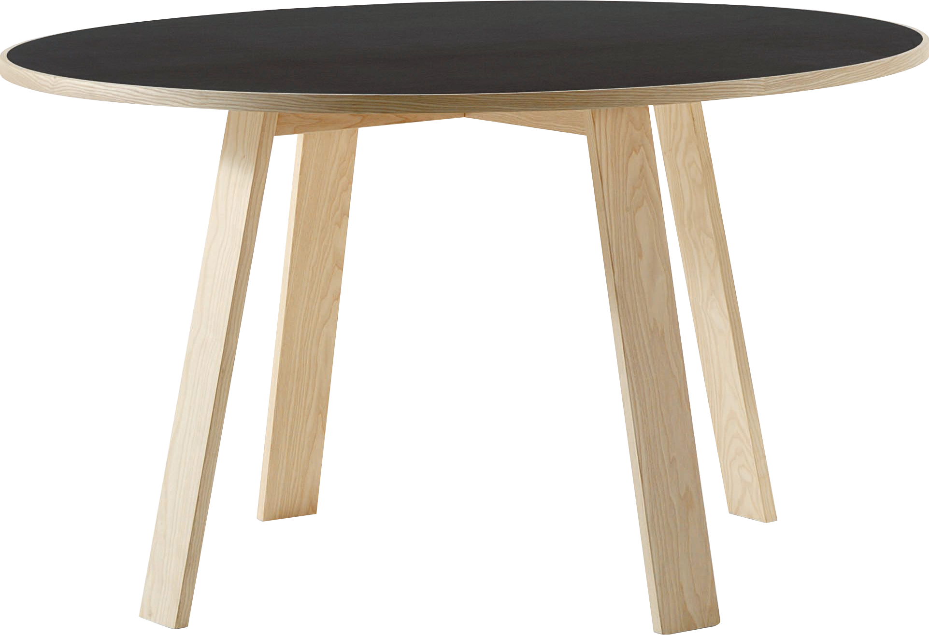
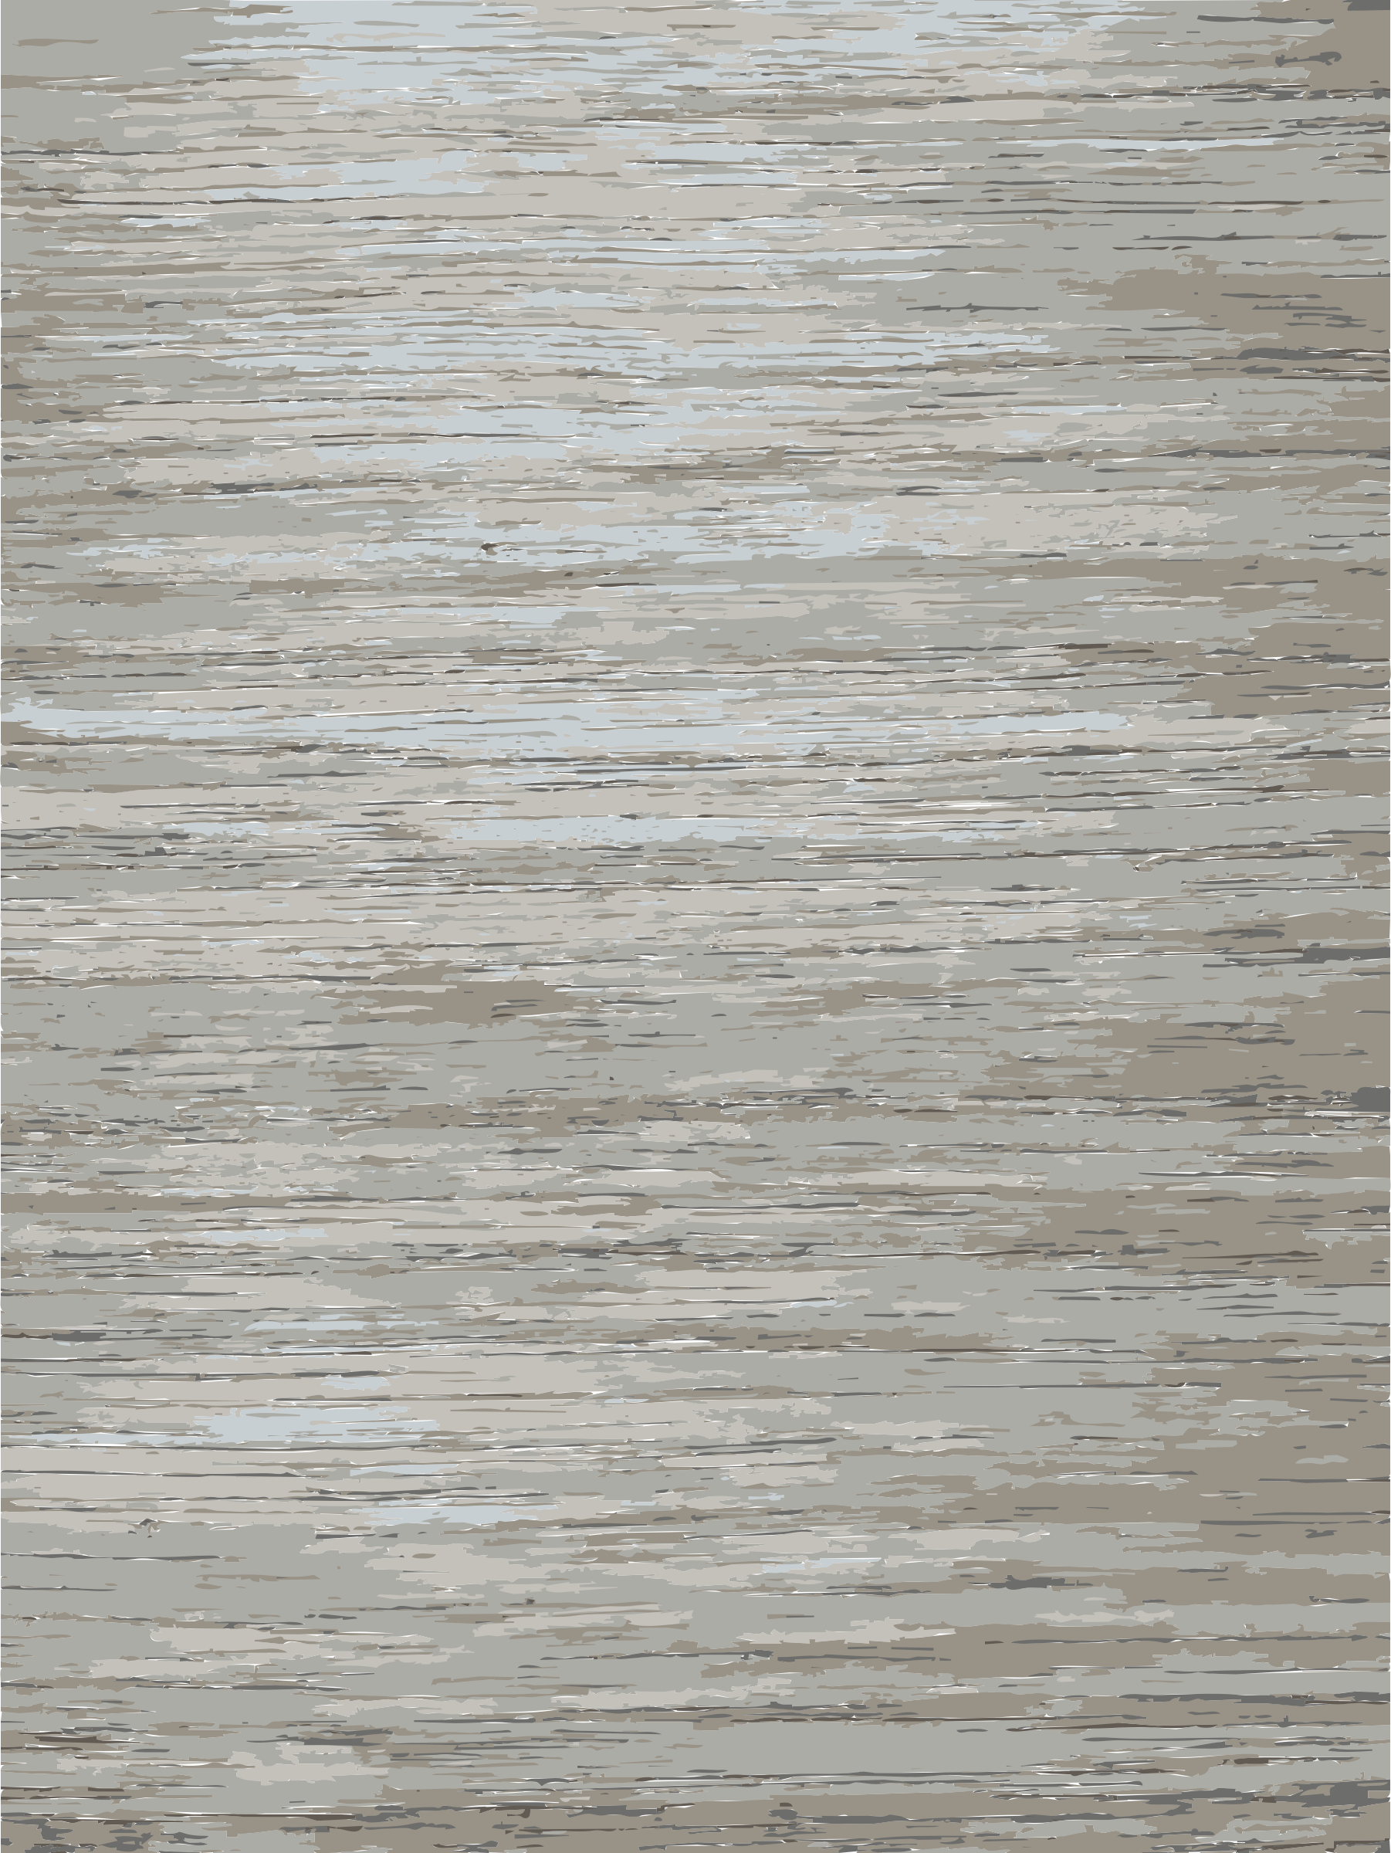
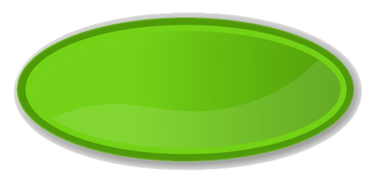
​
Welcome to Algebra 2
Mrs. Carter's Website
Delta Math

Slide 2
Welcome to Algebra 2
Hey guys! It’s a new year and I’m super excited to get started virtually with you all.
Please be patient with me, as I will be with you, in learning to navigate our curriculum
virtually. Do your best to learn all you can so you won’t fall behind when we eventually
return to the classroom.

Slide 3
Important Info
Name: Mrs. Tracy Carter
Email: cartertn2@scsk12.org
Website: www.cordovacarter.weebly.com
School Phone: (901) 416-4540
Remind: @chsalg234 (Standard) or @chsalg567 (Honors)
Delta Math: www.deltamath.com code: 507918

Slide 4
Learning Environment
Be patient, prepared and positive!
Have materials (computer, pencil, paper) ready when class starts
Take notes & Ask questions when appropriate
You play a major role in what you learn, so do your best and refrain from taking shortcuts.

Slide 5
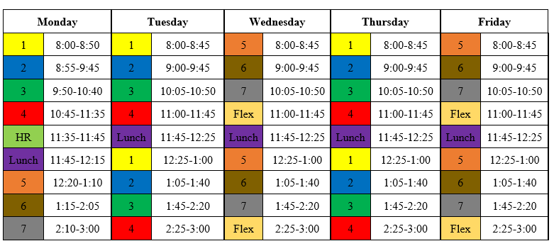
Schedule
All classes will meet Mondays.
Classes will meet Tuesday through Thursday mornings for instruction.
Afternoon help sessions Tuesday through Thursday are reserved for those that may need additional help or have questions.

Slide 6
Weekly Overview
Power Point to include…
Links to my website and Delta Math
Standards and Objectives
Bell work
Notes
Practice Problems
Weekly Assignments to include…
Bell Work (submit on TEAMS)
Delta Math (complete & submit work)
Enrichment (submit on TEAMS)
* Additional assignments may include quizzes, worksheets and tests. It is your responsibility to check
TEAMS and DELTA MATH regularly for due dates.

Slide 7
Note-taking
Notes should be taken regularly in class. Actively taking notes during class can help you focus and better understand main topics. Good note-taking will improve your active listening, comprehension of material, and retention. It will help you remember what you hear and see.
Notebooks of some form are expected to be kept and will be checked regularly.
Notes can be taken several ways.
You can print off a PDF copy of the notes from my website and fill them in.
Follow along on the computer and work examples with me on a separate sheet to be put in a notebook or binder.
Use OneNote from TEAMS.
-The Learning Center, University of North Carolina at Chapel Hill

Slide 8
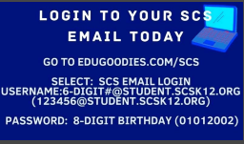
Next Steps…
Make sure you can access your SCS email, if you are not able to contact 901-416-5300.
If you do not have a Delta Math account, create one at www.deltamath.com. If you have an account, add me as a teacher. My teacher code is 507918.
Familiarize yourself with TEAMS and OneNote so you know where to submit files and submit assignments
Device Repairs 901-416-5300
M-F 8am – 5pm
Select option 2

