Slide 1
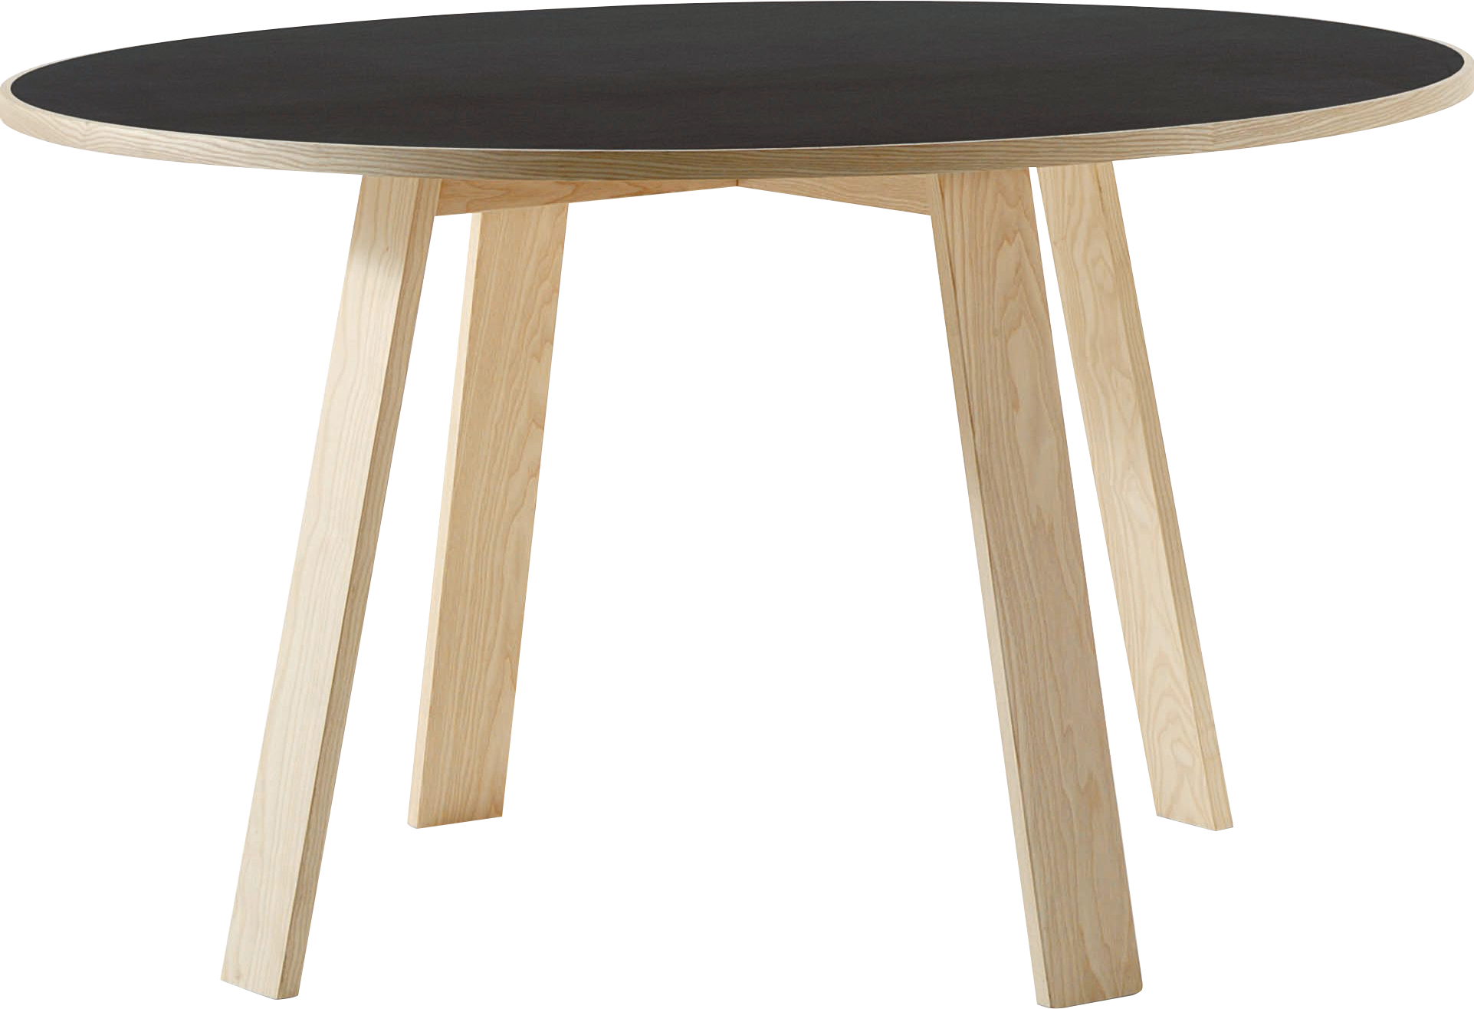
​
Welcome to Algebra 2
Mrs. Carter's Website
Delta Math

Slide 2
Weekly Overview
Lessons
1-1 Patterns & Expressions
1-2 Properties of Real Numbers
1-3 Algebraic Expressions
Activities
Introduction
Class Procedures
Navigate TEAMS & OneNote
Bell Work
Notes
Assignments
Complete & Submit Syllabus & Student Info
Complete & Submit Bell work
Complete & Submit Delta Math
Complete Practice Problems

Slide 3
Bell Work
Evaluate each expression using the order of operations.
(10 + 6) $÷$ 4 + 1
2. $2^{4}+32÷8−6$

Slide 4
1-1 Standards Objectives
A2.FBF.A.1 Write an expression that describes a relationship between two quantities.
A2.FBF.A.1 Write a function that describes a relationship between two quantities.
I can write an expression or function that describes the relationship between two quantities as illustrated with pictures, graphs and tables without procedural errors.

Slide 5
1-1 Patterns and Expressions
Key Concepts
__________________ - a symbol, usually a letter, that represents one or more numbers.
_________________________________- a mathematical phrase that contains numbers and operation symbols.
______________________________- a mathematical phrase that contains one or more variables.
Variable
Numerical Expression
Algebraic Expression

Slide 6
Lesson 1-1 Notes
Examples
(I do) Look at the figures below. Do you see a pattern? What would be the next figure in the pattern?
Heptagon

Slide 7
Lesson 1-1 Notes
Examples
2. (We do) What would be the 10th number in the pattern 4, 7, 10, 13, 16…? What is an
expression that describes the number for the nth term?
Expression: $3n+1$
10th term: $3\left(10\right)+1$
31

Slide 8
Lesson 1-1 Notes
Examples
(We do) Identify a pattern by making a table for the coordinates (1, 4), (2, 6), (3, 8), (4, 10). Then
find the next coordinate.
 | x | rule | y
 | 1 | 2(1)+2 | 4
 | 2 | 2(2)+2 | 6
 | 3 | 2(3)+2 | 8
 | 4 | 2(4)+2 | 10
 | n | 2n+2
Next coordinate: 2(5)+2
12

Slide 9
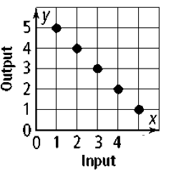
Lesson 1-1 Notes
Examples
4. (They do) Identify a pattern by making a table of the inputs and outputs. Include a
process column.
x | rule | y
1 | 6-1 | 5
2 | 6-2 | 4
3 | 6-3 | 3
4 | 6-4 | 2
5 | 6-5 | 1

Slide 10
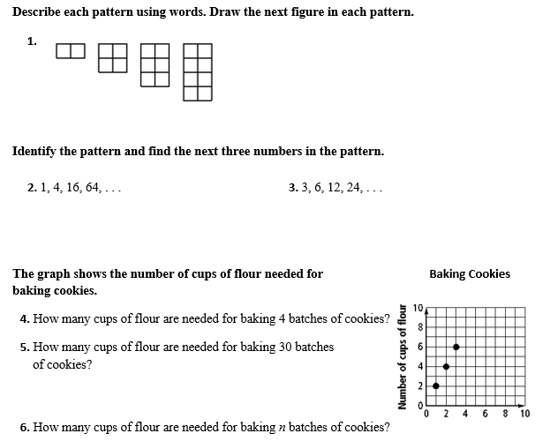
Independent Practice/Lesson Check 1-1

Slide 11
Independent Practice/Lesson Check 1-1

Slide 12
1-2 Standards Objectives
A2.FBF.A.1 Write an expression that describes a relationship between two quantities.
A2.FBF.A.1 Write a function that describes a relationship between two quantities.
I can use subsets of real numbers and given a number, I can identify the proper subset and graph numbers without procedural errors.
I can recognize and apply properties of real numbers accurately.

Slide 13
1-2 Properties of Real Numbers
Key Concepts
Name | Description | Examples
Natural Numbers | {1, 2, 3, …} counting numbers | 4, 7, 15
Whole Numbers | {0, 1, 2, 3, …} counting numbers from 0 | 0, 4, 7, 15
Integers | {…--2, -1, 0, 1, 2, …} includes negative numbers | -15, -7 , 0, 4, 7
Rational Numbers | Expressed as an integer divided by a non-zero integer. Includes decimals that terminate or repeat. | -17, $−\frac{2}{5}, \frac{2}{3}, \sqrt{25}$
Irrational Numbers | Decimals that do not terminate or repeat. Includes numbers that cannot be expressed as fractions. | $\sqrt{2}$, $π$

Slide 14
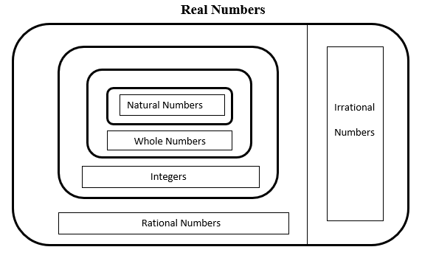
1-2 Properties of Real Numbers
Key Concepts

Slide 15
1-2 Properties of Real Numbers
Key Concepts
Property | Addition | Multiplication
Closure | a + b is a real number | ab is a real number
Commutative | a + b = b + a | ab = ba
Associative | (a + b) + c = a + (b + c) | (ab)c = a(bc)
Identity | 0 is the additive identity | 1 is the multiplicative identity
 | a + 0 = a | a•1 = a
Inverse | a + -a = 0 | a • (1/a) =1, a ≠ 0
Distributive | a( b + c) = ab + ac

Slide 16
Lesson 1-2 Notes
Examples
1. (I do) Graph the numbers $−4,\frac{3}{2}, \sqrt{5}, −\frac{12}{5}, π$
Step 1: Assign decimal values.
Step: 2 Order numbers on number line.
$$\frac{3}{2}=1.5$$
$$\sqrt{5}=2.24$$
$$−\frac{12}{5}=−2.4$$
-4 -$\frac{12}{5} 0 \frac{3}{2}$ $\sqrt{5}$ $π$

Slide 17
Lesson 1-2 Notes
Examples
2. (We do) Which set of numbers bests describes a person’s age?
Natural Numbers
3. (We do) Which set of numbers best describes the amount of money in a bank account?
Rational Numbers

Slide 18
Lesson 1-2 Notes
Examples
(They do) Name the property
a. $\left(\frac{2}{3}\right)\left(\frac{3}{2}\right)=1$ b. (3$∙$4)$∙$ 5 = (4$∙$3) $∙$ 5 c. x + (y + z) = (x + y) + z
Inverse Property of Multiplication
Commutative Property of Multiplication
Associative Property of Addition

Slide 19
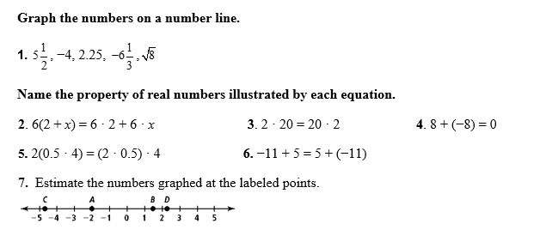
Independent Practice/Lesson Check 1-2

Slide 20
Independent Practice/Lesson Check 1-2

Slide 21
1-3 Standards Objectives
A2.FBF.A.1 Write an expression that describes a relationship between two quantities.
A2.FBF.A.1 Write a function that describes a relationship between two quantities.
I can simplify algebraic expressions without procedural errors.
I can evaluate algebraic expressions without procedural errors.

Slide 22
Bell Work
$\frac{45}{8\left(5−4\right)−3}$
2. $40÷2+(5−\sqrt{4})$
3. Identify the rule and find the next term -3, 1, 5, 9,…

Slide 23
1-3 Algebraic Expressions
Key Concepts
__________________ - an expression that is a number, a variable, or the product of a number and one or more variables
______________________- the numerical factor of a term
______________________________- a term with no variable
_____________________- the same variables raised to the same power
Term
Coefficient
Constant Term
Like Terms

Slide 24
Lesson 1-3 Notes
Examples
(I do) Write the algebraic expression for the phrases.
a. Seven fewer than t __________
b. Two times the sum of a and 5 __________
c. Four more than three times the difference of x and 12 ______________
$$t−7$$
$$2(a+5)$$
$$3\left(x−12\right)+4$$

Slide 25
Lesson 1-3 Notes
2. (We do) Model the situation using an algebraic expression.
a. A job pays $12.50 per hour and 20% commission. _____________
b. Your allowance is $150 per month and you spend $3 a day. _____________
$$12.50h+0.20s$$
$$150m−3d$$
3. (They do) You are hosting a party and decide to buy pizza, chips and drinks. Each pizza costs $5,
each bag of chips costs $3.50 and each 2-Liter drink costs $1.25. Write an algebraic expression that
models the situation. Then determine the total cost to purchase 3 pizzas, 2 bags of chips and 4 drinks.
Expression:
$$5p+3.50c+1.25d$$
Total Cost:
$$5\left(3\right)+3.50\left(2\right)+1.25(4)$$
$$15+7+5$$
$$27$$
The total cost is $27.

Slide 26
Lesson 1-3 Notes
Simplify by combining like terms.
a. (I do) $4x^{2}+5x−12x^{2}−3+x$ ______________________________
b. (We do) $−1+3x−4x+x^{2}−2$ ______________________________
c. (They do) $3\left(a+4\right)−x+2(x−4)$ ______________________________
5. (They do) Evaluate the expression 6c + 5d - 4c - 3d + 3c - 6d; for the given values of the variables
c = 4 and d = -2
$$−8x^{2}+6x−3$$
$$x^{2}−x−3$$
$$3a+x+4$$
$$6\left(4\right)+5\left(−2\right)−4\left(4\right)−3\left(−2\right)+3\left(4\right)−6(−2)$$
$$24−10−16+6+12+12$$
28

Slide 27
Independent Practice/Lesson Check 1-3

Slide 28
Independent Practice/Lesson Check 1-3

Slide 29
THIS WEEK’S ASSIGNMENTS
Please check TEAMS and DELTA MATH regularly for assignments
Course Info/Syllabus Form
Bell work
Delta Math “Patterns, Properties, Algebraic Expressions”

