Slide 1
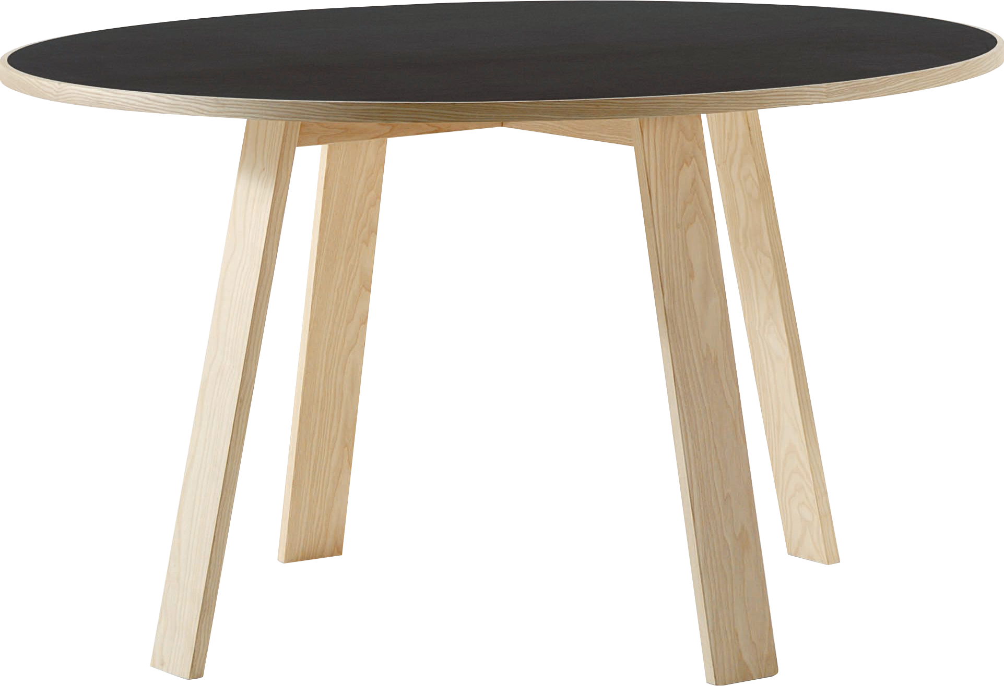
​
Welcome to Algebra 2
Mrs. Carter's Website
Delta Math

Slide 2
Weekly Overview
Lessons
Review: Rules of Integers
Review: Rounding
Review: Graphing
Review: Order of Operations
Activities
Introduction
Class Procedures
Navigate TEAMS & OneNote
Bell Work
Notes
Assignments
Complete & Submit Syllabus & Student Info
Complete & Submit Bell work
Complete & Submit Delta Math
Complete Practice Problems

Slide 3
Bell Work
What are your mathematical goals for this year?
Describe one of your strengths mathematically.
Describe one of your weaknesses mathematically.

Slide 4
Pre-Algebra/Algebra Review Objectives
I can add, subtract, multiply and divide integers without procedural errors.
I can round rational numbers to the indicated place indicated with no procedural errors.

Slide 5
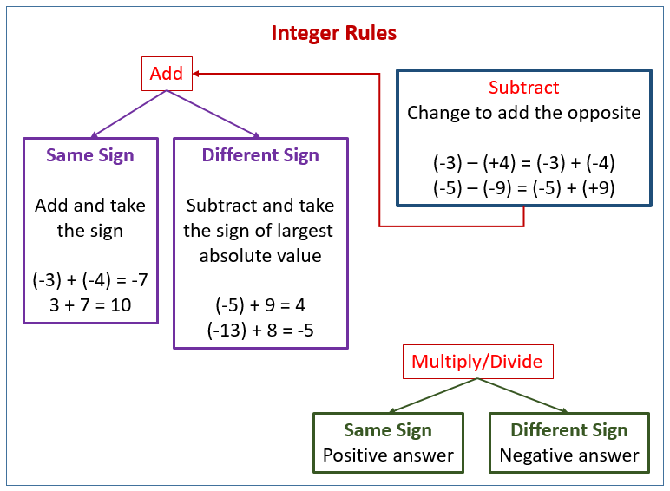
Rules of Integers

Slide 6
Rules of Integers
Examples
(We do) Evaluate the following expressions using integer rules.
a. $5+ −3$ b. $8+ −11$ c. $−10+ −3$ d. $2−( −3)$
e. $−3−(−5)$ f. $4( −3)$ g. $−12÷ −3$ h. $−10÷20$
2
-3
-13
5
4
$$−\frac{10}{20}$$
2
-12
- $\frac{1}{2}$

Slide 7
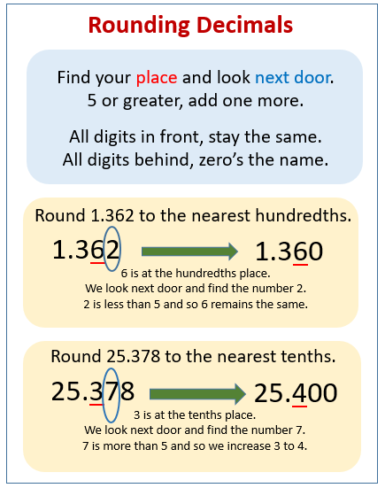
Rounding

Slide 8
Rounding
Examples
2. (We do) Round as indicated.
a. Round 8.5263 to the nearest integer. ___________
b. Round 8.5263 to the nearest tenth. ___________
c. Round 8.5263 to the nearest hundredth. ___________
d. Round 8.5263 to the nearest thousandth. ___________
9
8.5
8.53
8.526

Slide 9
Bell Work
Simplify -3 + 4
Simplify -12(-3)
Round 16.4321 to the nearest integer.
Round -2.456 to the nearest hundredth.

Slide 10
Graphing

Slide 11
Graphing
Examples
(We do) Plot and label the following points.
a. A (0, 4)
b. B (1, -3)
c. C (-2, 0)
d. D (4, 2)
e. E (-5, -4)
f. F (1, -2)

Slide 12
Order of Operations

Slide 13
Order of Operations
Examples
4. (We do) Evaluate each expression.
a. $(30−3)÷3$ ___________
b. $8÷2(2+2)$ ___________
c. $6^{2}÷2\left(3\right)+4$ ___________
d. $\left(4−1+16 ÷4\right)×3$ ___________
e. $\frac{18}{(5−2)(2)}$ ___________
9
16
58
21
3

Slide 14
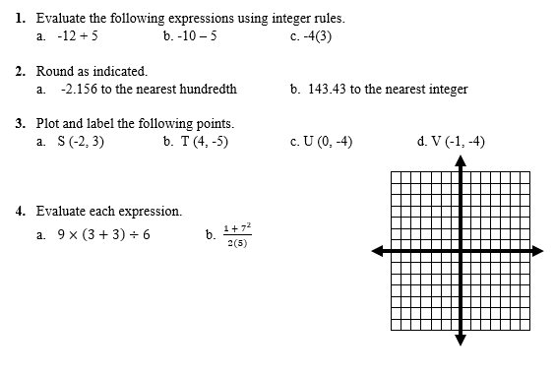
Independent Practice

Slide 15
Independent Practice

Slide 16
THIS WEEK’S ASSIGNMENTS
Please check TEAMS and DELTA MATH regularly for assignments
Course Info/Syllabus Form
Bell work
Delta Math “Pre-Algebra/Algebra Review”

